Slide 1
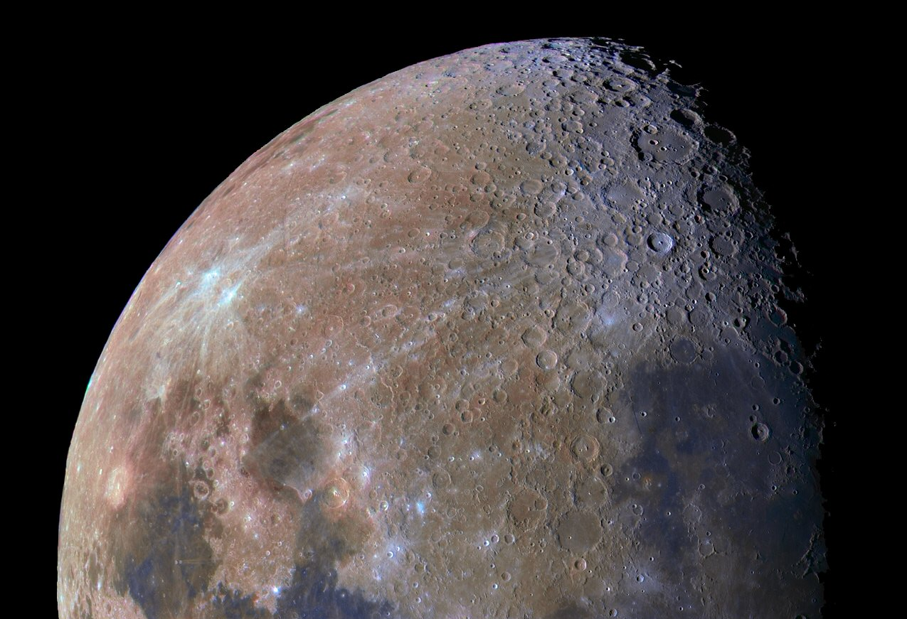







An Update on MoonLITE
Rob Gowen
on behalf of the UK Penetrator Consortium
IAC 2008 : Glasgow, Oct’08
MSSL/UCL UK

Slide 2
MoonLITE
A UK led science mission including an orbital communications package and to emplace 4 penetrators on the Moon for :-
Science: Lunar science (inc. geology, chemistry, interior structure)
+ water ice/volatiles in permanently shadowed craters and
astrobiological connections
+ ground truth.
Exploration: For manned missions -> water for ISRU
+ sites of possibly dangerous seismic levels for lunar bases
+ radiation shielding effectiveness of lunar regolith.
UK plc: Showcase British Innovation
Public interest: First UK led mission for 30+ years,
already much media and personal interest.
Strategic Potential: For future solar system bodies (e.g. Europa/Ganymede, Titan/Enceladus, NEOs…)
‘Shoot for the Moon’
Jon Excell, ‘The Engineer’, 02Jun08

Slide 3
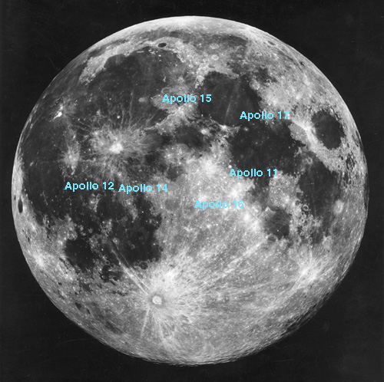
Mission Description
Polar comms
orbiter
3
Delivery and communications
spacecraft
(Polar Orbiter)
4 descent modules to
emplace penetrator s
into lunar surface
each penetrator
13Kg @300m/s
Landing sites:
Globally spaced
- far side
- polar region(s)
- one near an Apollo landing
site for calibration
Aiming for 2014 launch
& 1 year operations
Far side
4
2
1

Slide 4
Science & Exploration Objectives
3
Characterize water, volatiles, and
astrobiologically related material at
lunar poles.
=> Water is key to manned missions
Constrain origin, differentiation, 3d
internal structure & far side crustal
thickness of moon via a seismic
network.
Investigate enigmatic strong surface
seismic signals
=> identify potentially dangerous sites
for lunar bases
Determine thermal & compositional
differences at polar regions and far side.
Obtain ground truth for remote sensing instruments
lunar base ?
Far side
4
2
1

Slide 5
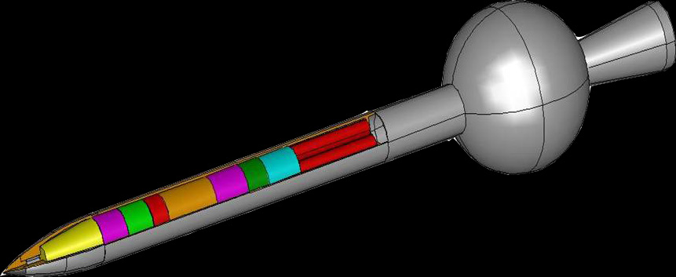
What are kinetic penetrators ?
  Instrumented projectiles
  Survive high impact speed
  Penetrate surface
  ~ few metres
  An alternative to soft
  landers
  Low mass/lower cost
  => multi-site
  deployment
Detachable Propulsion Stage
Point of Separation
Payload Instruments
PDS
(Penetrator Delivery System)
Penetrator
Penetrators - a new tool in the toolbox for planetary exploration

Slide 6

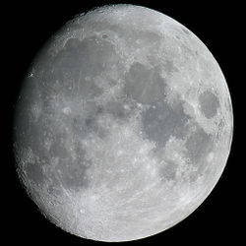

Feasibility & Heritage
DS2 (Mars) NASA 1999 ?
  Lunar-A and DS2
  space qualified
  Military have been
  successfully firing
  instrumented projectiles
  for many years
  Most scientific
  instruments have
  space heritage


Mars96 (Russia) failed to leave Earth orbit
When asked to describe the condition of a probe that had impacted 2m of concrete at 300 m/s a UK expert described the device as ‘a bit scratched’!

Japanese Lunar-A cancelled

Many paper studies and ground trials

Slide 7
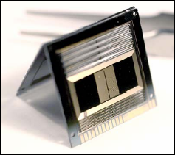
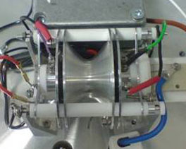
Penetrators Payload
Payload (2kg) | Science Capability
Micro seismometers | inner body structure seismic activity sub-surface ocean (astrobiology, geophysics)
Chemistry package (mass spect.) | organics and inorganics water (astrobiology)
Soil/environment package (accelerometers, thermometer, dielectric constant, radiation monitor, magnetometer, pH, Redox) | soil mechanical properties, thermal & electrical properties (astrobiology /geophysics)
Mineralogy/astrobiology camera | soil properties/astrobiology
Descent camera | impact site context & PR
Notes:
7

Slide 8
Challenges...
impact survival
communications
power/lifetime/cold
delivery
funding
what the recent trial addressed
Need to counter all elements
not just impact survival
Most difficult !

Slide 9
Cost Effective Approach
Study
Use extensive UK defence sector modelling, small and full scale trial capability
Use extensive UK space instrument heritage
Modelling
Small scale trials
Avoid overly expensive iterative empirical approach
Full scale trials

Slide 10
Milestones
~2002: Started
Late 2006: PPARC initiated lunar mission studies
Early 2007: MoonLITE recommended for first mission
May 2008: Full scale impact trial held at
Pendine Sands, Wales.
July 2008: MoonLITE International Peer Review.
Strongly endorsed and recommended
proceed to Phase-A study.
08 Sep’08: MoonLITE SOI considered by STFC PPAN
– awaiting outcome…
‘ MoonLITE mission...inspirational...’ NASA

Slide 11
Full Scale Impact Trial
May19-21 2008

Slide 12
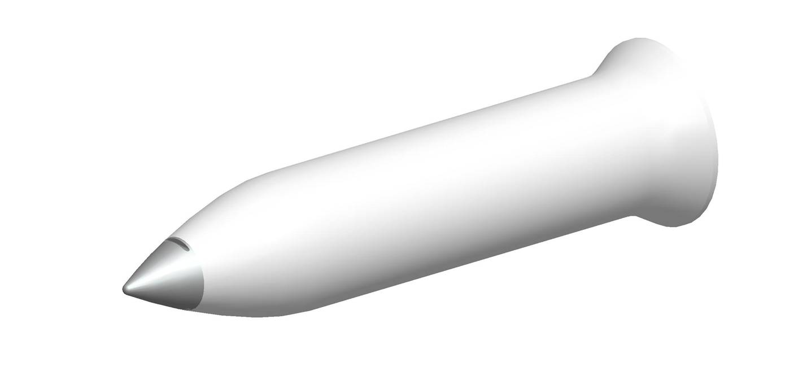
Impact Trial: 19-21 May 2008
Full-scale
3 Penetrators, Aluminium
300m/s impact velocity
Normal Incidence
Dry sand target
13 Kg
0.56m
… just 9 months from start to end. Starting from scratch in Sep’07

Slide 13
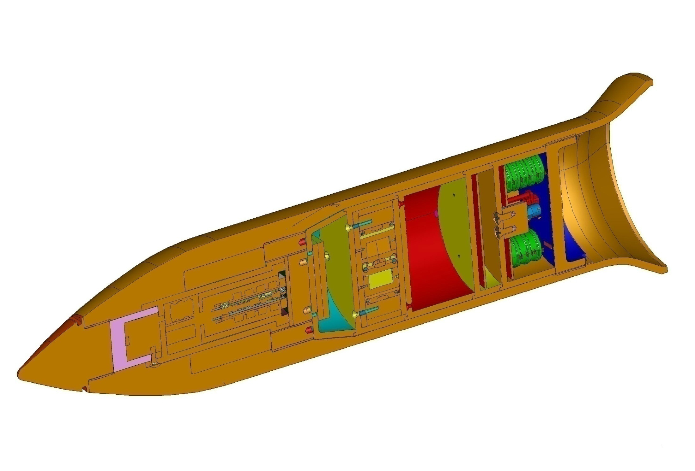




Impact trial - Contributors
Notes:
13

Slide 14
Impact trial – Payload
Radiation sensor
Mass
spectrometer
Batteries
Magnetometers
Accelerometers
Power
Interconnection
Processing
Micro-seismometers
Accelerometers, Thermometer
Batteries,Data logger
Drill assembly
Notes:
14

Slide 15
Impact Trial - Objectives
Demonstrate survivability of penetrator shell, accelerometers and power system.
Assess impact on penetrator subsystems and instruments.
Determine internal acceleration environment
at different positions within penetrator.
Extend predictive modelling to new impact materials and penetrator materials.
Assess alternative packing methods.
Assess interconnect philosophy.
Notes:
15

Slide 16
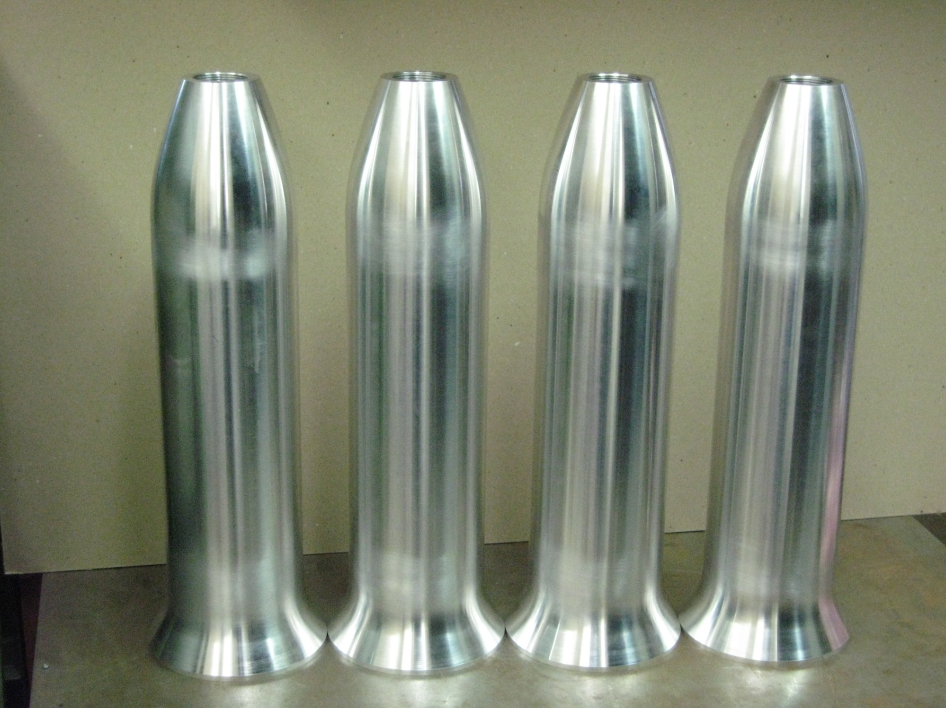
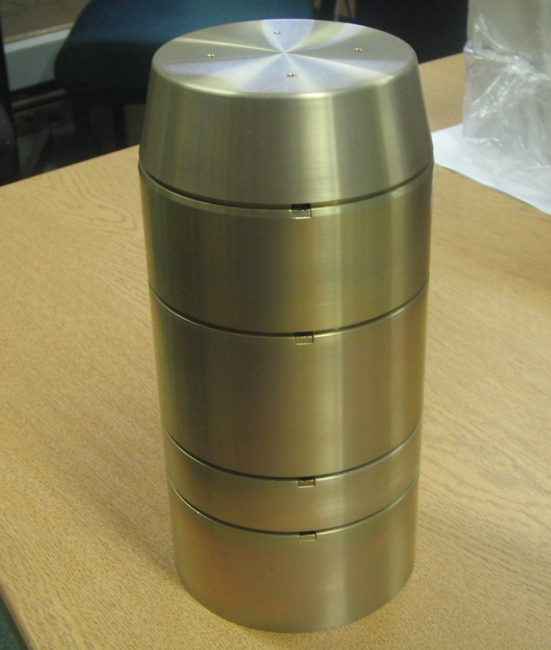
Trial Hardware
Inners Stack
Notes:
16

Slide 17
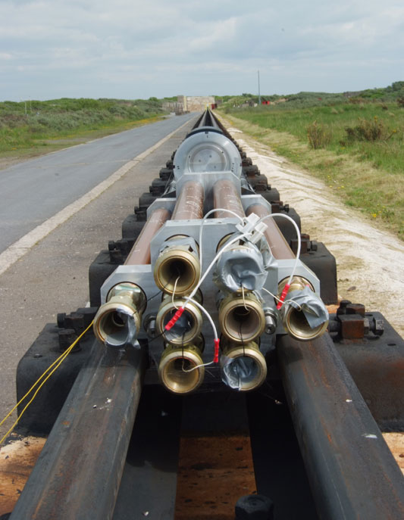
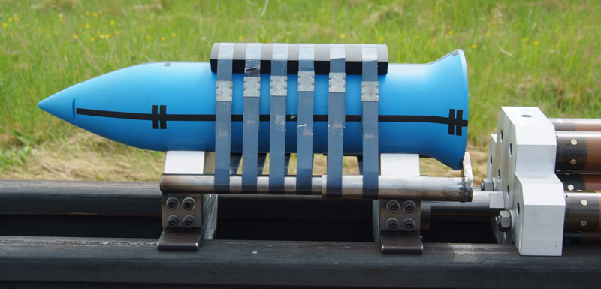
Impact Trial - Configuration
Rocket sled
Penetrator

Slide 18
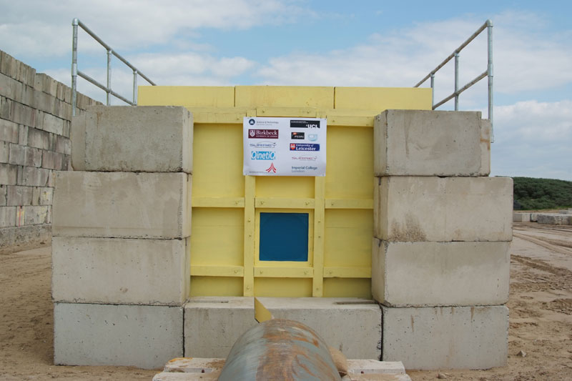
Target
Dry sand
2m x2m x6m
Small front entrance aperture (polythene)

Slide 19
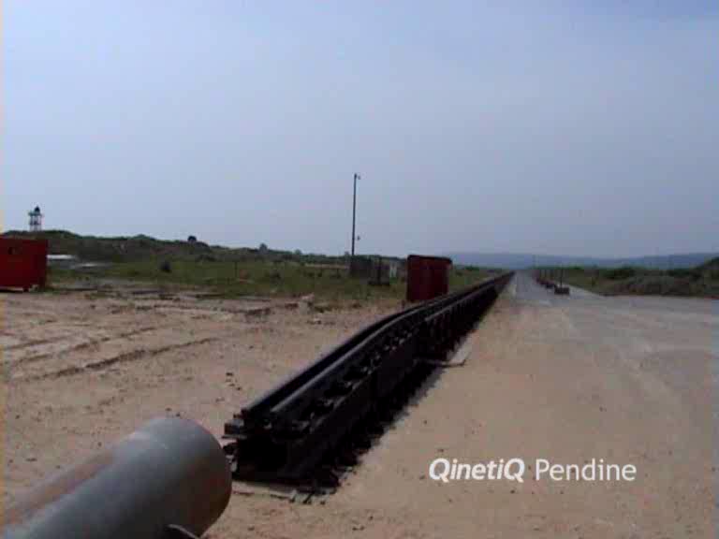
Real-Time Impact Video
Notes:
19

Slide 20
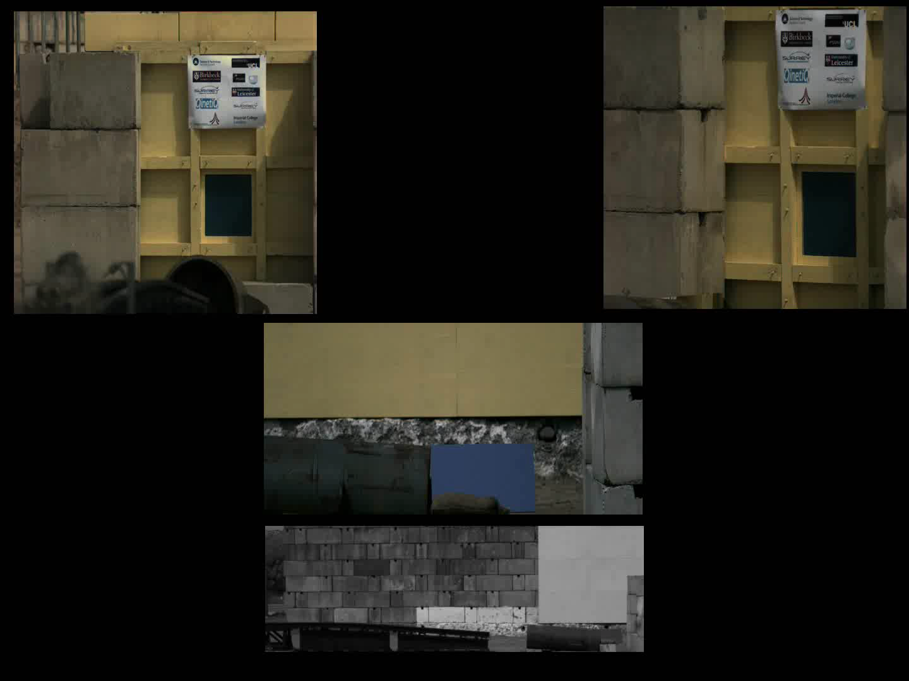
Firing

Slide 21
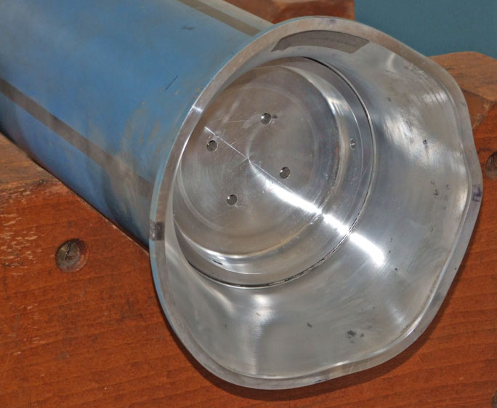
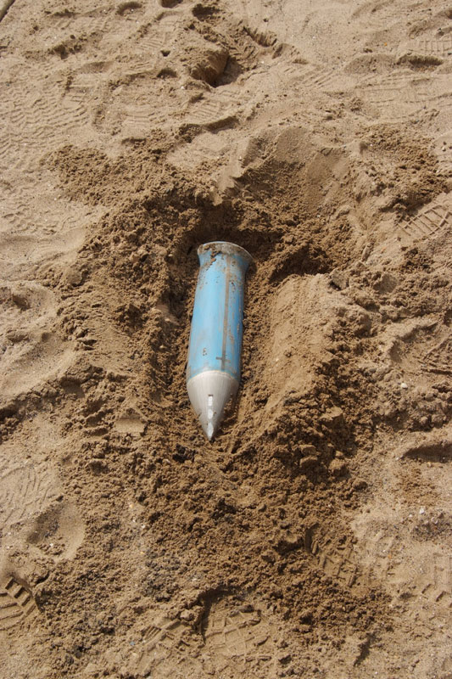
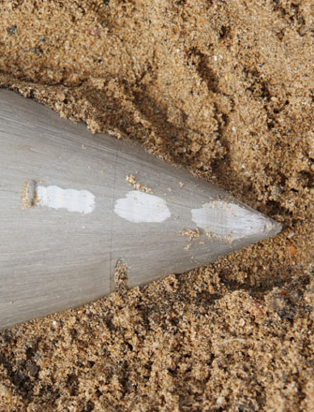
1’st Firing - Results
Firing parameters:
Impact velocity: 310 m/s
(c.f. 300m/s nominal)
Nose-up ~8degs
(c.f. 0 degs nominal)
=> worst case
Penetrator found in top of target
Glanced off a steel girder which
radically changed its orientation.
Penetration: ~3.9m
Much ablation to nose and belly
Rear flare quite distorted.
Penetrator in one piece ✓

Slide 22
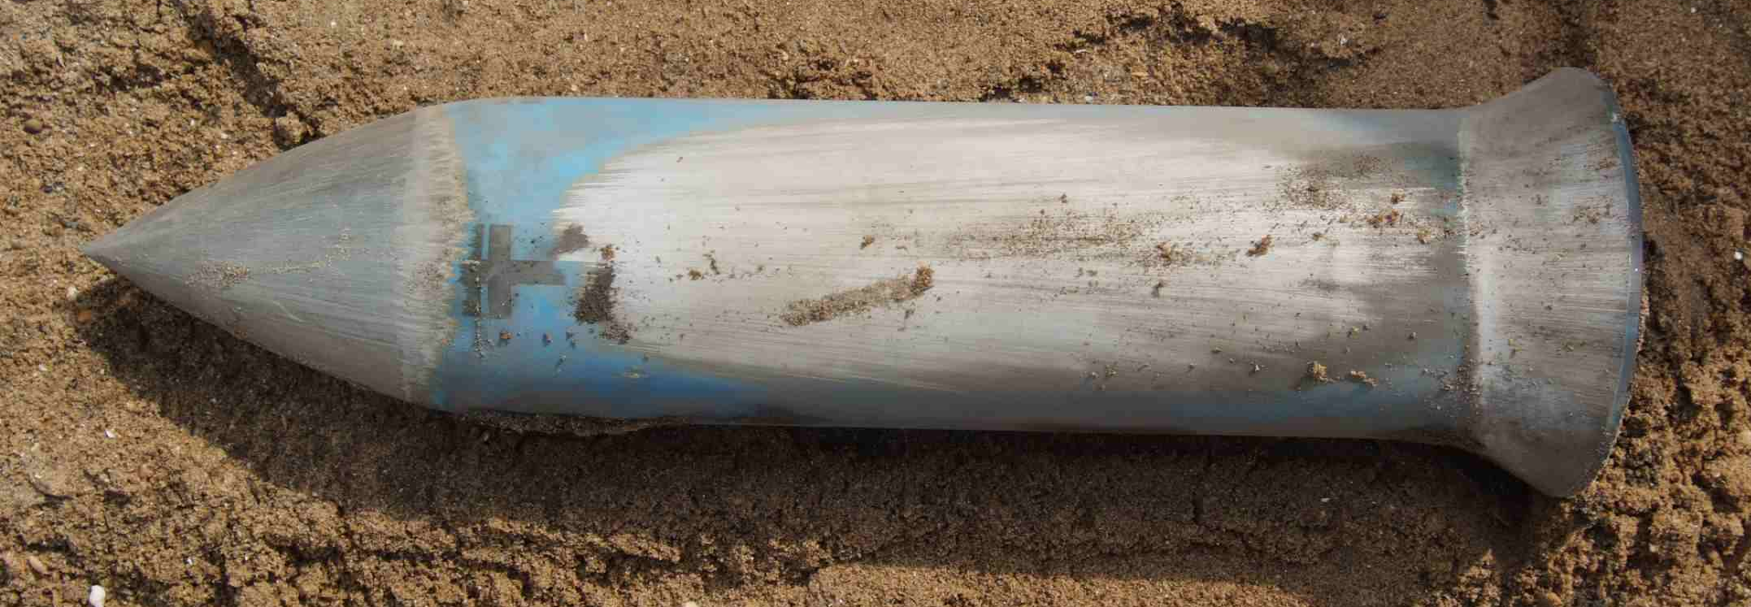
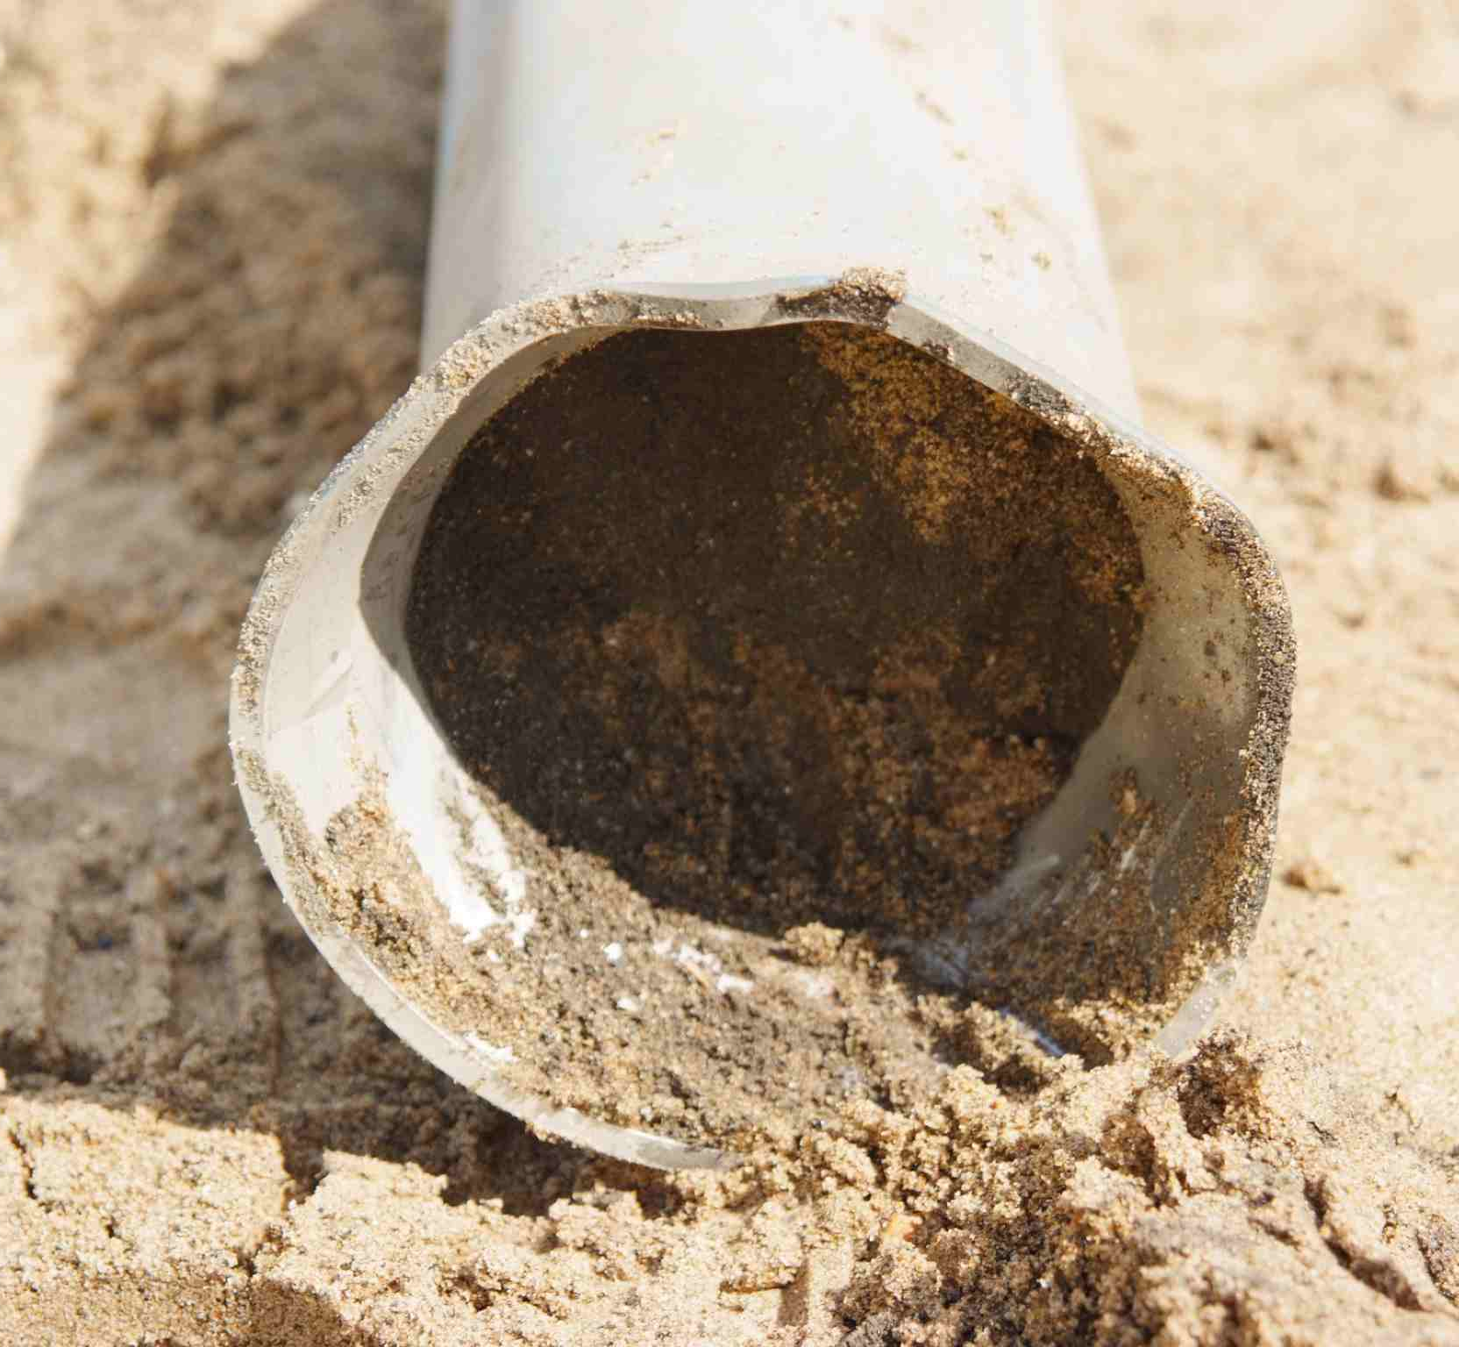
Post Firing belly up !

Slide 23
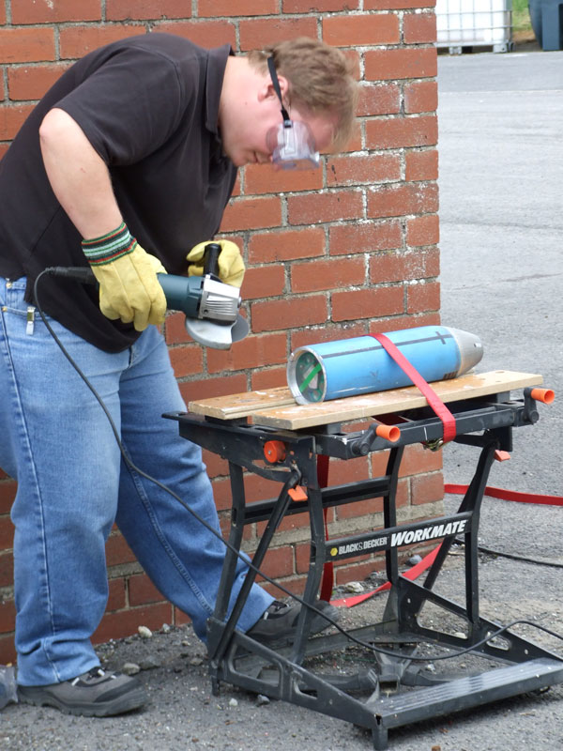
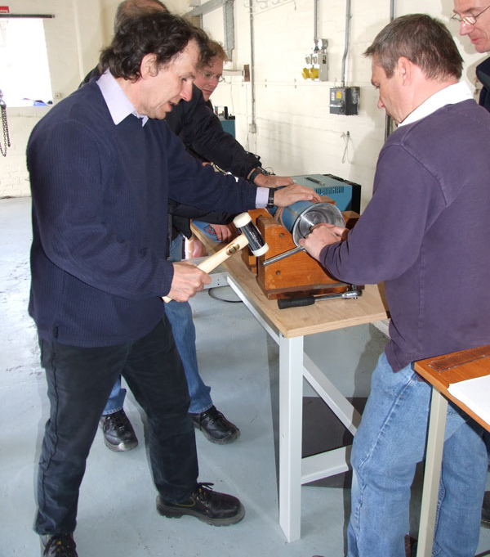
First Firing – Opening up
s

Slide 24
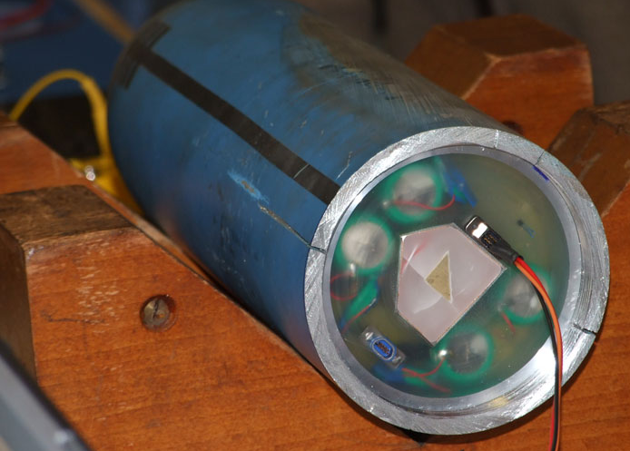
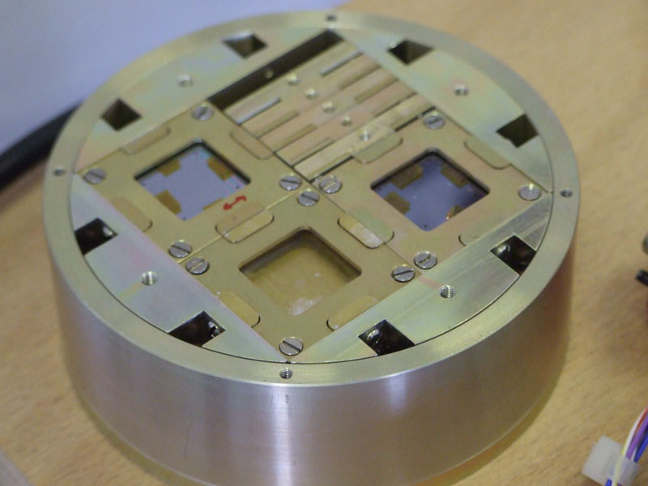
1st Firing – internal Results
Micro seismometer bay
Connecting to MSSL accelerometer
and data processing bay

Slide 25
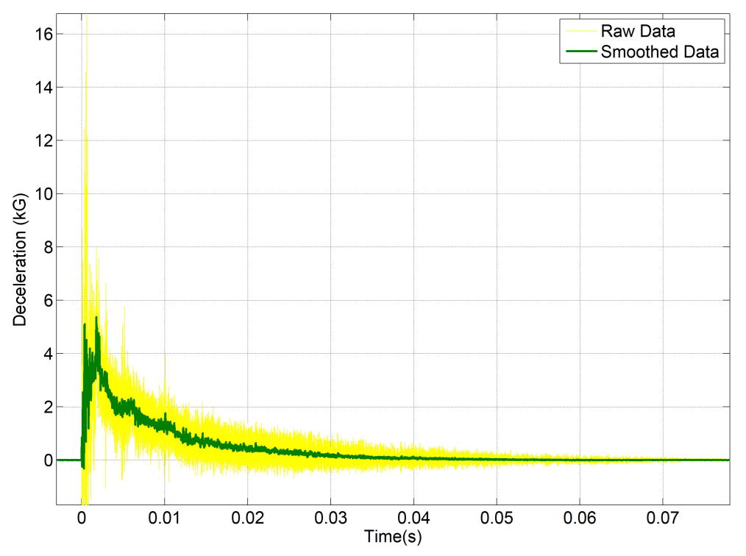
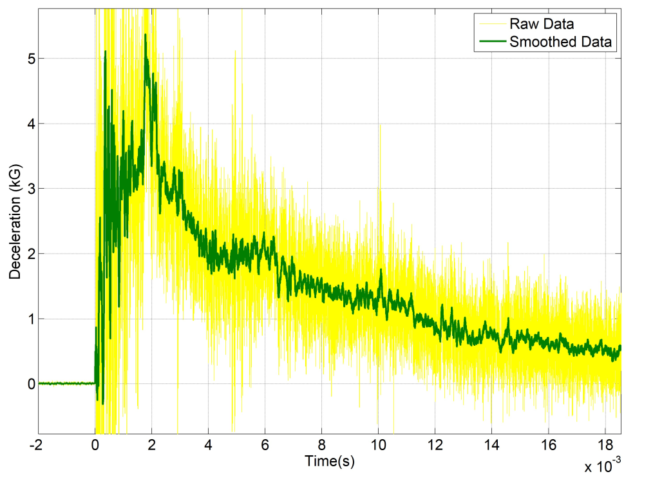
1’st Firing – accelerometer data
(a) Front end (QinetiQ)
hi-time res: 2nd peak- > body slap
higher gee forces than along axis
~ 5 kgee smoothed,
~16 kgee peak
high frequency components ~5khz

Slide 26
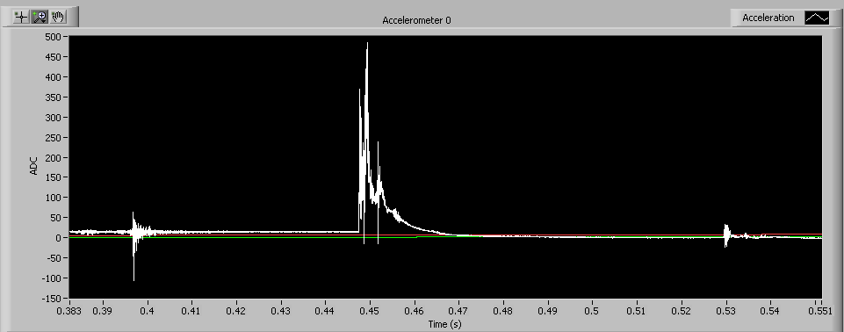
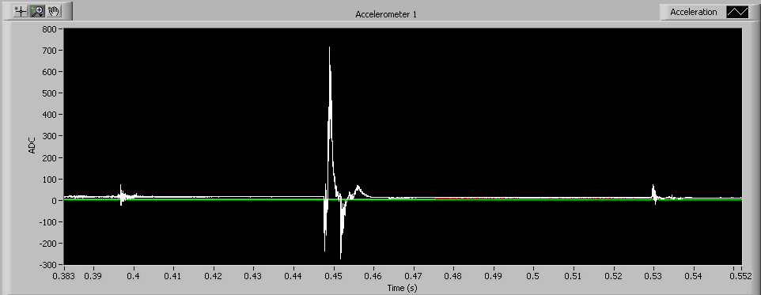
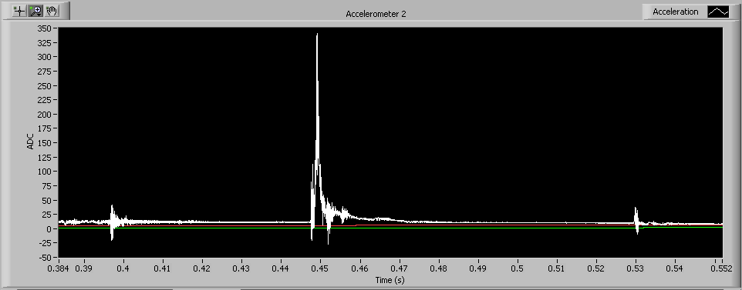
1st Firing - accelerometer data
(b) Rear end (MSSL)
11 kgee
Along axis
Along axis:
Cutter impact : 3kgee
Main impact : 10kgee
Girder impact : 1kgee
cutter
Main impact
Girder
15 kgee
Vertical axis
4 kgee
Lateral Axes:
~40% more gee forces than along axis.
Horizontal axis

Slide 27
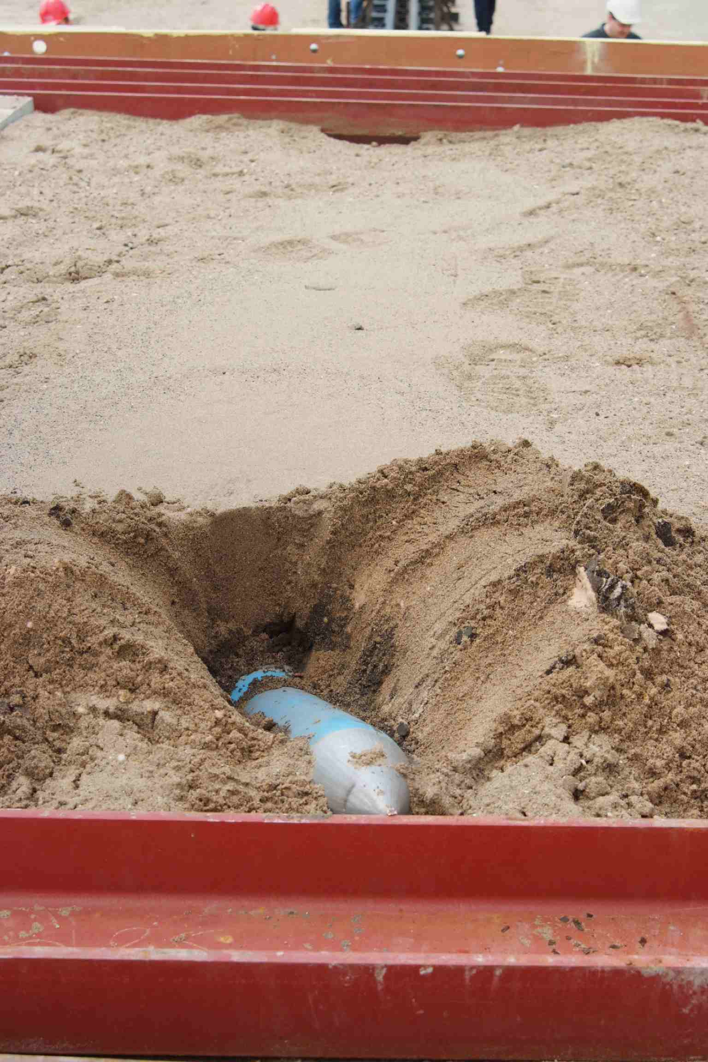
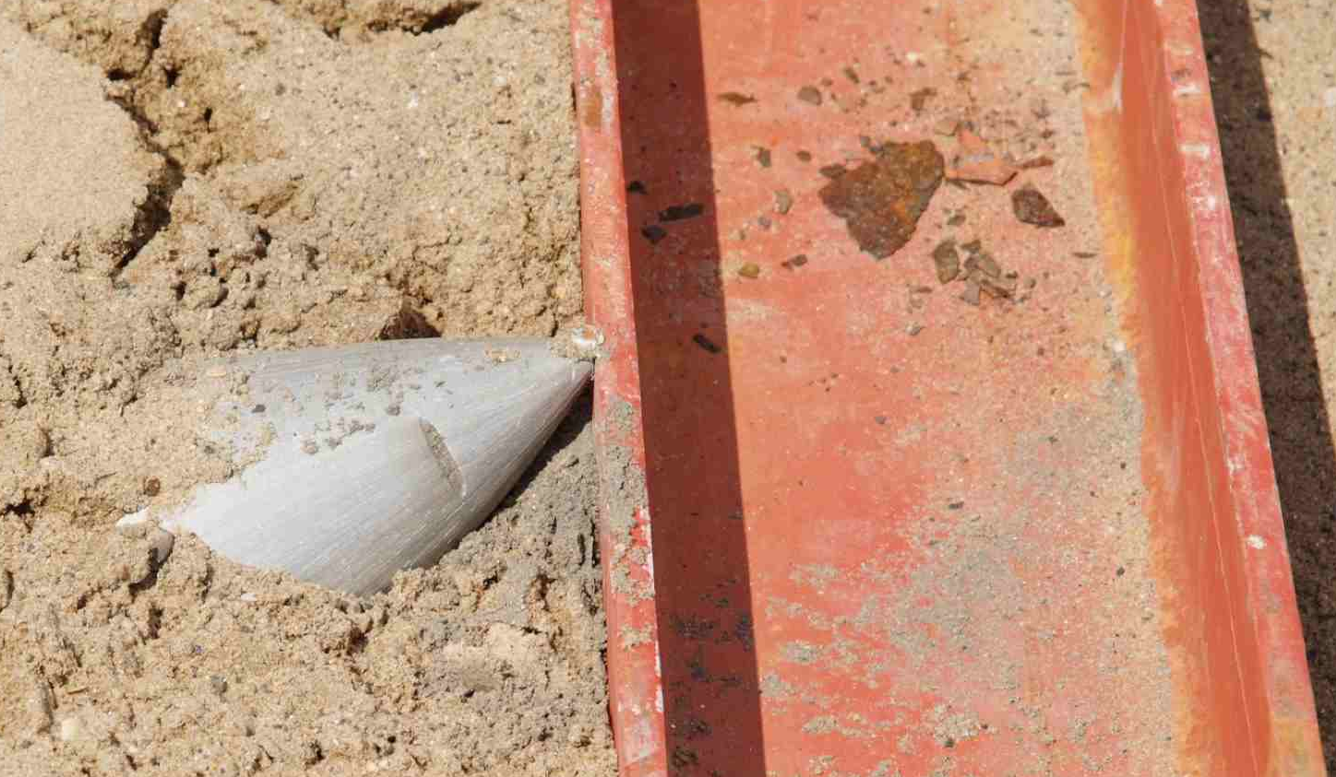
2nd Firing
“Jaws-3” ?
..struck steel girder and moved it 6 inches

Slide 28
Survival Table
No critical failures
Triple worst case: exceed 300m/s, ~8deg attack angle
Item | Firing 1 | Firing 2 | Firing 3
Penetrator | ✓ | ✓ | ✓
Q-accel sys | ✓ | ✓ | ✓
Rad sensor | ✓ | not present | not present
Batteries | ✓ (reduced capacity) | not present | not present
Drill assembly | ✓ | not present | not present
Magnetometer | ✓ | not present | not present
Micro seismometers | not present | ✓ (protected suspensions ok) | ✓ (protected suspensions ok)
Mass spectrometer + other package elements | not present | ✓ x pressure sensor x 3” heating element | ✓ x pressure sensor ✓6” heating element
MSSL accel sys | ✓ | ✓ | ✓
Notes:
28

Slide 29
Impact Trial Objectives
Demonstrate survivability of penetrator body, accelerometers and power system.
Assess impact on penetrator subsystems and instruments.
Determine internal acceleration environment
at different positions within penetrator.
Extend predictive modelling to new penetrator materials,
and impact materials.
Assess alternative packing methods.
Assess interconnect philosophy.
Notes:
29

Slide 30
Next Steps & Strategy …
Next trial – aiming for Sep’09.
Impact into closer representative of lunar regolith
Design for Moon
…and eventually…
Full-up system (all operating)
Transmit from target
in parallel :-
MoonLITE Phase-A
Delta developments for icy planets

Slide 31
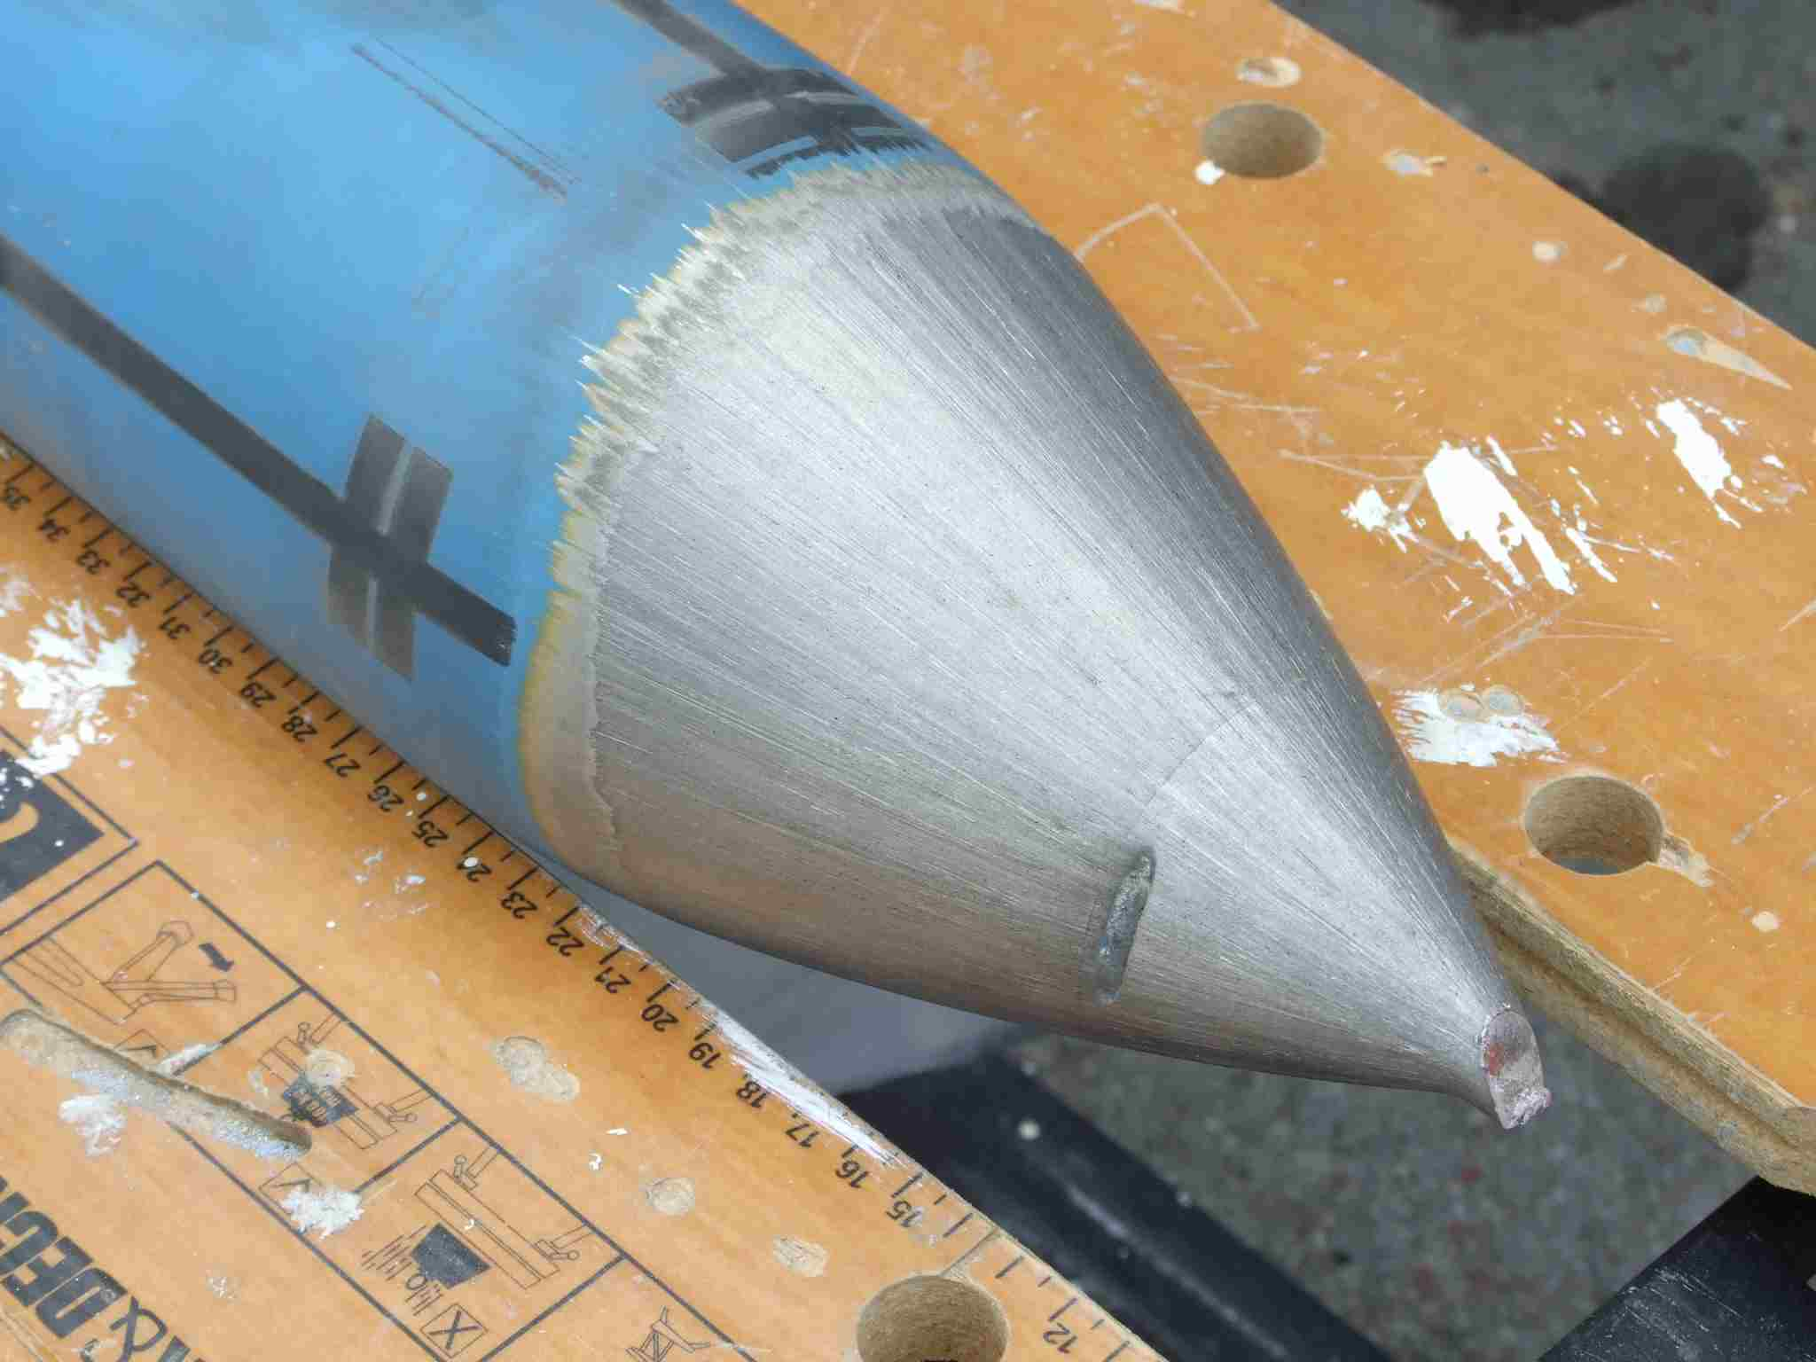
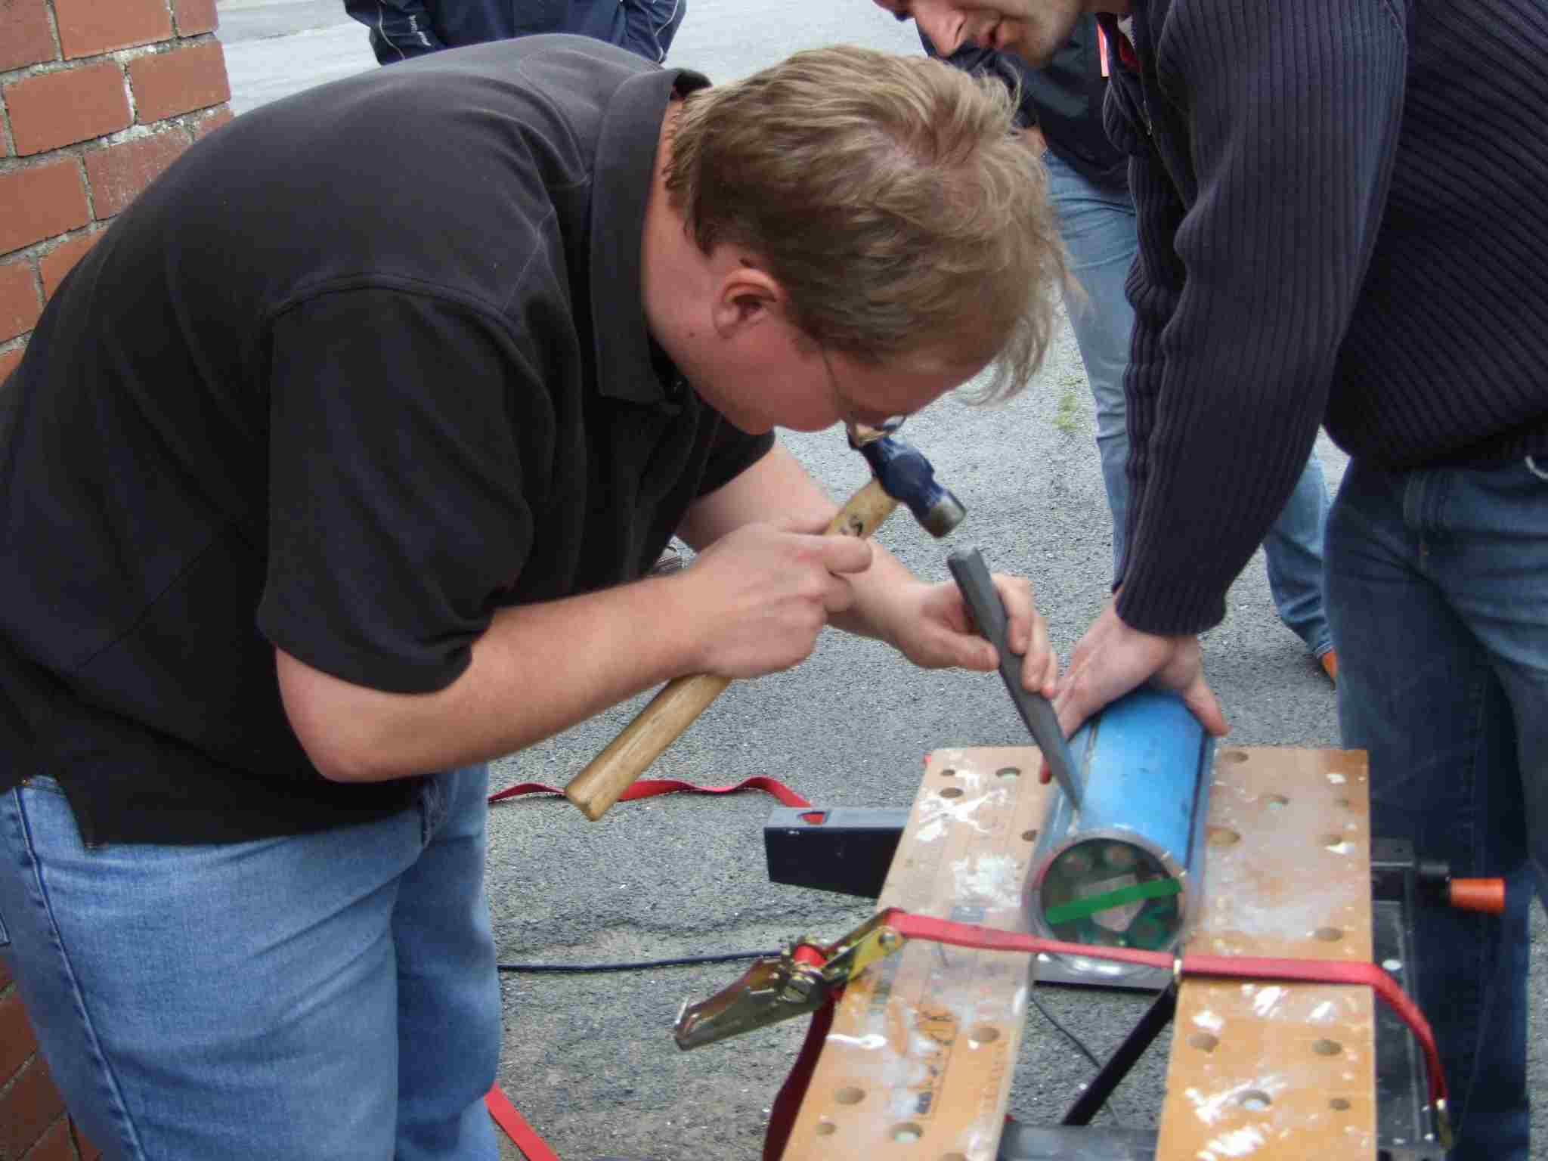
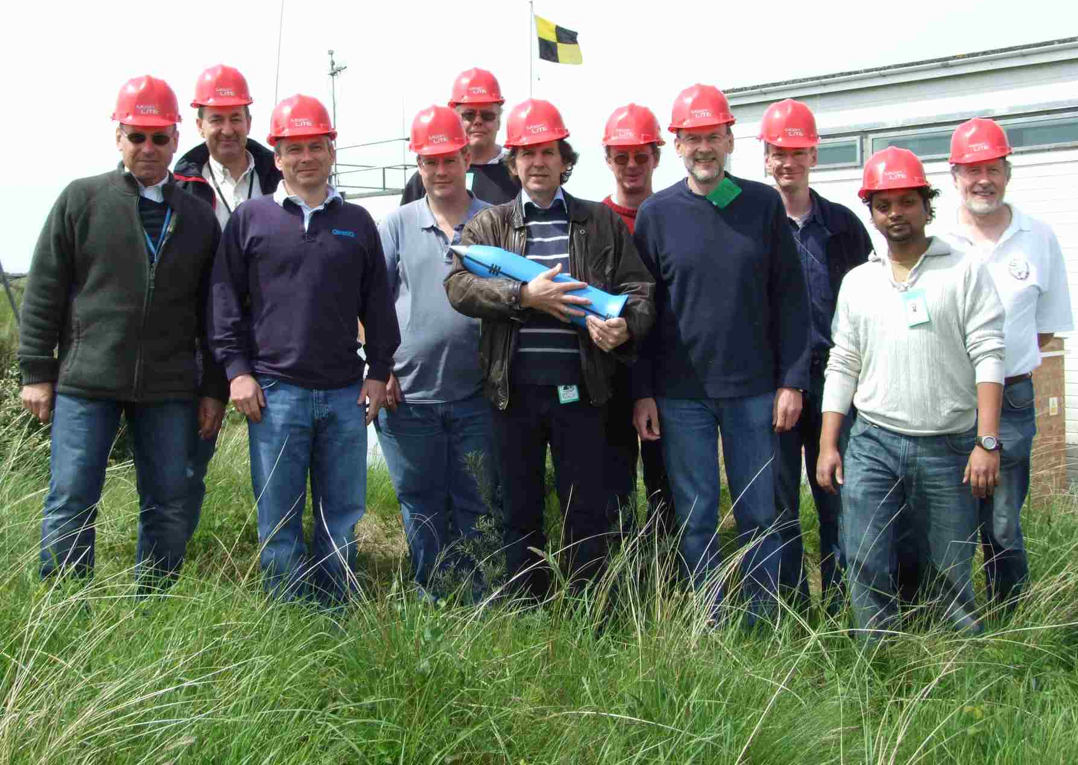
- End -
Penetrator website:
http://www.mssl.ucl.ac.uk/planetary/missions/Micro_Penetrators.php
email: rag@mssl.ucl.ac.uk

