Slide 1
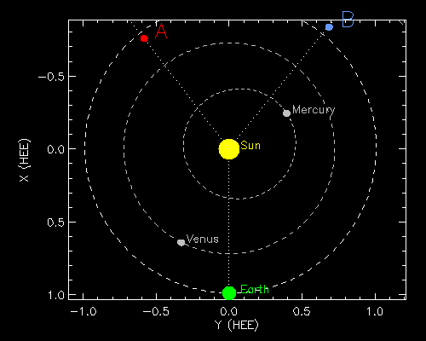
STEREO mission update
Recently celebrated the 10th Anniversary of its launch
Having passed through superior conjunction, STEREO-A & B are now 141° & 142° from the Sun-Earth line
STEREO-A is operating nominally
Contact with STEREO-B was lost in Oct 2014, prior to conjunction
Recent attempts to re-establish contact partly successful; recovery efforts are set to intensify later this year.

Slide 2
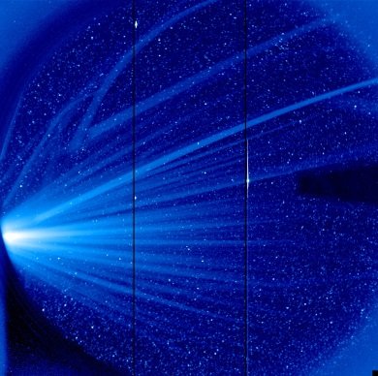
STEREO/HI update
HI on STEREO-A is operating nominally
Accurate photometric calibration of HI-1 & HI-2 has been achieved*
http://www.stereo.rl.ac.uk for data, movies, plots and information
http://helcats-fp7.eu for additional products - including event lists (~1000 heliospheric CMEs for each of HI-A and HI-B)
For more information, please contact:
Richard Harrison (STEREO/HI Principal Investigator)
Jackie Davies (STEREO/HI Project Scientist)
*Care must be taken in use of HI data in astronomical studies, in particular since the switch to gyroless operations.

