Slide 1
What is the Sun up to? Solar cycle 24 in a long-term context
Mathew Owens

Slide 2
Overview
Where have we been?
  Sunspot numbers
  Photospheric extrapolations
  In situ measurements
  Geomagnetic reconstructions
  Cosmic rays
  Modelling
Where are we?
Where are we going?

Slide 3

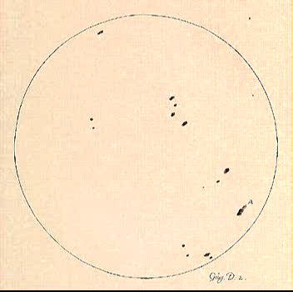
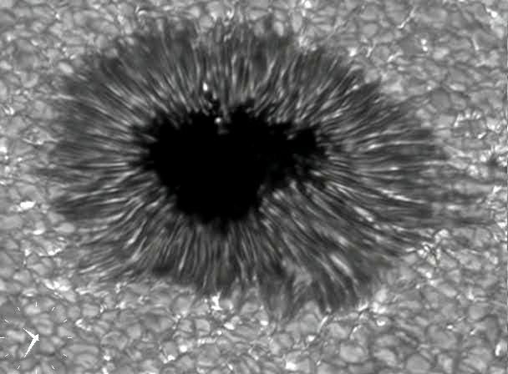
Sunspots – evidence of photospheric structure
Notes:
1613

Slide 4
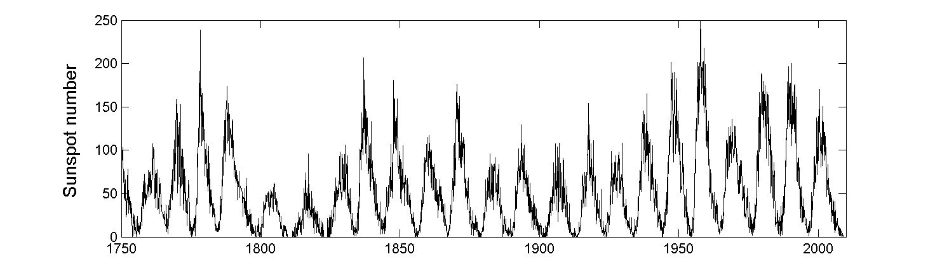
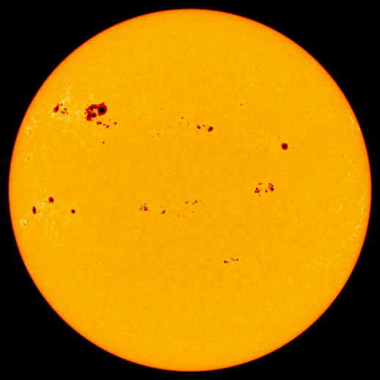
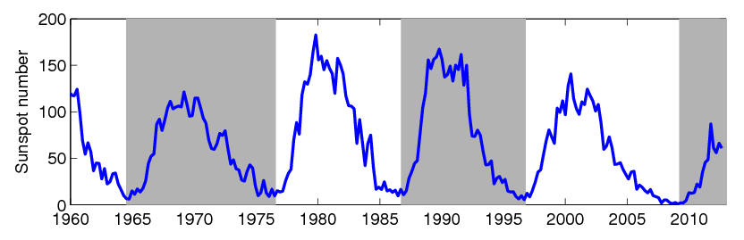
Sunspot number records
Royal Greenwich Observatory data
Notes:
Sunspots – dark regions on the Sun’s surface.
Recent minimum – longer and deeper than anything seen in the space age: New parameter regime for observations

Slide 5
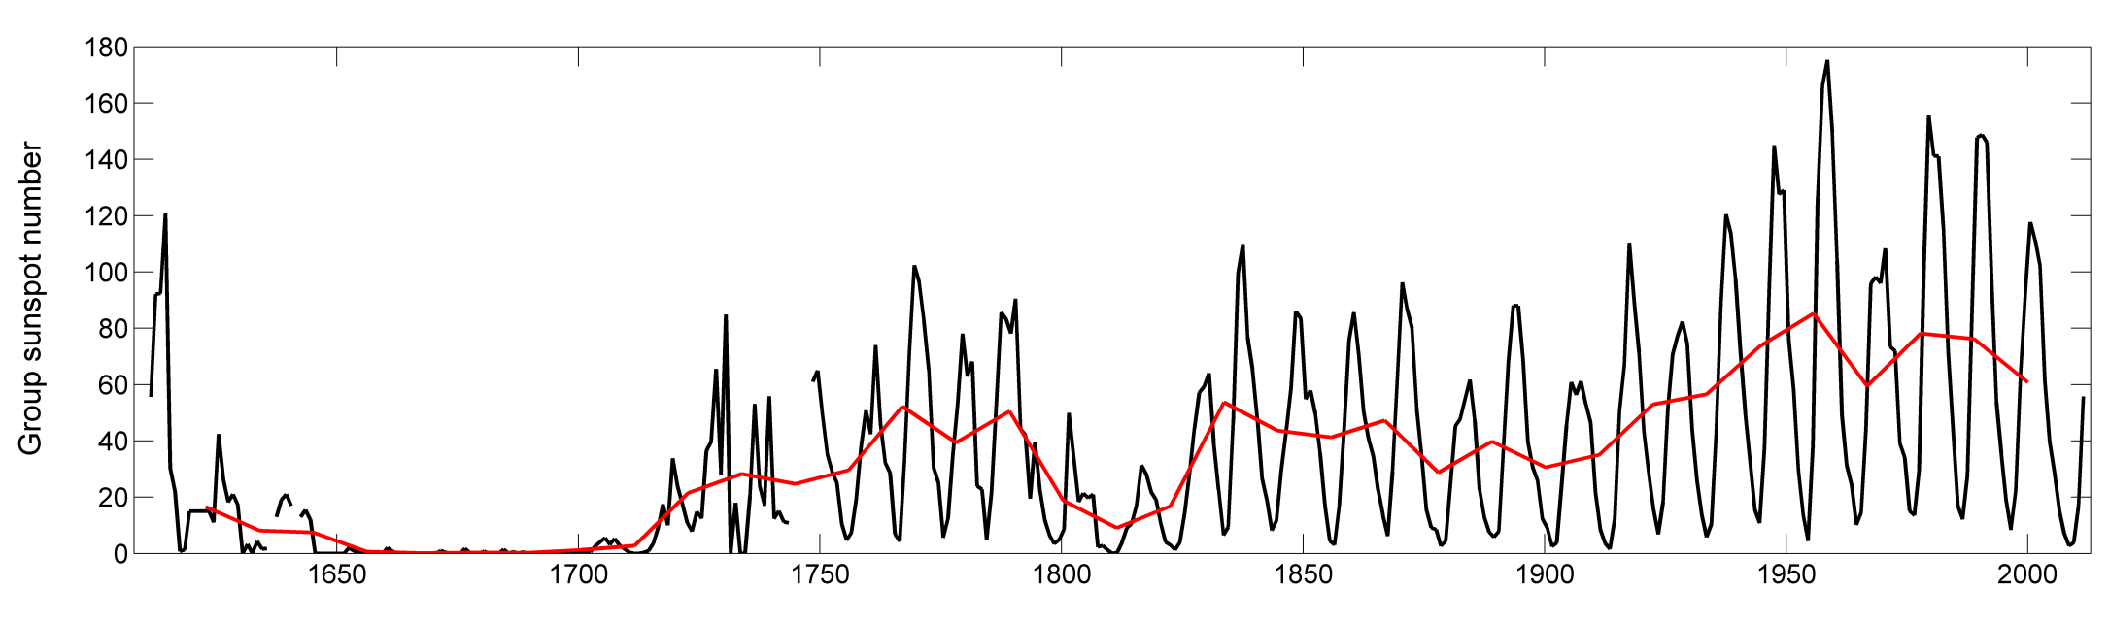
Group sunspot number
Hoyt & Schatten, Sol. Phys, 1998

Slide 6
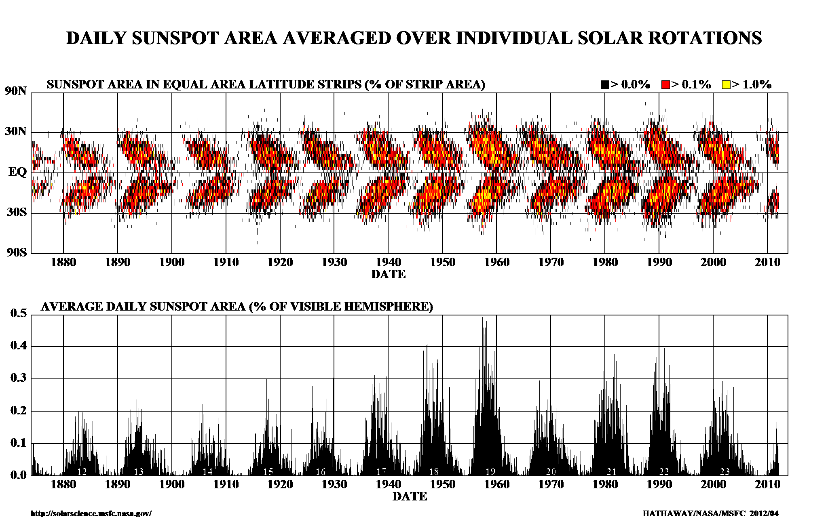
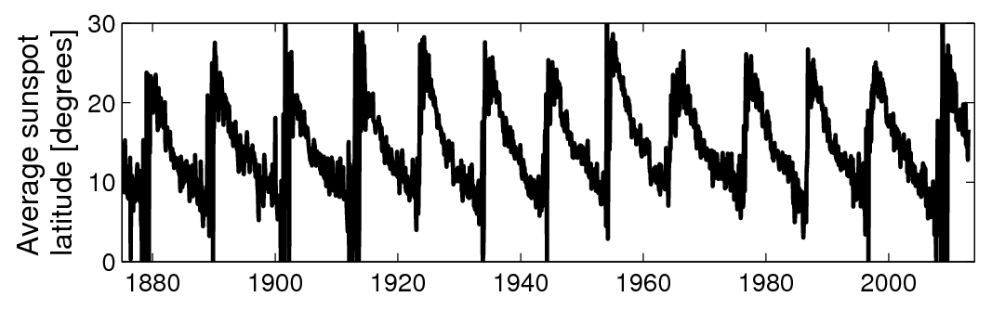
Sunspot latitude

Slide 7
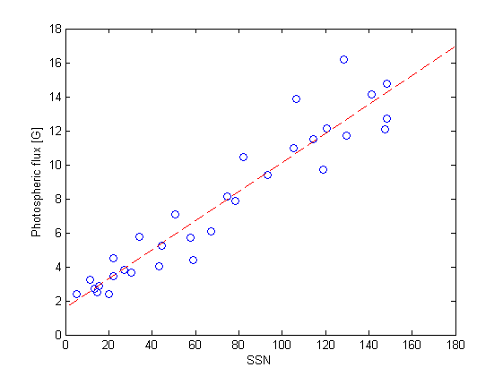
What does sunspot number actually measure?
No, really.
Changing observers, changing eyesight, changing telescopes, even changing methods of counting!
At best, sunspot number is a threshold concept
  Flux still emerges at R=0

Slide 8
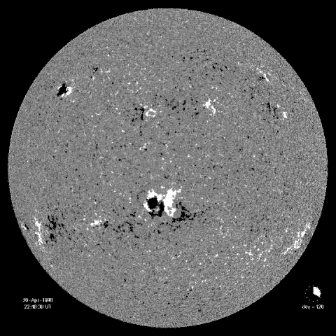
Photospheric flux
SOHO MDI magnetogram
Zeeman splitting to measure line-of-sight B
Magnetograms back to 1970s
Hard to observe polar regions

Slide 9
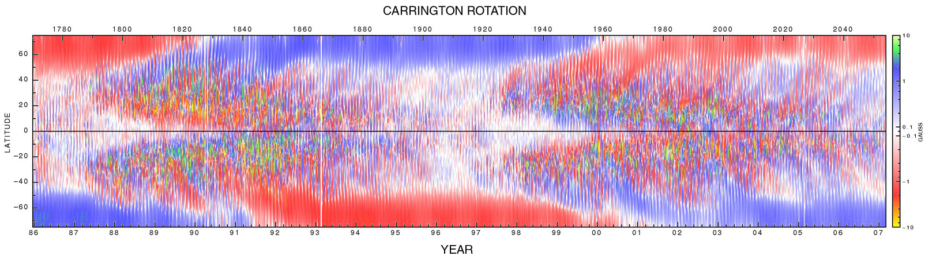
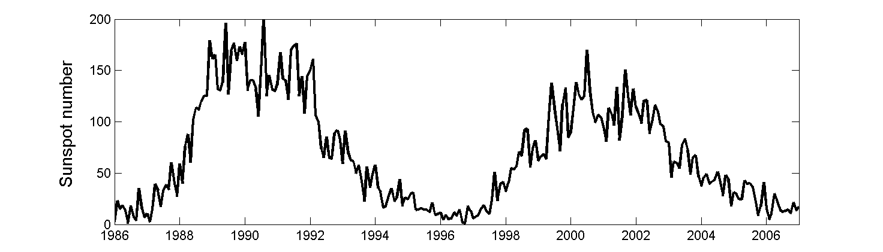
Photospheric flux
Top: David Hathaway, MSFC
Notes:
Top plot. Each vertical slice is the a magnetogram, averaged over all longitude and binned by latitude
Introduce idea of solar wind dragging solar field out into interplanetary space: The heliosphere

Slide 10
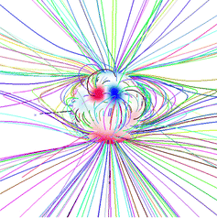
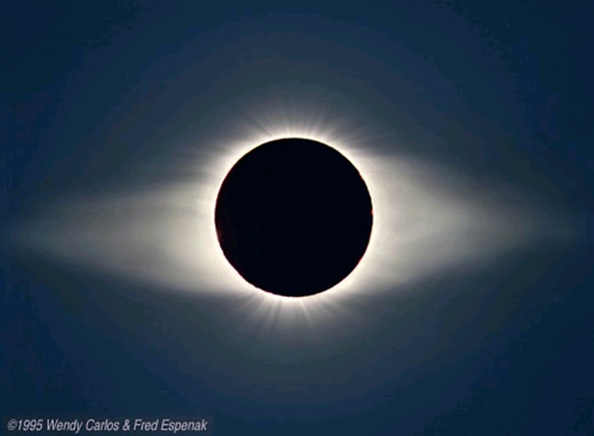
Modelling the corona
Left: Riley et al., 2006; Owens et al., 2008a
Right: Eclipse photograph, Carlos & Espenak, 1995.

Slide 11
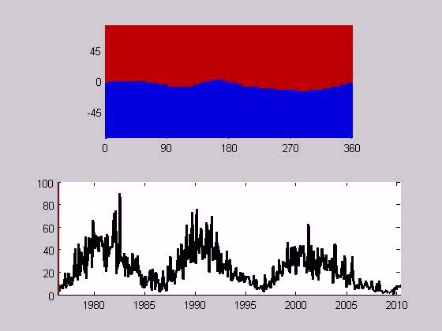
PFSS solutions
Magnetic field polarity at coronal source surface

Slide 12
Open Solar Flux
Flux threading the coronal source surface
Unsigned Flux,
F_{U}=∫ ∫ |B_{R}| r² cos(Λ) dφdΛ
r = heliocentric distance
B_{R} = radial field
Λ = solar latitude
φ = solar longitude
+π/2 2π
-π/2 0
“closed” field line
“open” field lines

Slide 13
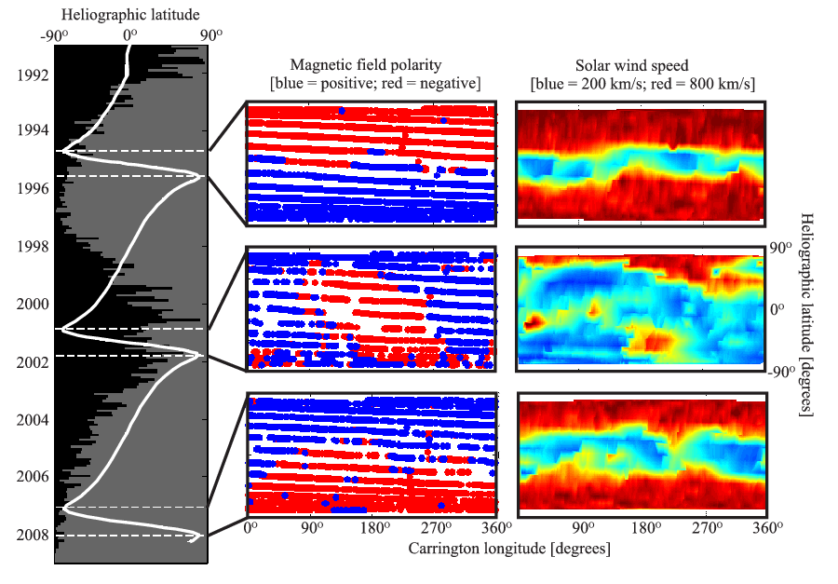
Three-dimensional structure of interplanetary magnetic field
Owens et al., JGR, 2011

Slide 14
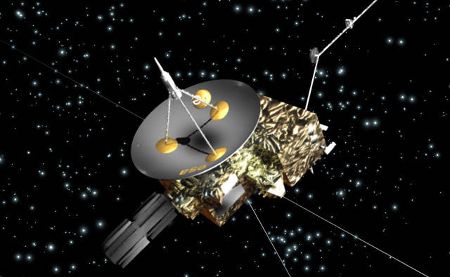
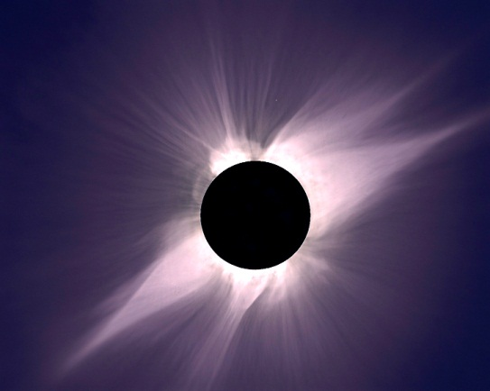
Ulysses
Balogh et al., 1995; Smith et al., 2001; Lockwood et al., 2000
|B_{R}|
ecliptic
d
R
|B_{RE}|
Ulysses showed that everywhere |B_{R}|(d/R)² = |B_{RE}|
Thus total unsigned magnetic flux leaving the sun = 4πR² |B_{RE}|
Earth

Slide 15
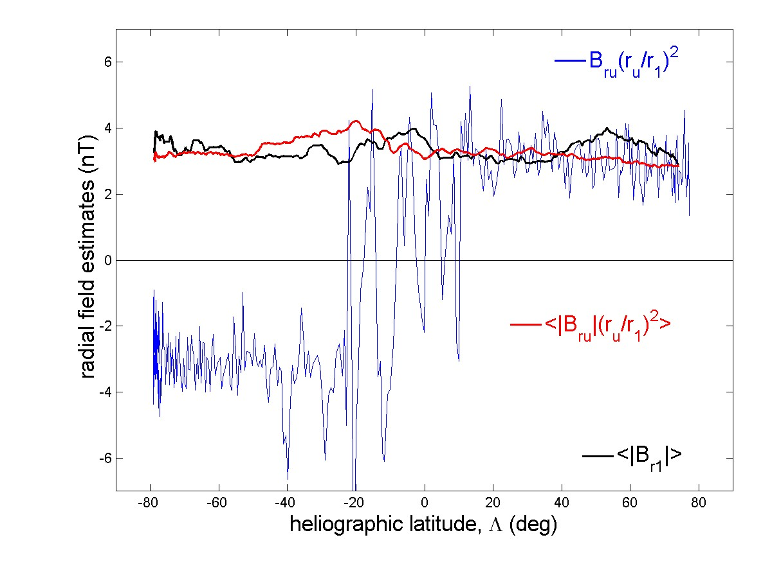
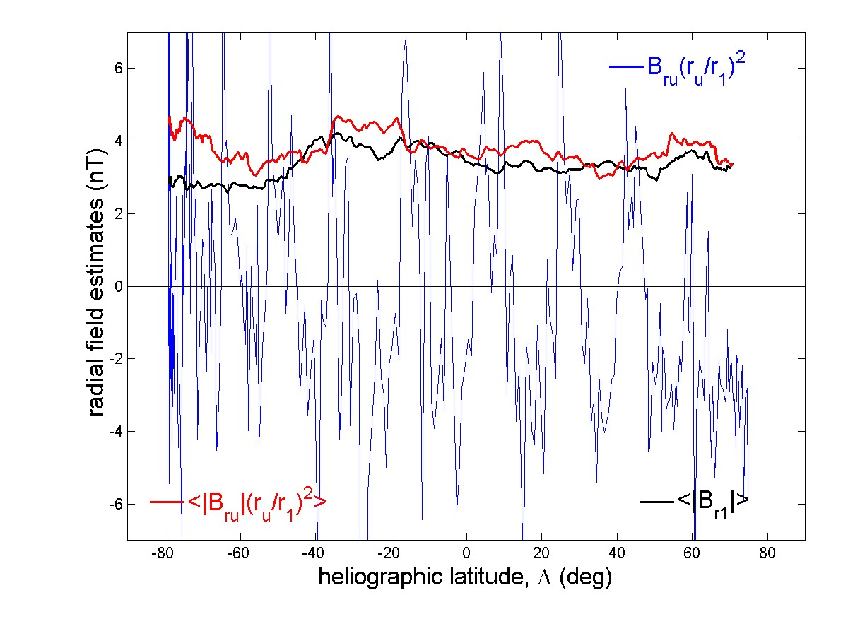
Ulysses Perihelion passes
(Fast Latitude Scans)
• 1st - near sunspot min • 2nd - near sunspot max

Slide 16
The “Ulysses Result”
Very important – but why does it work?
V_{SW}
N
B_{r}
Sun
S
tangential pressure,
P_{t} ≈ B_{r}² / 2μ_{o} (as β << 1)
Slight non-radial flow at r > ∼10R_{S} to equalise P_{t} & thus B_{r}
Radial flow at r > ∼10R_{S} with B_{r} independent of latitude

Slide 17
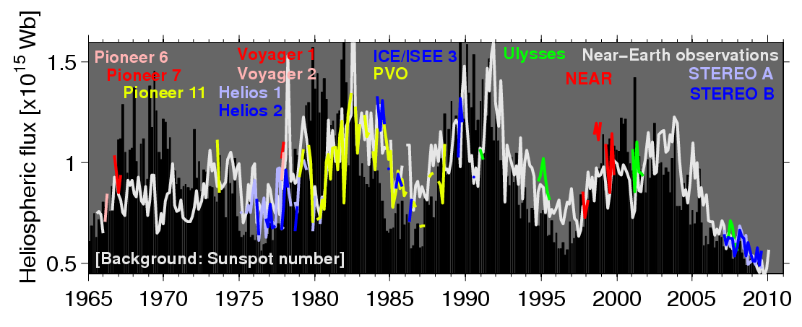
Heliospheric magnetic flux
Owens et al., JGR, 2008

Slide 18
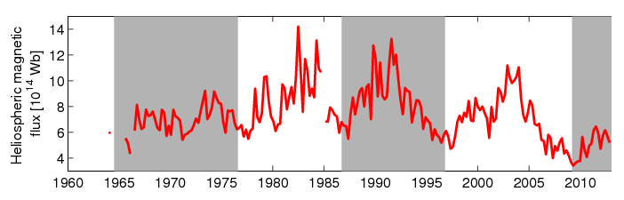
Heliospheric magnetic flux
Owens et al., JGR, 2008

Slide 19
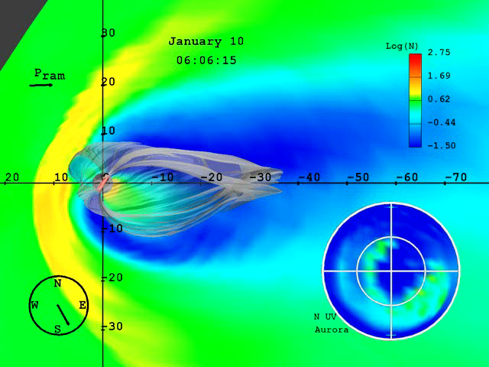
Geomagnetic disturbances
Movie courtesy John Lyon of the CISM group

Slide 20
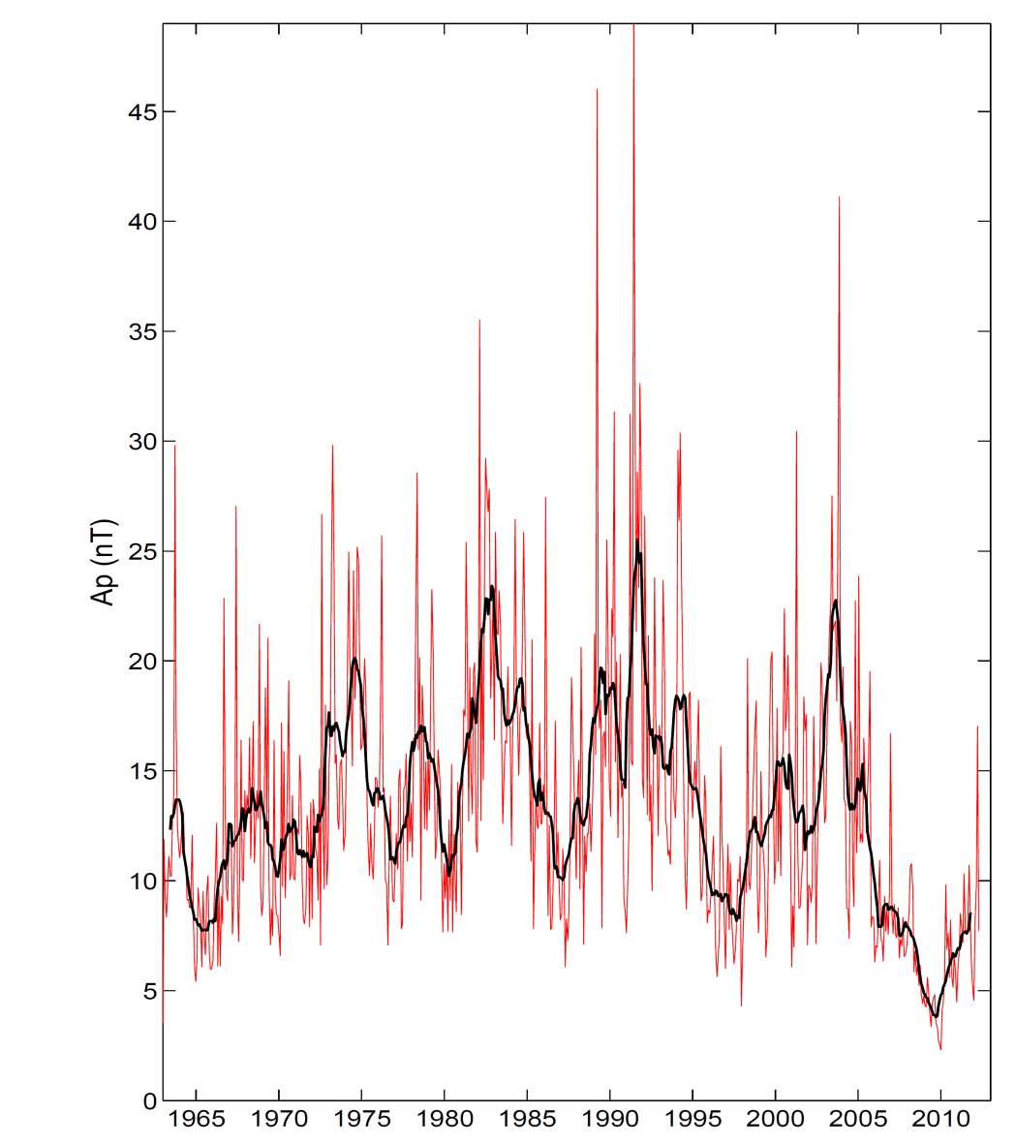
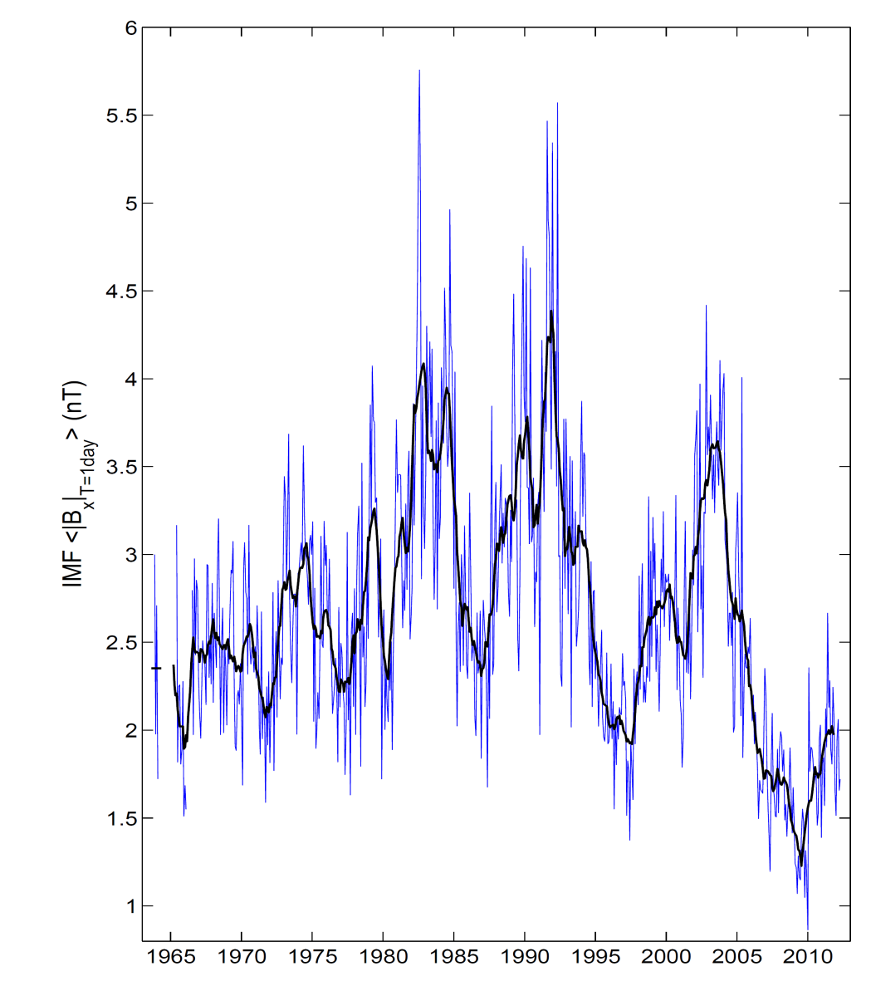
Geomagnetic Ap Index
(from 13 stations around the globe)
<Ap>
<|B_{x}|_{T=1day}>

Slide 21
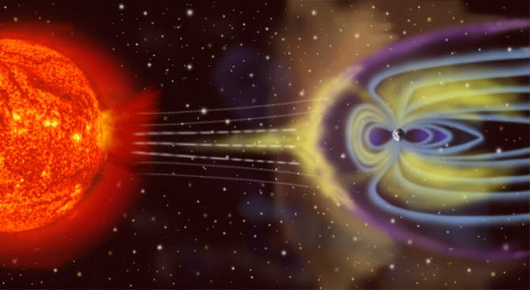
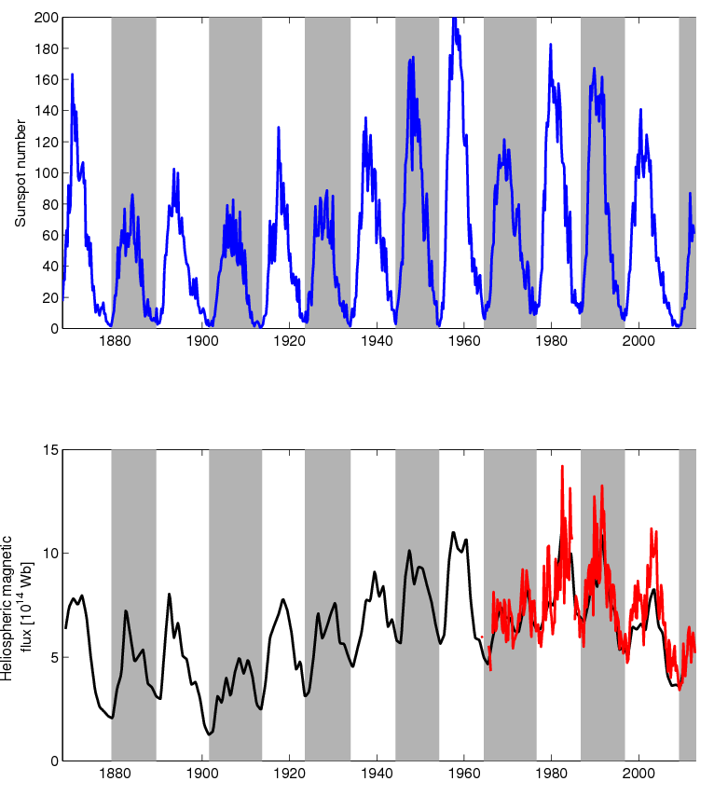
Long-term variations in HMF
Geomagnetic reconstructions

Slide 22
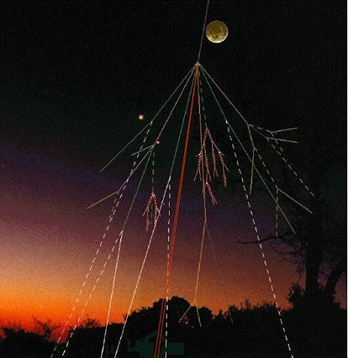
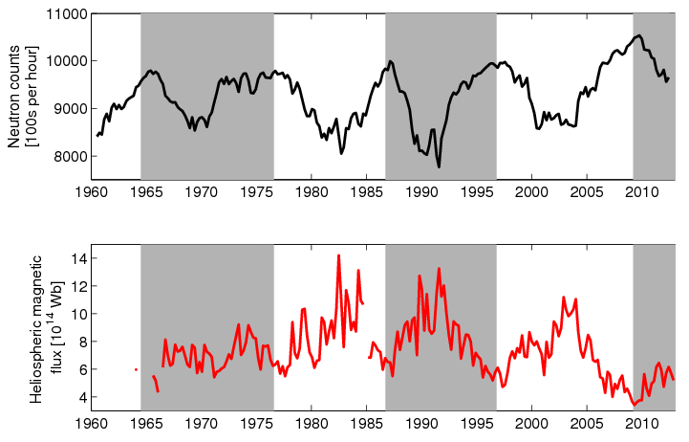
Longer-term variations in HMF
Geomagnetic reconstructions

Slide 23
Rise and fall of open solar flux e.g., Lockwood et al., JGR, 2002
12.0
11.2
10.4
9.6
8.8
8.0
7.2
from (Moscow) cosmic ray observations
from aa geomagnetic index
from IMF data
from PFSS method *
Total Open Solar Flux (10¹⁴ Wb) →
150
0
R →
1975 1980 1985 1990 1995

Slide 24
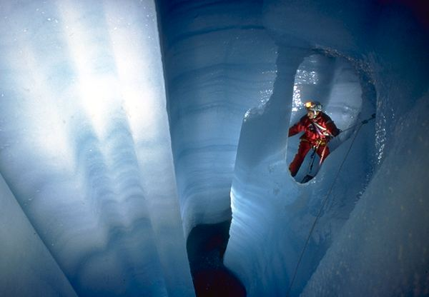
¹⁴C & ¹⁰Be: spallation products from O, N & Ar
¹⁴C
• τ_{1/2} = 5370 yr
• < q_{G} > = 2 atoms cm⁻²s⁻¹
GALACTIC COSMIC RAYS
¹⁰Be
• τ_{1/2} = 1.5×10⁶ yr
• < q_{G} > = 0.018 atoms cm⁻²s⁻¹
STRATOSPHERE (≈2/3)
¹⁴C+0→¹⁴C0 ; ¹⁴C0+0H→¹⁴C0₂+ H
TROPOSPHERE (≈1/3)
( ~1 year) ( ~1 week)
OCEANS
¹⁰Be + AEROSOL
BIOMASS
ICE SHEETS

Slide 25
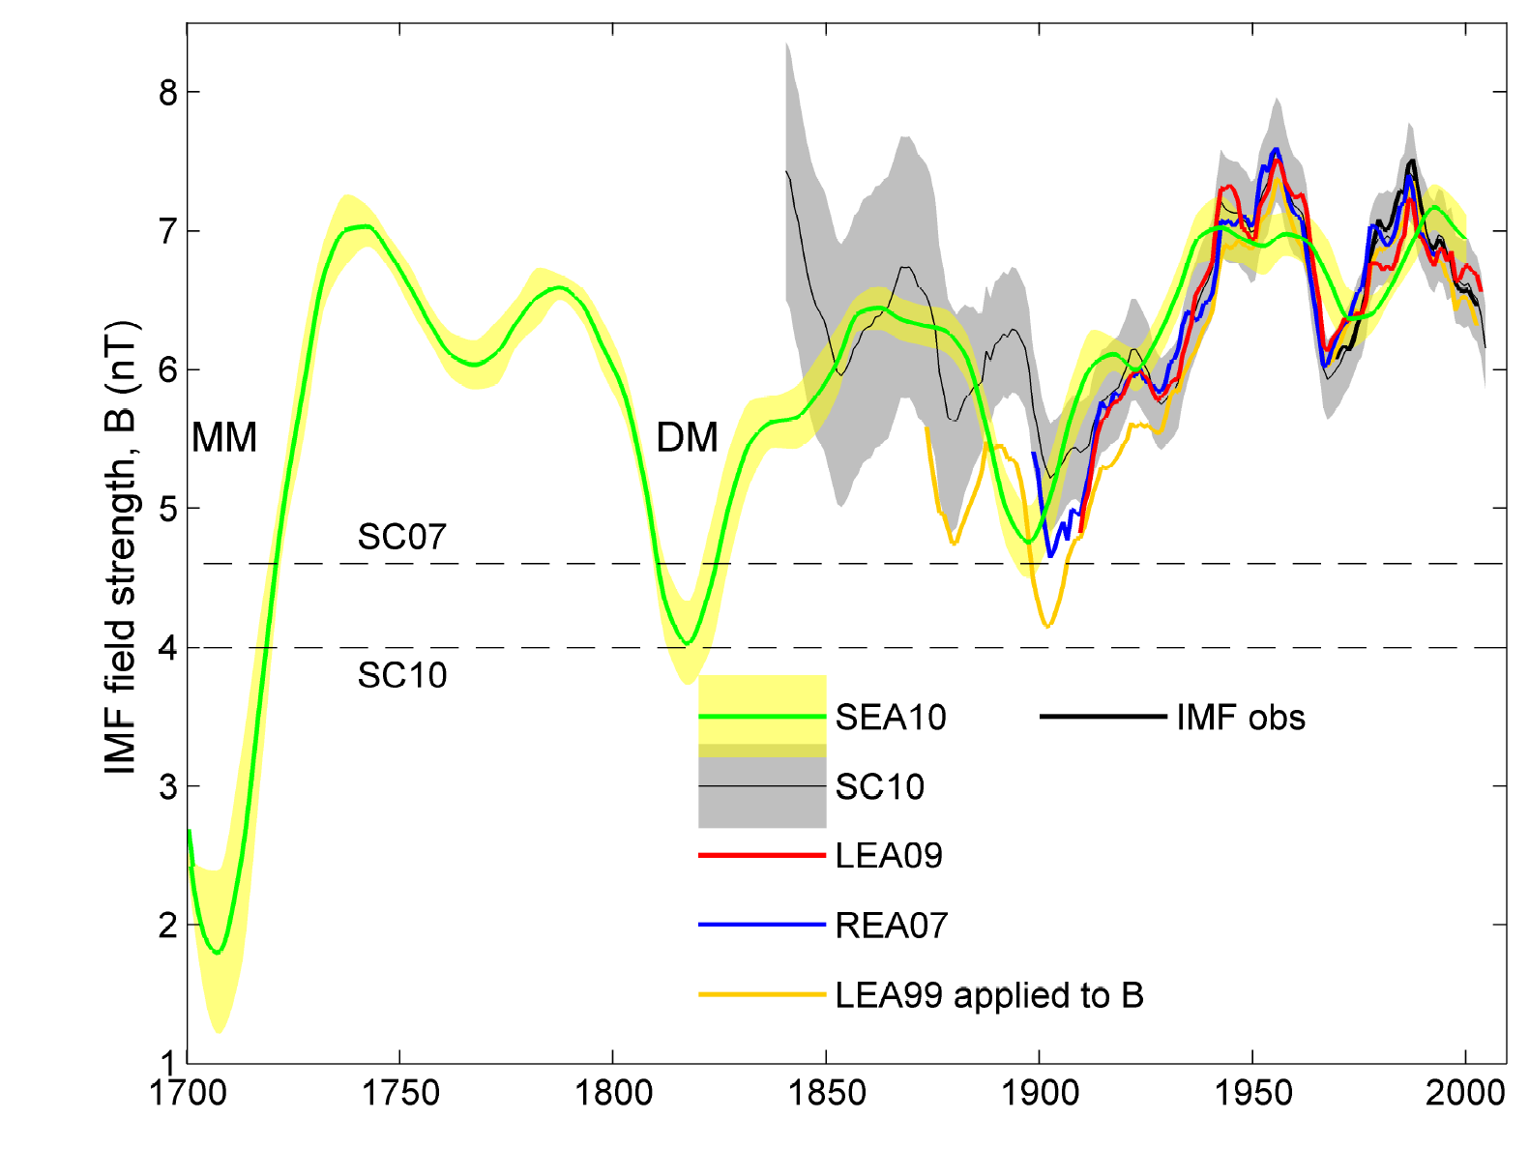
Ice core reconstructions
Steinhilber et al., JGR, 2010

Slide 26
Millennial Variation
φ composite (40-year means) from cosmogenic isotopes ¹⁴C & ¹⁰Be by Steinhilber et al. (2008)
we are still within recent grand maximum
1000
800
600
400
200
0
Solar Modulation Parameter, φ (MV) →
-6000 -4000 -2000 0 2000
Year AD →
Solanki et al., 2004; Vonmoos et al., 2006 & Muscheler et al., 2007

Slide 27
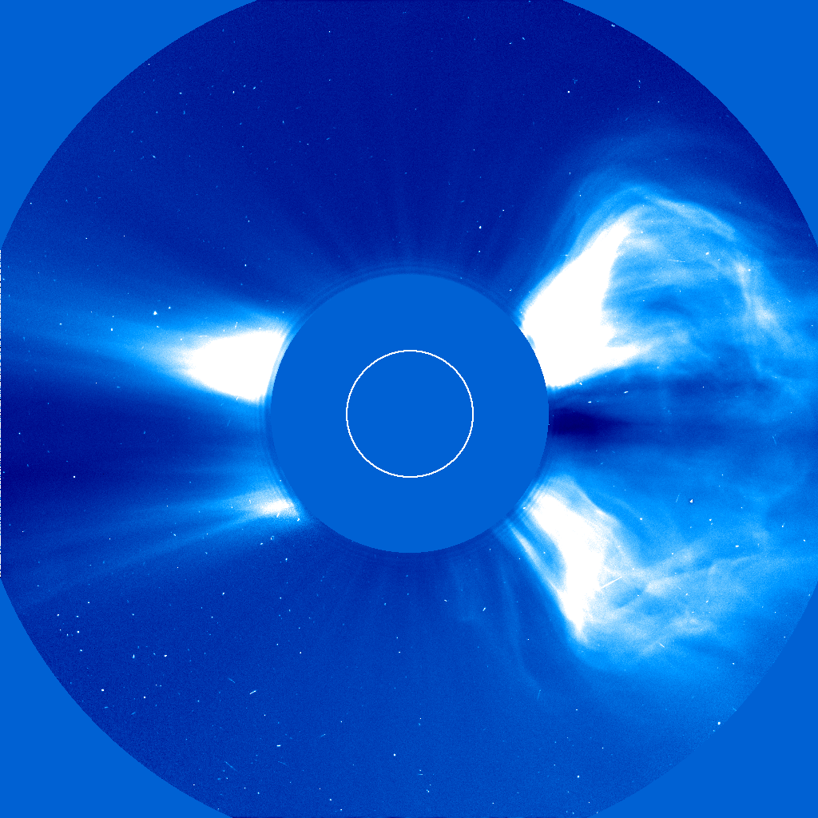
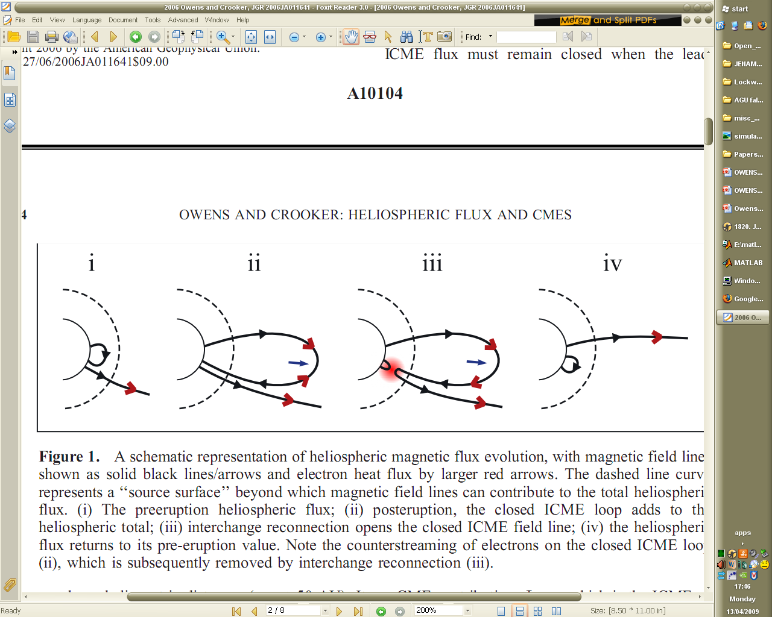

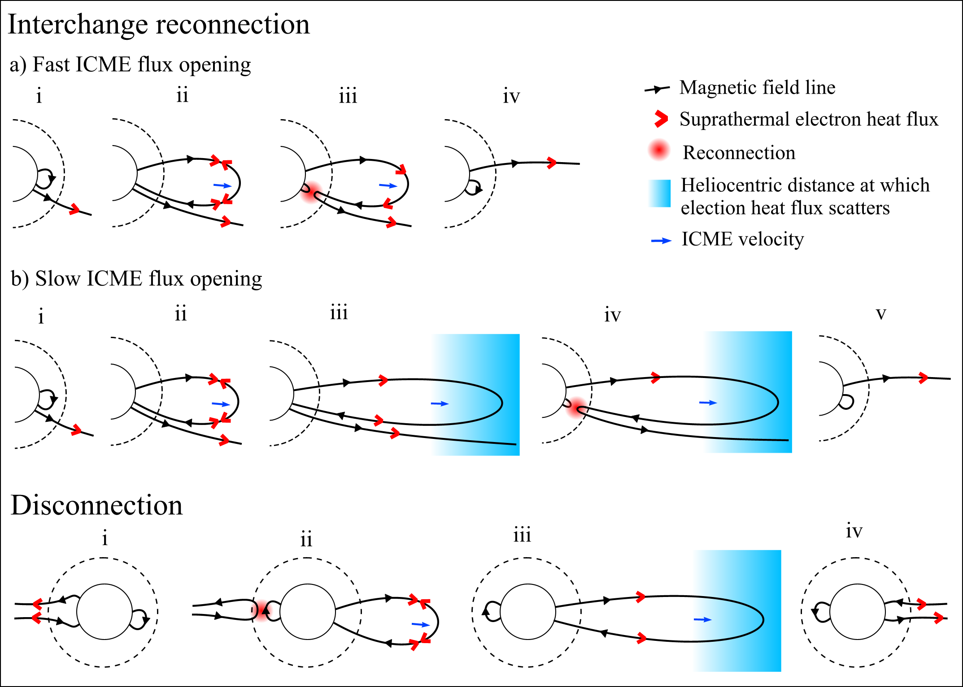
Modelling open solar flux
Solanki et al., Nature, 2000
OSF can be modelled as a continuity equation
Source: New closed loops. Sunspots or CMEs
Loss: Disconnection of magnetic flux. ???
Owens and Crooker, JGR, 2006
Owens and Crooker, JGR, 2007

Slide 28
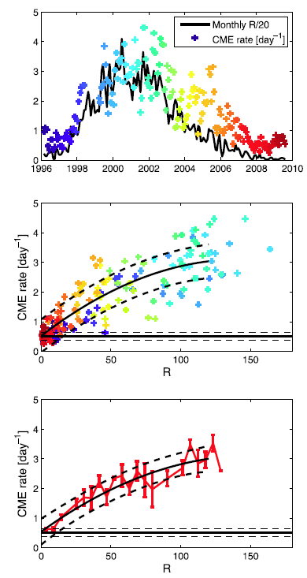
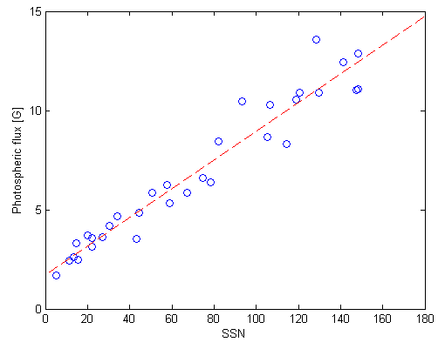
Coronal mass ejections and sunspot number
WSO
MWO

Slide 29
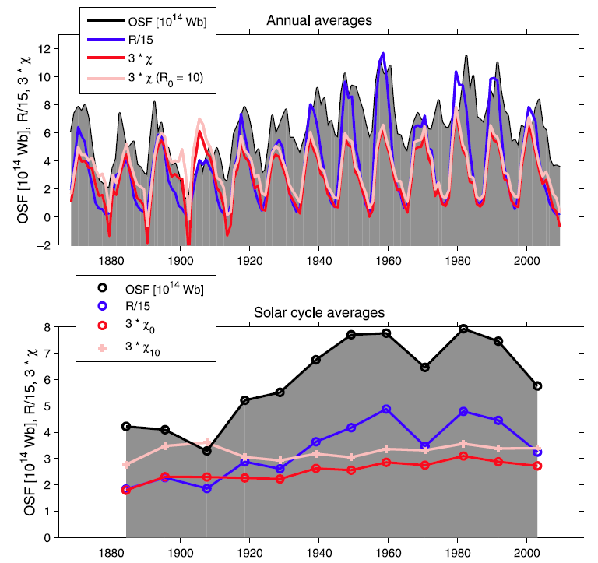
Computing the OSF loss rate
Owens and Lockwood, JGR, 2012

Slide 30
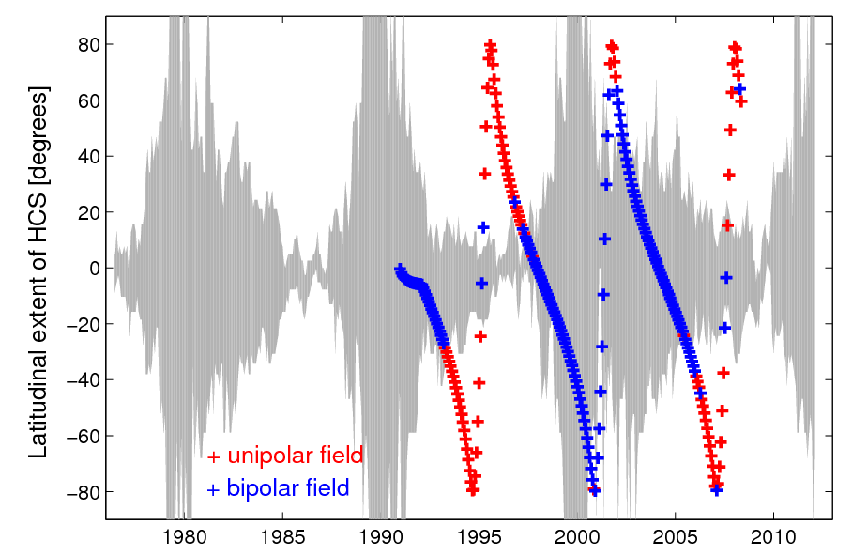
HCS location e.g., Smith el al., 2003

Slide 31
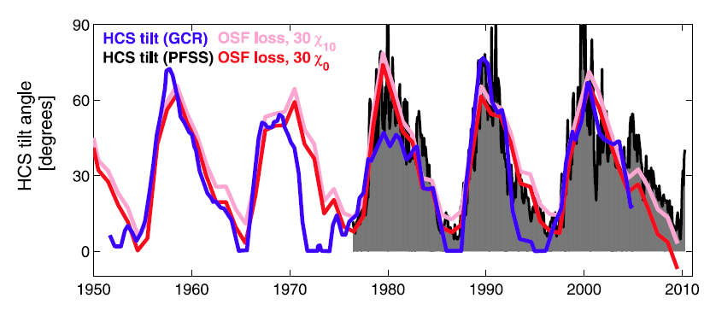
OSF loss and the HCS tilt
Owens and Lockwood, JGR, 2012

Slide 32
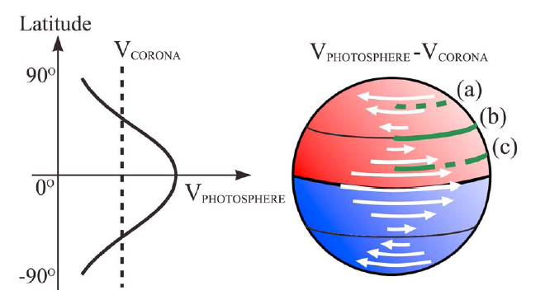
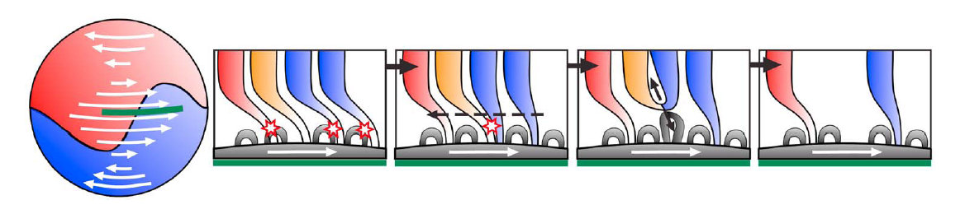
OSF loss and HCS tilt
Owens et al, JGR, 2011

Slide 33
OSF reconstruction
Owens and Lockwood, JGR, 2012

Slide 34
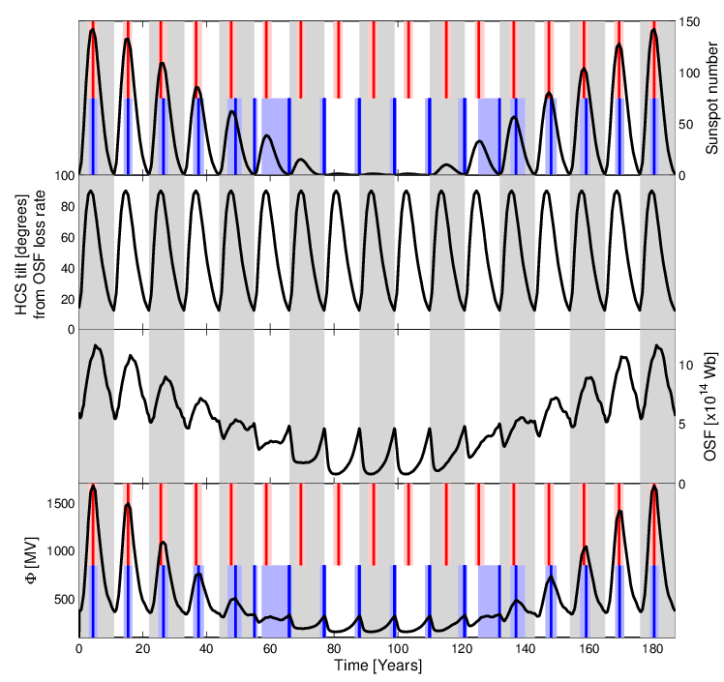
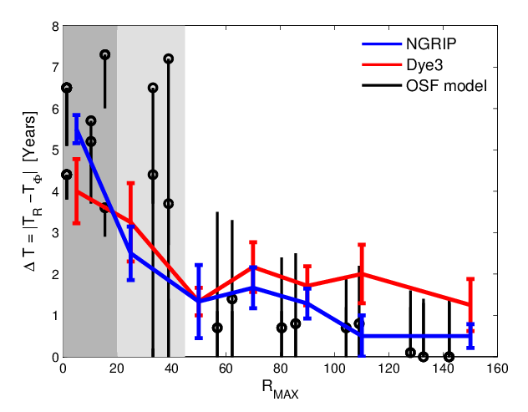
Maunder minimum
Owens, Usoskin and Lockwood, GRL, 2012

Slide 35
Cycle 24 – where are we now?
Unsigned open solar flux

Slide 36
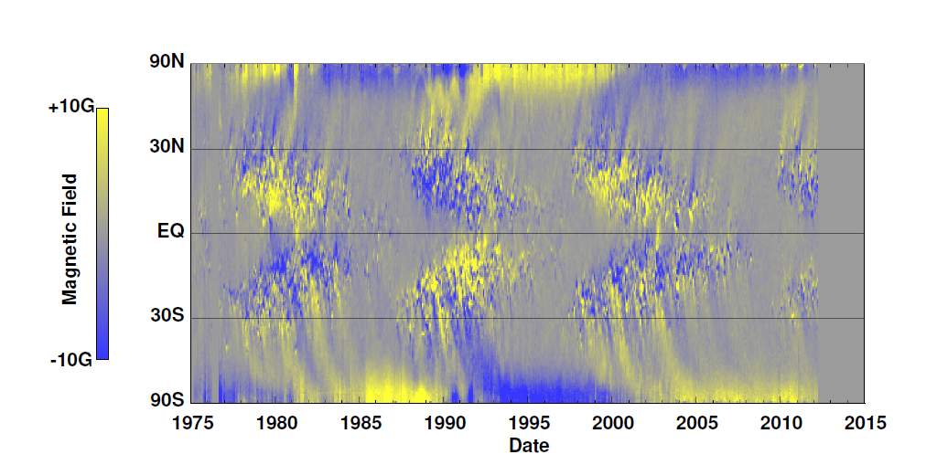
Cycle 24 – where are we now?
Dave Hathaway (NASA/Marshall Space Flight Center)
Magnetic Butterfly Diagram
Observed by the Kitt Peak Magnetograph

Slide 37
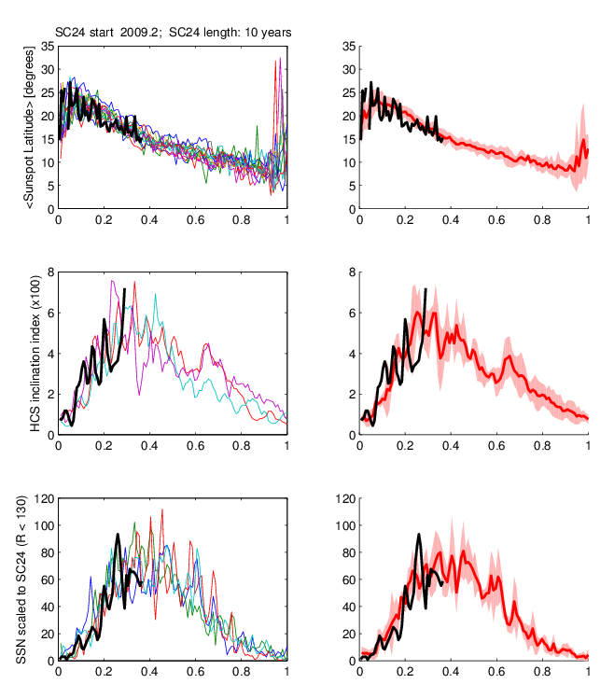
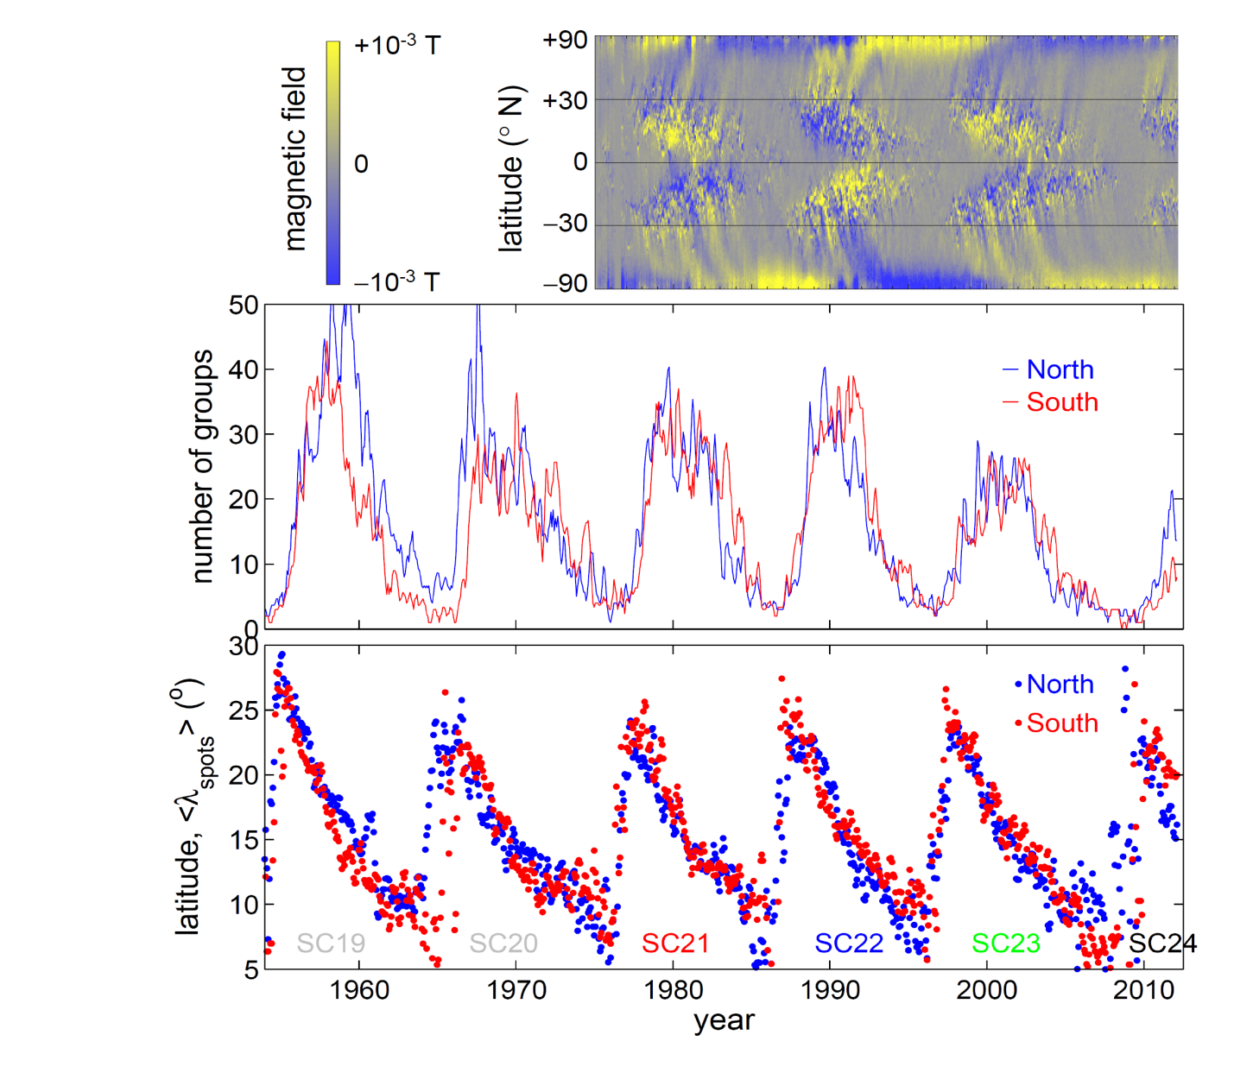
Cycle 24 – where are we now?

Slide 38
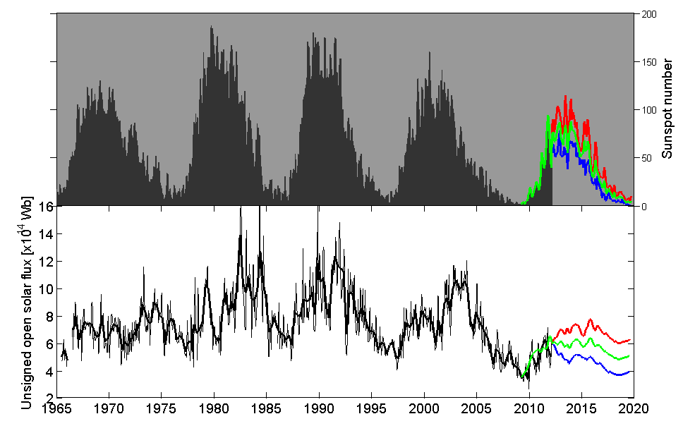
Where are we going?
The next solar cycle
20
21
22
23
24

Slide 39
End of previous GSMs
Steinhilber et al. (2008)
1000
800
600
400
200
0
Solar Modulation Parameter, φ (MV) →
-6000 -4000 -2000 0 2000
Year AD →

Slide 40
Previous GSMs
Barnard et al., GRL, 2011
(24 events in 9000 yrs)
↓ end of grand solar maximum
800
600
400
200
0
Solar Modulation Parameter, φ (MV) →
-80 -40 0 40 80
time after end of grand maximum (yrs) →

Slide 41
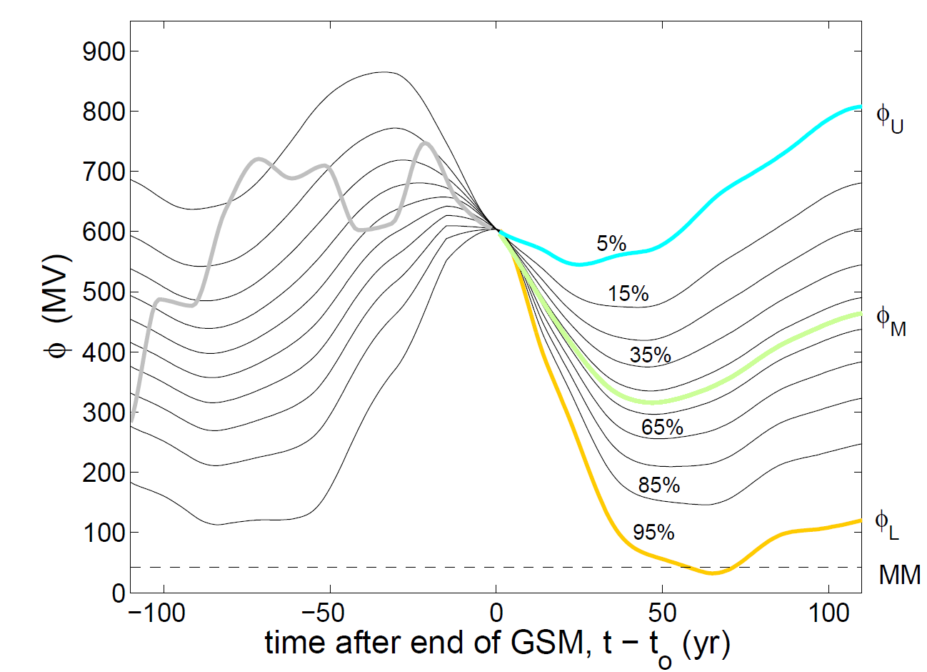
“Analogue” forecast
Barnard et al., GRL, 2011

Slide 42
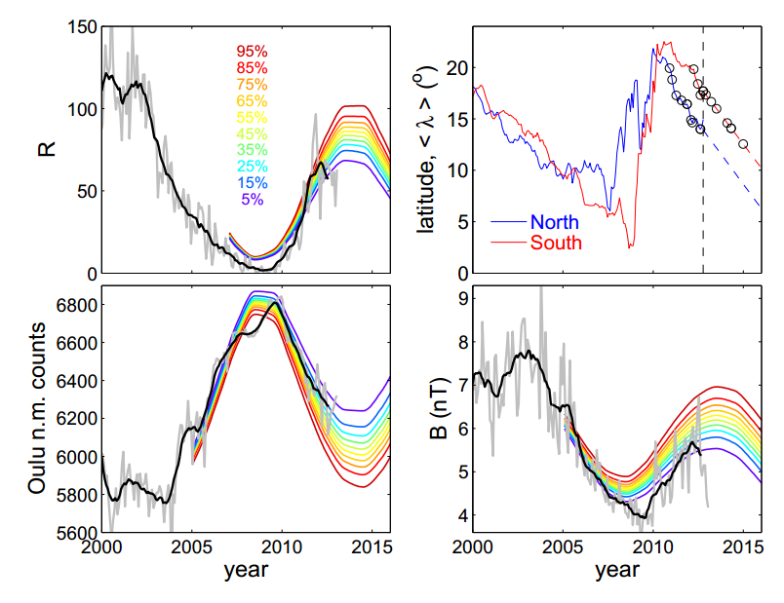
“Analogue” forecasts
Lockwood et al., Astron&Geophys, 2012

Slide 43
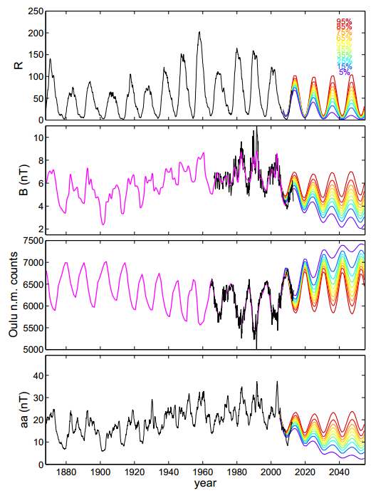
Sunspot number
IMF B
Oulu n.m. GCR counts
aa geomagnetic index

Slide 44

Total solar irradiance
Jones et al., JGR, 2012
Lean (2000)
Krivova et al. (2007)
Lean (2009)

Slide 45
Conclusions
The Sun varies on many timescales, from seconds to millennia.
The space-age has been a period of high activity
We’re currently very close to solar maximum, likely the smallest for ~100 years.
This could well be the start of a long-term decline.
We live in interesting times!

