Slide 1


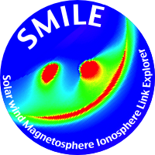
SMILE
Solar wind Magnetosphere Ionosphere Link Explorer
A novel and global way to explore
solar-terrestrial relationships
Graziella Branduardi-Raymont Chi Wang
UCL – MSSL CAS – NSSC
and the SMILE collaboration
See http://mssl.ucl.ac.uk/SMILE/
Notes:
SMILE offers a new way to explore Sun-Earth connections. It is a joint space mission from start to finish by the European Space Agency and the Chinese Academy of Sciences, currently under development and due for launch at the end of 2023. Because of this tight collaboration there are two co-PI for the mission and of course a large team of scientists and engineers who are working hard to make it a reality.

Slide 2
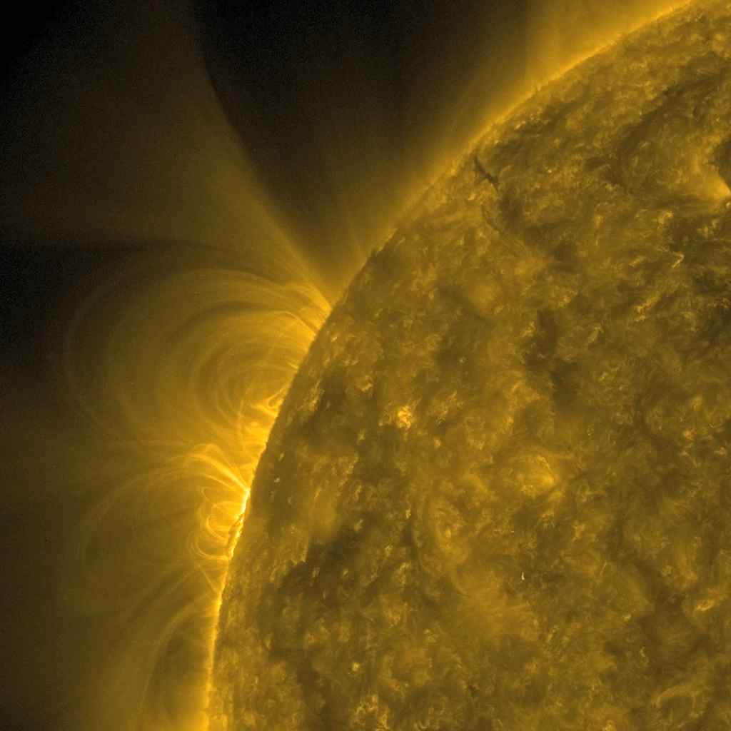
The Sun’s activity
Credit:
NASA/SDO
Notes:
Flare and small CME
https://sdo.gsfc.nasa.gov/gallery/main/
Images taken in Extreme UV light.

Slide 3
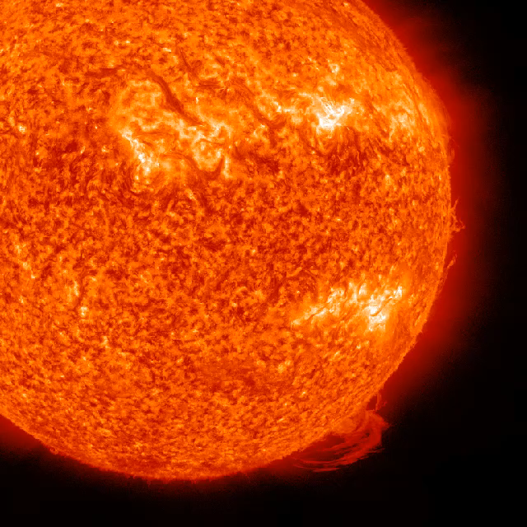
The Sun’s activity
Credit:
NASA/SDO

Slide 4
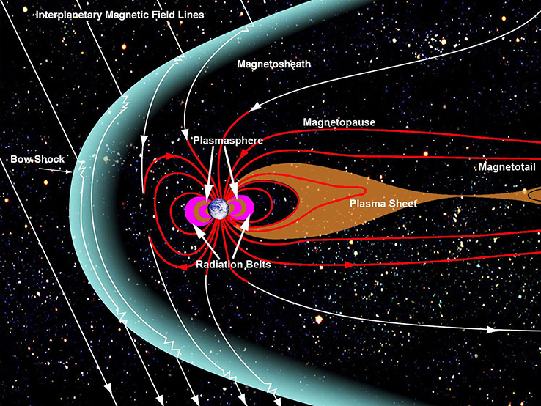
Earth’s magnetosphere

Slide 5
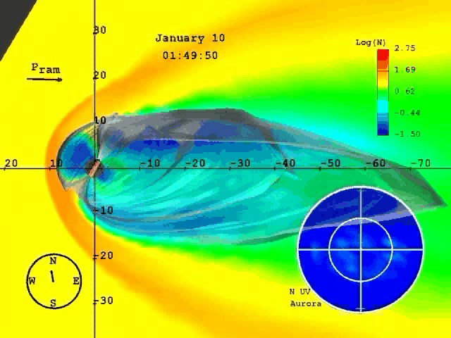
Courtesy C. Goodrich

Slide 6
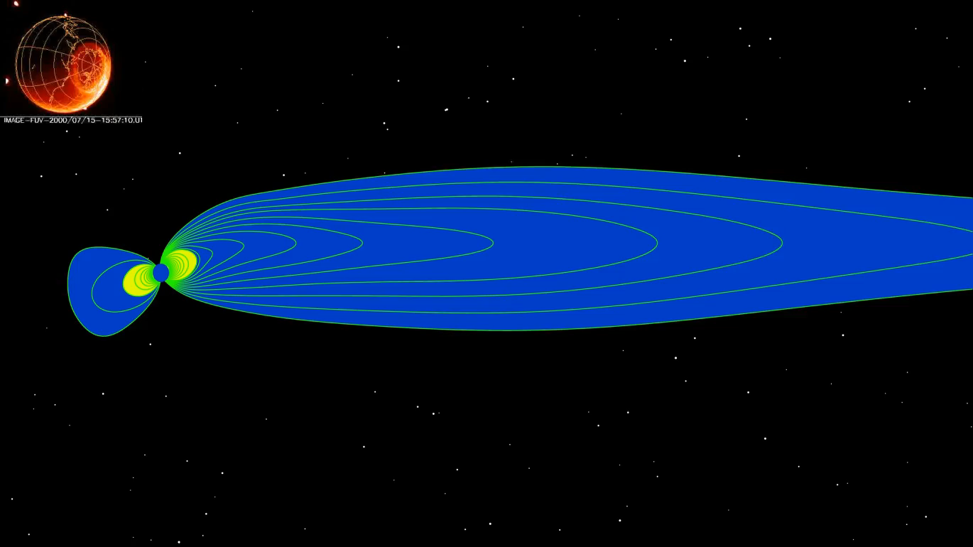
Formation of a substorm and the aurora
Courtesy C. Forsyth

Slide 7
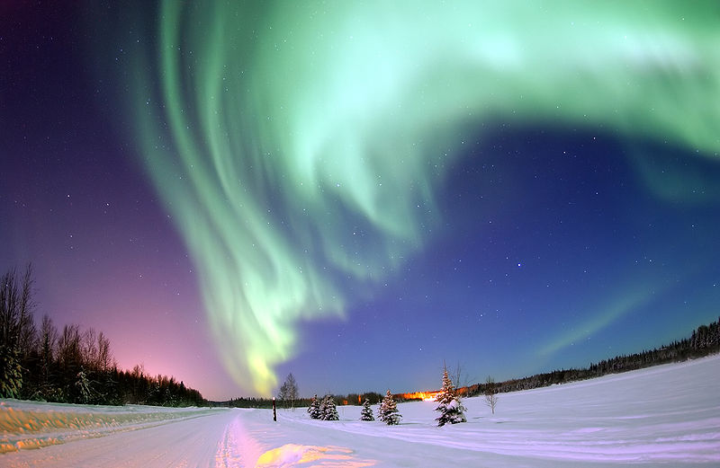
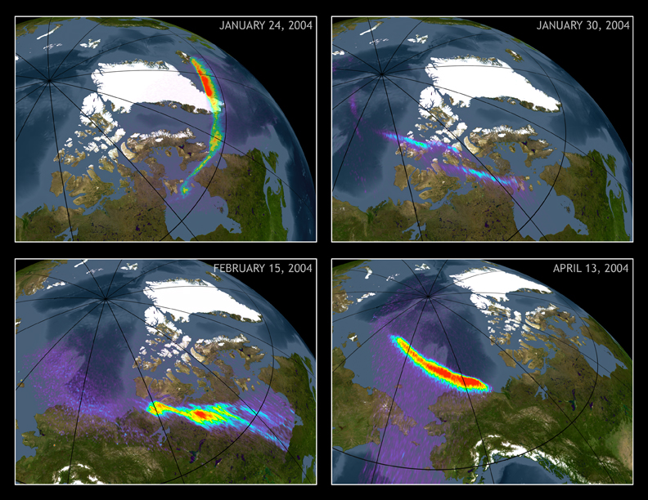

Aurorae in visible, and X-ray light

Slide 8
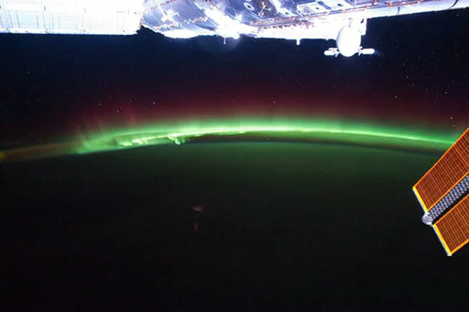
Aurora from the International Space Station

Slide 9
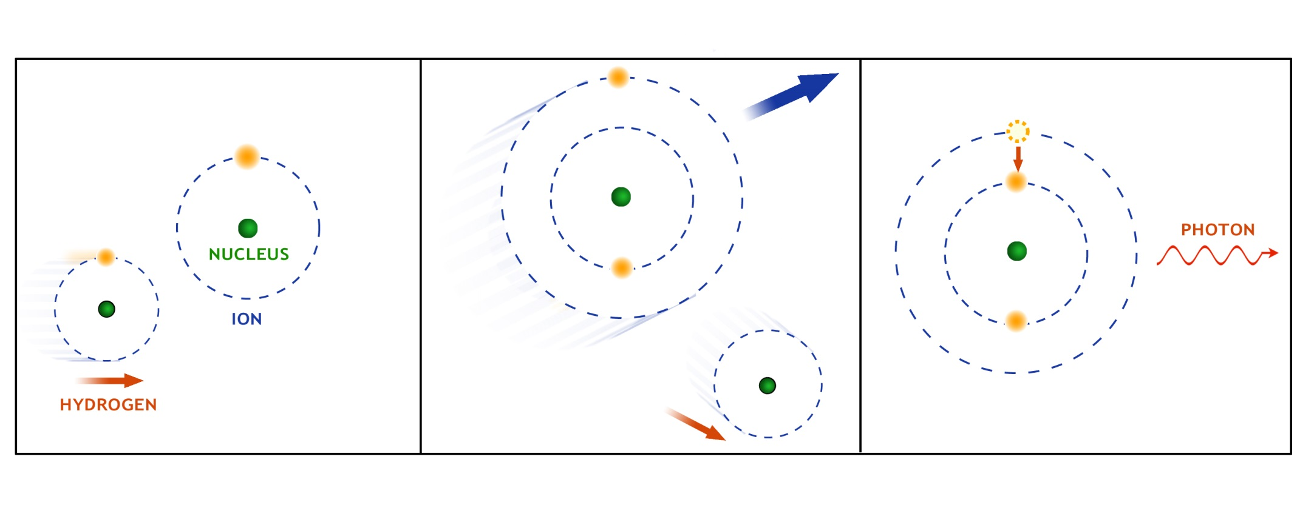
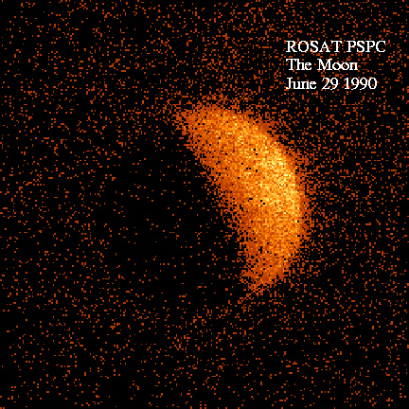
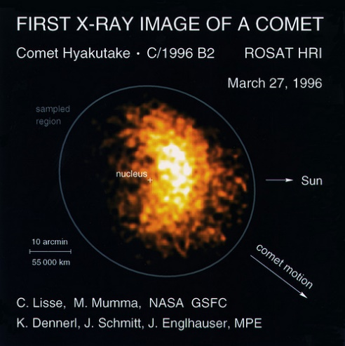
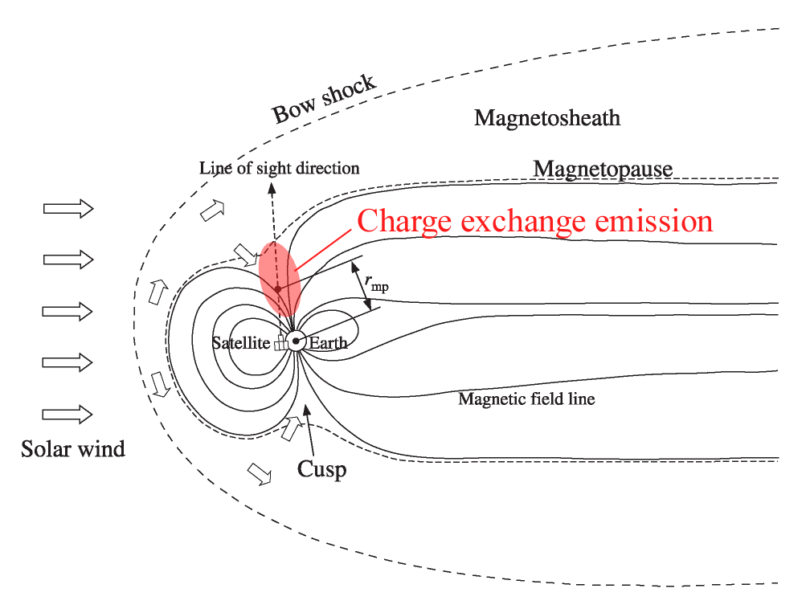
Solar Wind Charge eXchange (SWCX)
SW O⁷⁺
O⁶⁺*
O⁶⁺
0.57 keV
Harvard Univ.
X-ray emission proportional to density
of solar wind ions and neutrals
Fujimoto et al. 2007
Notes:
SWCX responsible for bright X-ray emission of comets, for the dark side of the Moon residual X-rays and variable X-ray b/g in astronomical X-ray observations with line of sight crossing the magnetosheath and the cusps.

Slide 10
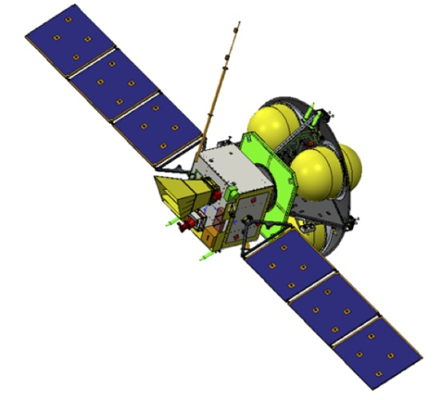
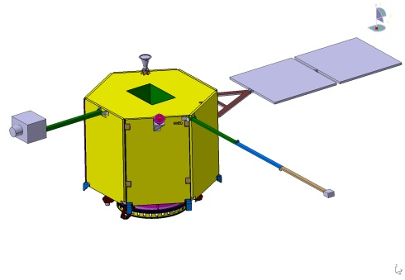
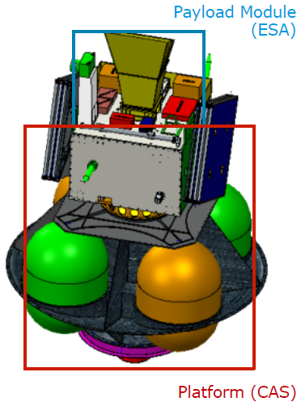
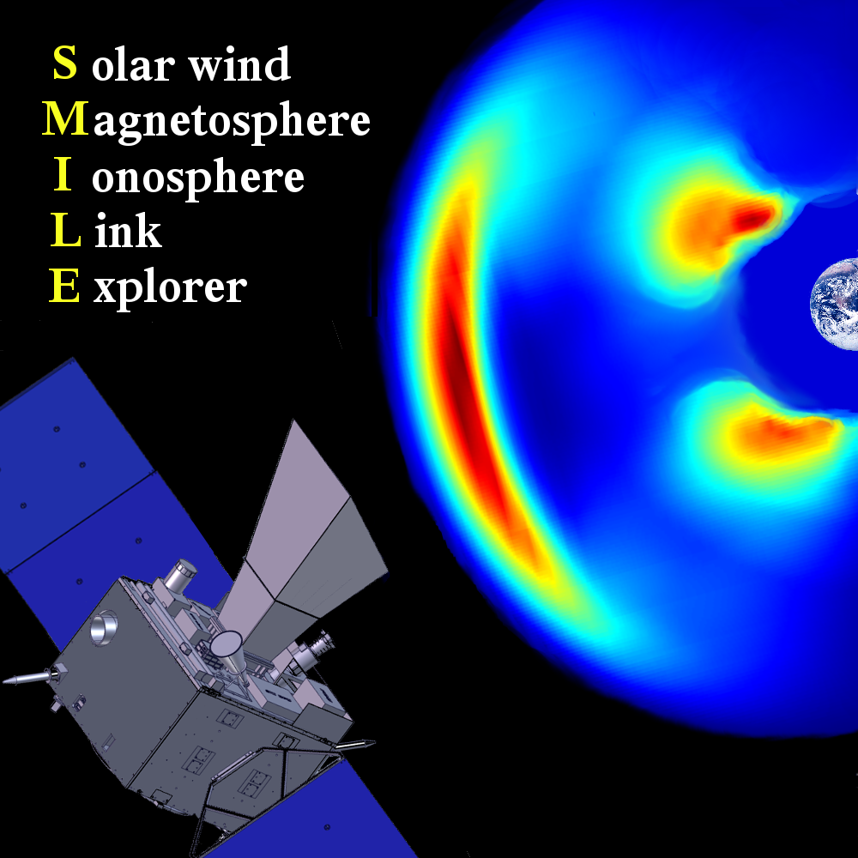
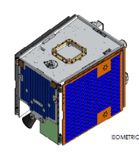
X-ray imaging of geospace:
AXIOM → AXIOM-C → SMILE
SMILE 2015
AXIOM 2010
AXIOM-C 2012
Notes:
Idea of taking advantage of this soft X-ray emission, which is background and nuisance for X-ray astronomers, and use it as a diagnostic of solar-terrestrial interactions. This generated several proposals on the NASA and ESA sides to develop a space mission to achieve this. These are the attempts I have been involved with.
From science questions to conceptual design and implementation of space instruments, mission launch, operations in orbit and space data analysis, interpretation and publication. The circle closes with more questions and ideas being generated and the next generation of instruments and missions developed.

Slide 11
ESA-Chinese Academy of Sciences joint mission
SMILE:
Solar wind Magnetosphere Ionosphere Link Explorer
Call issued in January 2015
13 proposals received
SMILE recommended in June 2015 as candidate for the collaborative science mission and selected for implementation in Nov. 2015 (launch 2023)
After Phase A study, ESA Adoption in March 2019; on into Phase B, breadboarding some of the subsystems, passed Preliminary Design Review in January 2020 and now in Phase C (build)
‘Small’ mission but complex (four instruments with different requirements)
Creating substantial interest and support from space plasma, planetary and astrophysics communities
Notes:
How a space mission comes about and is developed through many Phases.

Slide 12
SMILE
Solar wind Magnetosphere Ionosphere Link Explorer
CME ➔
Credit: ESA
Notes:
Consider the impact of a CME arriving at the Earth: SWCX X-rays are produced in the dayside magnetosheath and the cusps and eventually the solar wind particles precipitate into the polar regions forming the aurorae.
So SMILE combines global X-ray imaging of the dayside magnetosheath and the cusps, simultaneous UV imaging of the Northern aurora and in situ monitoring of the solar wind and magnetosheath conditions from a highly elliptical orbit.
→ full chain of events that drive Space Weather: solar wind injection / magnetospheric sub-storm cycle / CME-driven storms

Slide 13
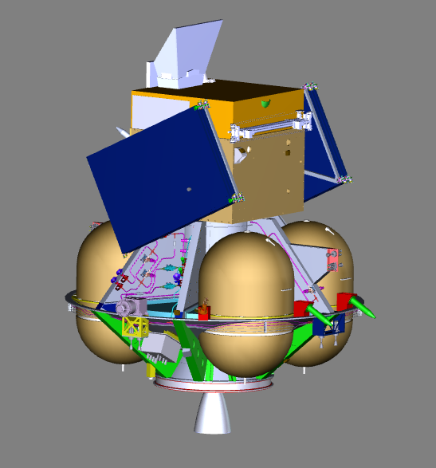



SMILE shares of responsibilities
CAS provides the Propulsion Module, Service Module, Spacecraft Prime, Mission Operations (with ESA contribution), Chinese instruments
ESA provides the Payload Module, launcher, AIT facilities for spacecraft integration and testing; ESA member states/Canada provide instruments
Baseline: ~ 5000 km x 120,000 km HEO,
51 hr orbit (40 hr SXI and UVI science operations)
Ground stations: Troll (Antarctica, baseline, ESA)
and Sanya (China, support, CAS)
Launch (2023): Vega-C (single passenger, ~70º incl.)
or Ariane 6 (dual launch into SSO 700 km, 98º incl.),
both from Kourou, French Guiana
SXI
UVI
SMILE orbit
PLM
MAG
LIA
Platform
Notes:
SMILE in its launch configuration.
Reach final orbit after a few weeks or up to 6 months in the two cases.
Orbit unstable, EOL uncontrolled descent into Earth’s atmosphere in less than 25 years after launch.

Slide 14
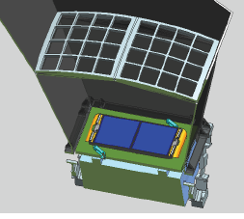
SMILE Soft X-ray Imager (SXI)
CCD Detector Plane
Photon counting: Event lists
with 1 to 2 s time resolution
High QE in soft X-rays
~80% at 250 eV
Medium energy resolution
~50 eV FWHM at 500 eV
Lobster-eye Micropore
Optic
Ultra-wide field of view
~16°x 27°
Focal length 30 cm
Optic Mass < 1kg
Instrument ~ 26 kg
PI S. Sembay, Univ. of Leicester, UK
Notes:
Wide field soft X-ray telescope, based on light-weight lobster-type optic.
Compare with XMM-Newton optic: each one of the mirror assemblies has a mass of ~400 kg (70 cm diameter)
Simulated images after IMF turning from northward to southward (in active solar wind conditions)

Slide 15
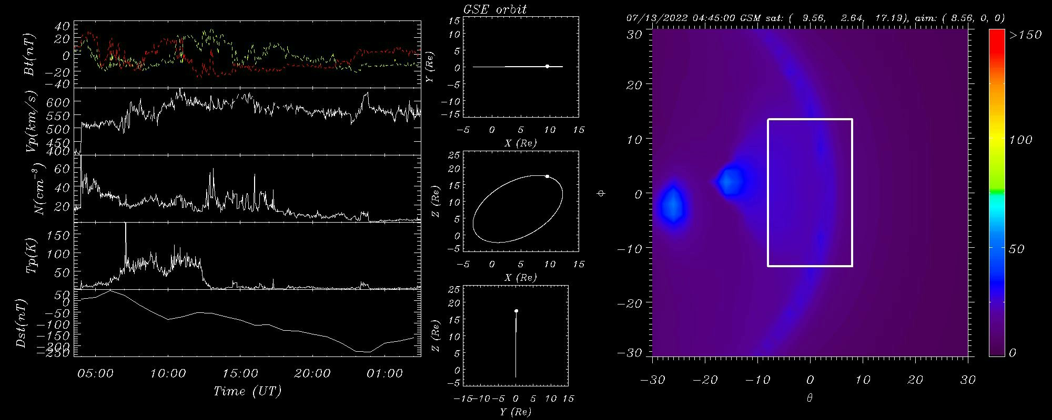
SMILE SXI: 17th March 2015 solar storm
T. Sun, 2015
Notes:
Needs file Tianran's_170315 wd150317x

Slide 16
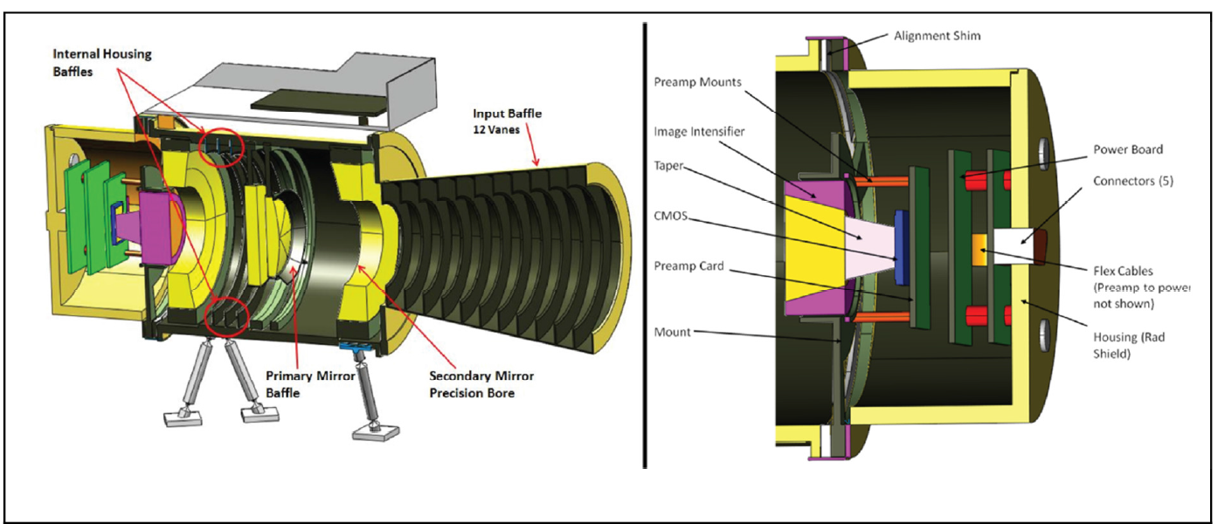
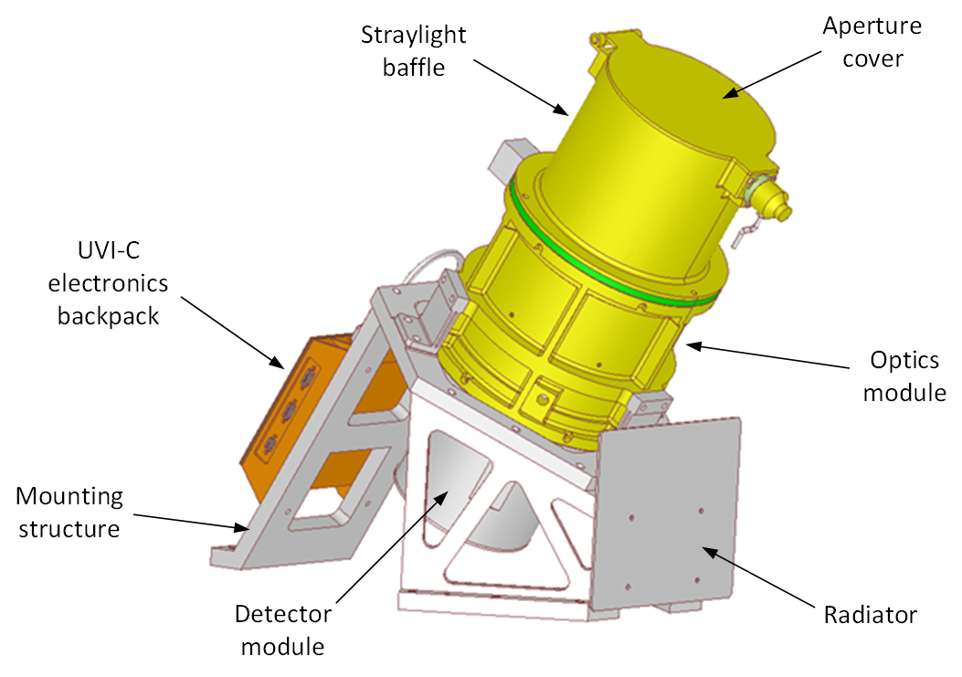
SMILE UltraViolet Imager (UVI)
Four mirror reflective UV imager of whole northern aurora at high spatial and temporal resolution
UV bandpass (155-175 nm) achieved coating optical & detector surfaces
Image intensifier detector (photocathode → MCP → phosphor → CMOS sensor)
PI E. Donovan, Univ. of Calgary, Canada
Notes:
Drawing to illustrate inner workings of the UVI. Mirrors coating to suppress visible light.

Slide 17
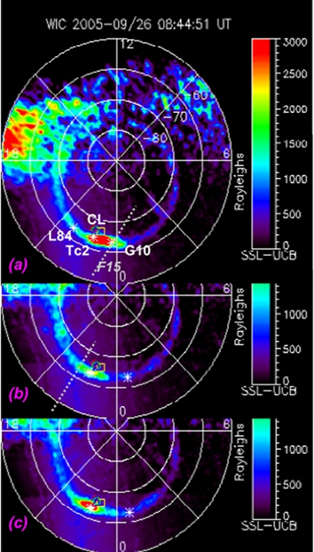
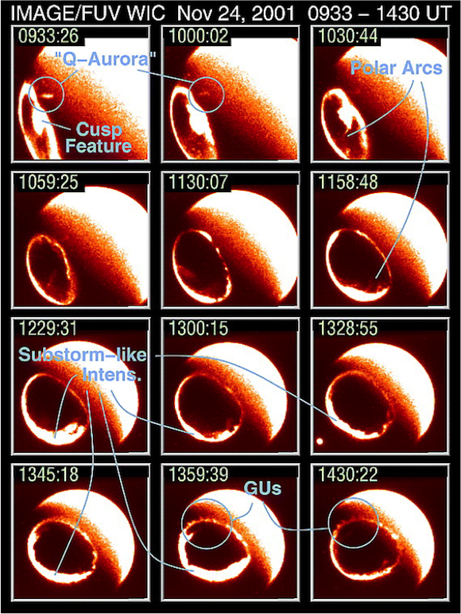
SMILE UVI targets the Earth’s North aurora
SMILE UVI will observe the Earth's northern auroral oval like the IMAGE satellite did
Credit:
IMAGE/NASA/GSFC

Slide 18
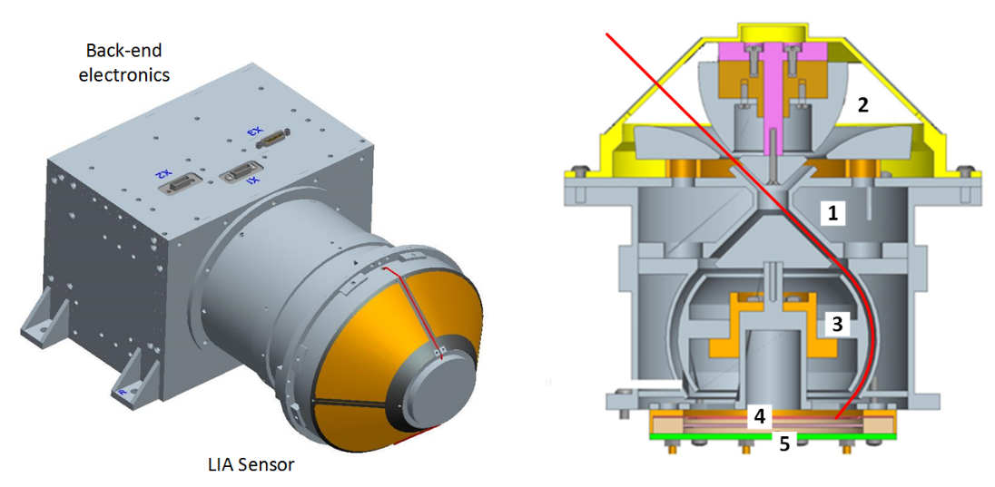
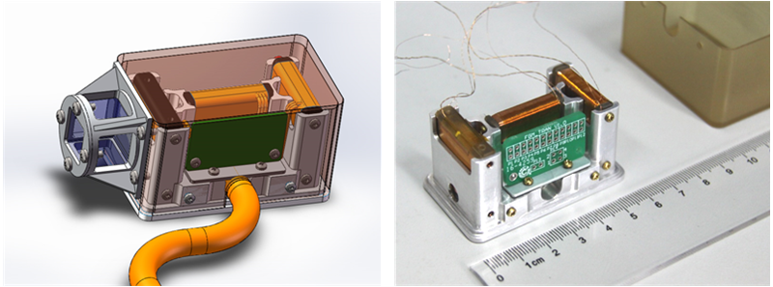
SMILE Light Ion Analyser (LIA)
& MAGnetometer (MAG)
Fluxgate magnetometer for
magnetic field strength & direction
3 m boom, two sensors
Top-hat analyser for p and α
density, velocity and temperature
Energy range: 50 eV - 20 keV
FOV : 360º (azimuth) and up
to 90º (elevation)
PI L. Dai, NSSC, CAS, China
PI L. Li, NSSC, CAS, China
Notes:
In-situ instrument package is China responsibility

Slide 19
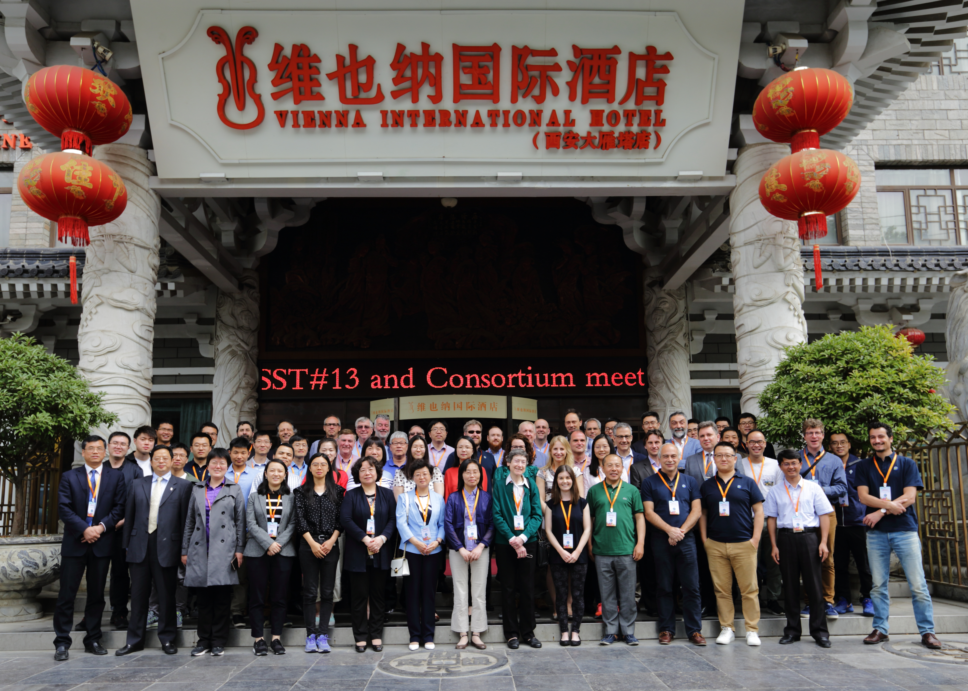
SMILE Consortium meeting # 7
13-15/5/2019, Xi’an, China
Notes:
Collaboration with Chinese scientists ad engineers working very well. This photo is from the SMILE Consortium meeting we had in China in May 2019.

Slide 20
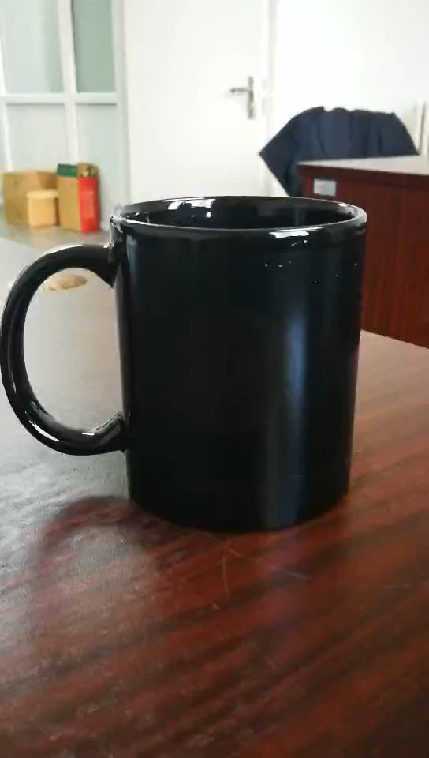
Temperature sensitive SMILE mug!
Jing Li, CAS-NSSC
Notes:
An amazing new gadget! Like magic!

Slide 21
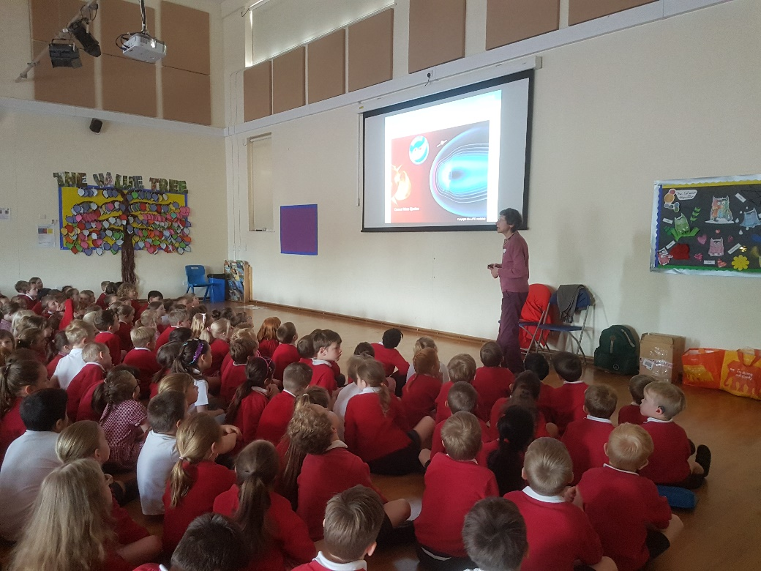

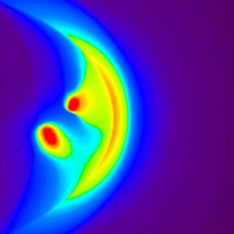
SMILE impact
X-rays from the magnetosphere: from ‘unwanted background’ for X-ray astrophysical observatories to diagnostic tool of Sun-Earth relationships
SMILE will apply X-ray astronomical techniques to investigate the impact of the variable solar wind on the space around the Earth, and provide important scientific input to models of this interaction
This has very important implications on our technological infrastructures (‘space weather’) → mitigate and ultimately predict it?
Outreach: Captivate public to science so far invisible, and initiate projects with schools ...
Artist’s impression - NASA

