Slide 1
Finding our SMILE
From an X-ray astronomer’s headache to imaging the Earth’s magnetosphere
J. A. Carter, University of Leicester
@JennyaCarter #SMILEesacas
November 2019
With input from, and thanks to:
H. Connor (UAF);
S. E. Milan, S. F. Sembay, A. R. Fogg (U. Leicester);
A. Samsonov, G. Branduardi-Raymont (MSSL)

Slide 2
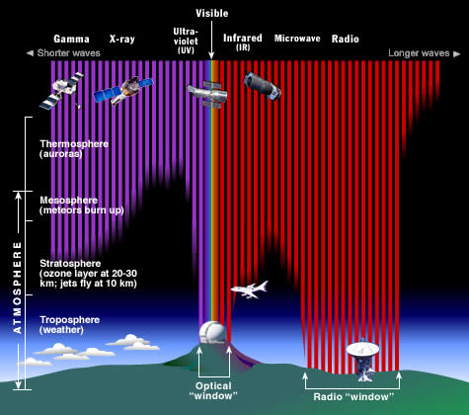
The X-ray sky: early ROSAT days

Slide 3
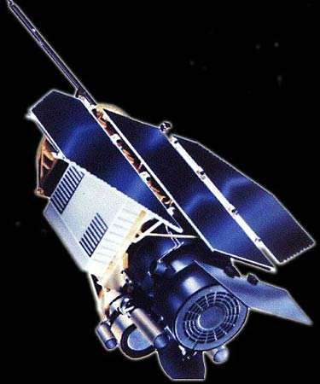
The X-ray sky: early ROSAT days

Slide 4
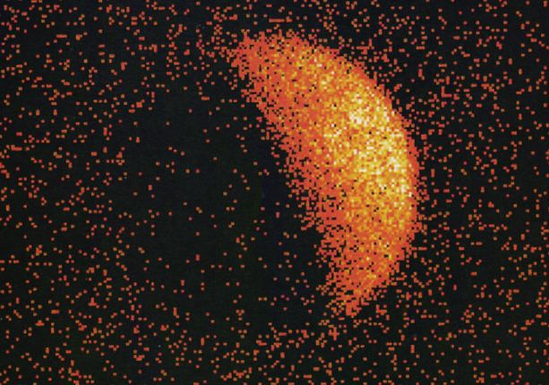
The X-ray sky: early ROSAT days
Credit: J. Schmitt (MPE)

Slide 5
The X-ray sky: all sky maps

Slide 6
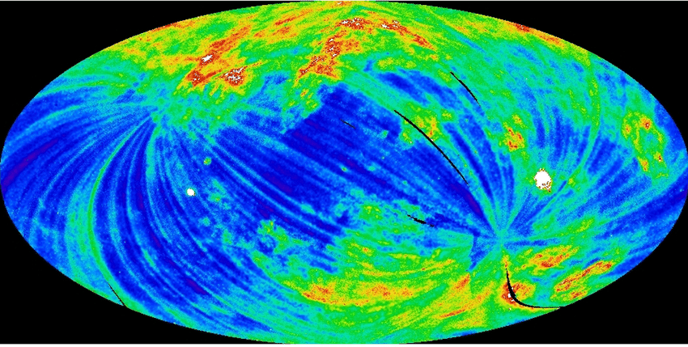
The X-ray sky: all sky maps

Slide 7
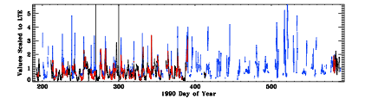
The X-ray sky: long-term enhancements
X-rays: black
Solar wind flux
Solar wind protons
Kuntz 2015, Freyberg 1994

Slide 8
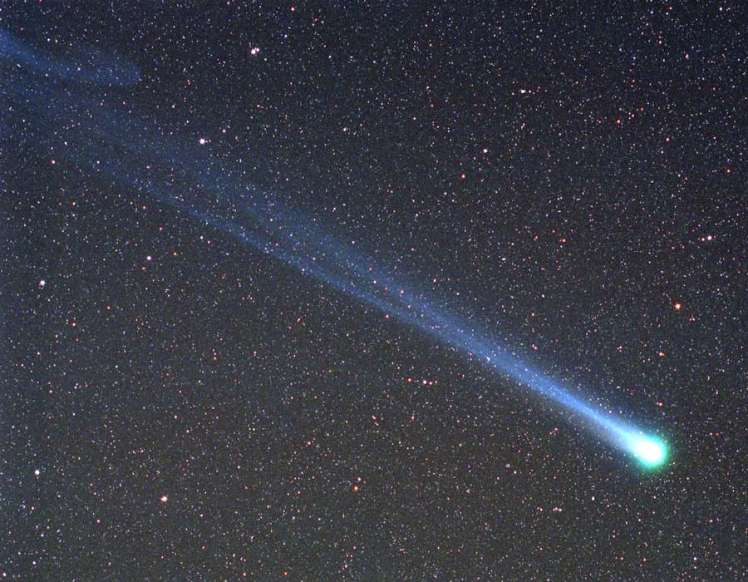
The X-ray sky: comets as X-ray emitters
Comet: Hyakutake 1996 B2

Slide 9
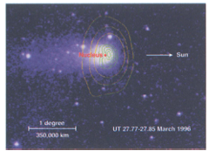
The X-ray sky: comets as X-ray emitters
Comet: Hyakutake 1996 B2
Lisse et al. 1996 - cometary X-rays related to solar wind?

Slide 10
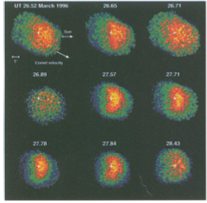
The X-ray sky: comets as X-ray emitters
Comet: Hyakutake 1996 B2
Lisse et al. 1996 - cometary X-rays related to solar wind?
HRI images with time, band 0.1 - 2.0 keV

Slide 11
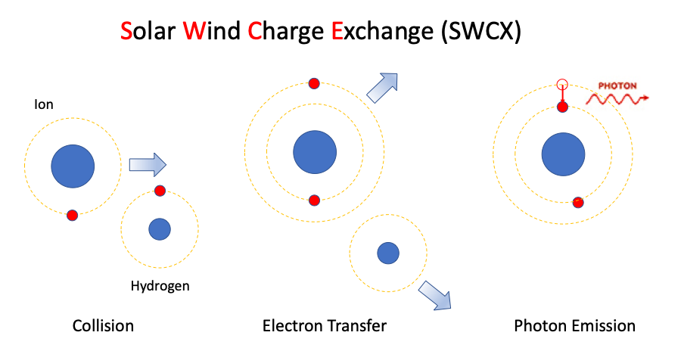
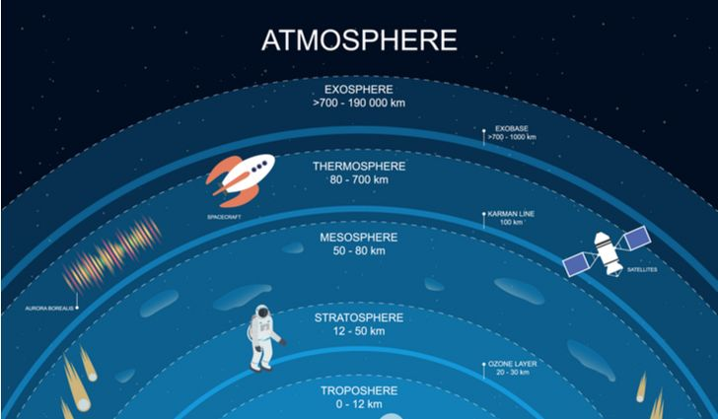
Charge exchange emission
Credit: World Atlas
Credit: S. Sembay
Cravens 1997: Geocoronal X-rays?

Slide 12
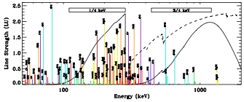
Charge exchange emission
Credit: World Atlas
Credit: S. Sembay
Cravens 1997: Geocoronal X-rays?
PX-ray = ∫ ⍺ * NH * Nsw * Veff ds
Veff = √ (V²SW + 3kT/m)
Koutroumpa+ 2009

Slide 13
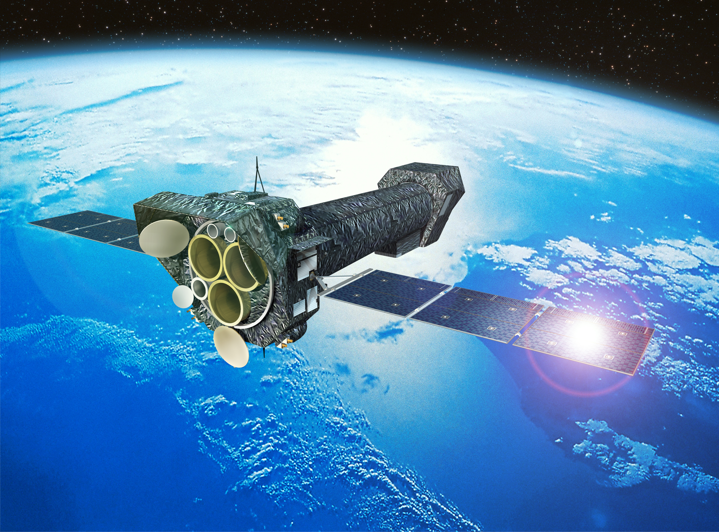
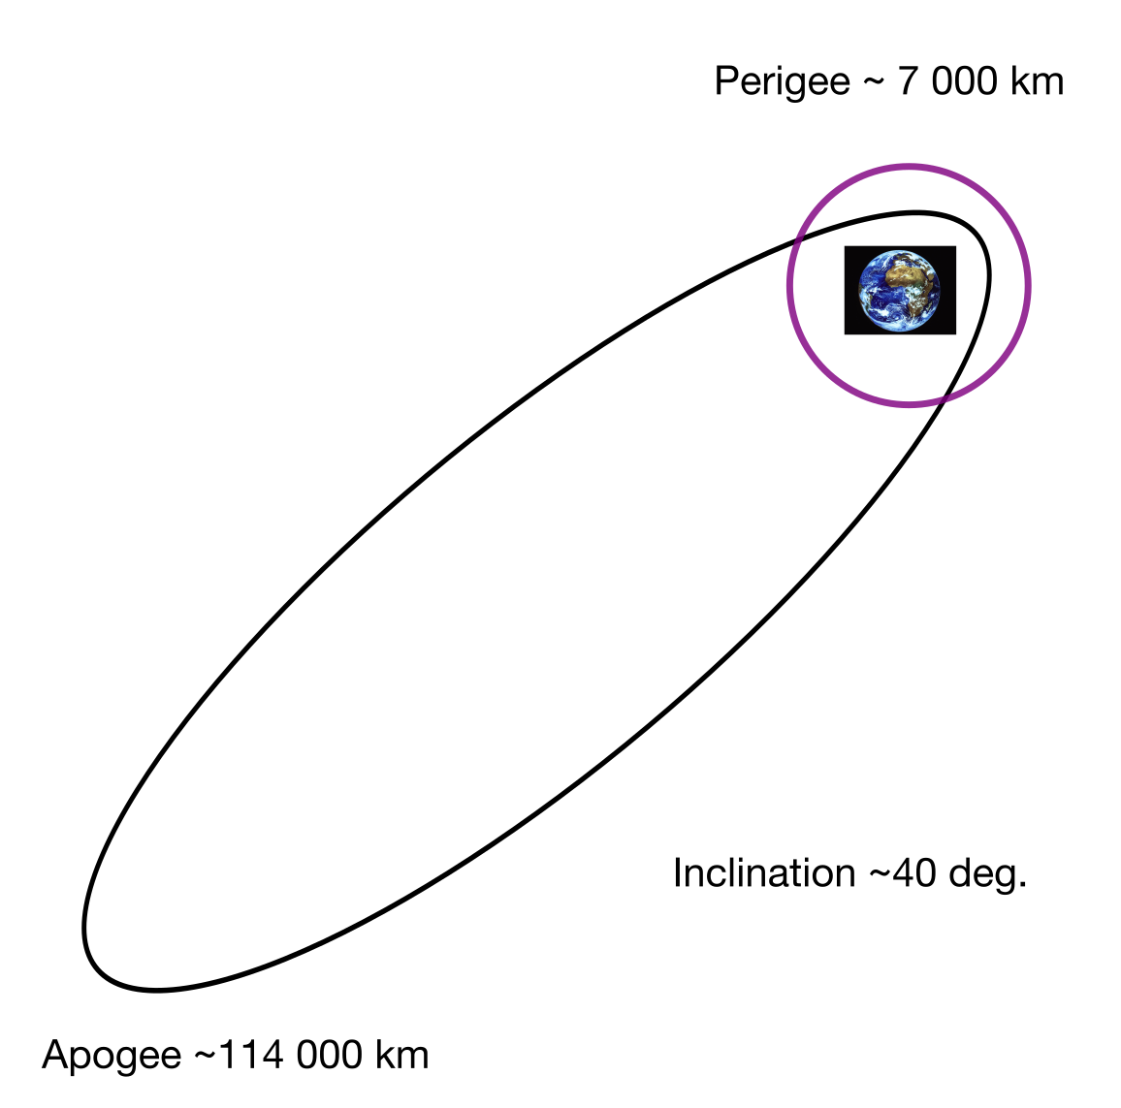
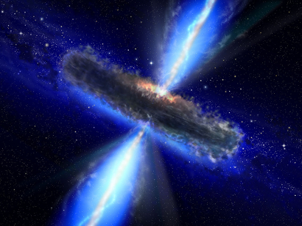
The X-ray sky: XMM-Newton
Credit: ESA
Launched: December 1999
Targets: high-energy universe
Orbit: with high -ve Z, i.e. below the ecliptic
Credit: P. Padovani

Slide 14
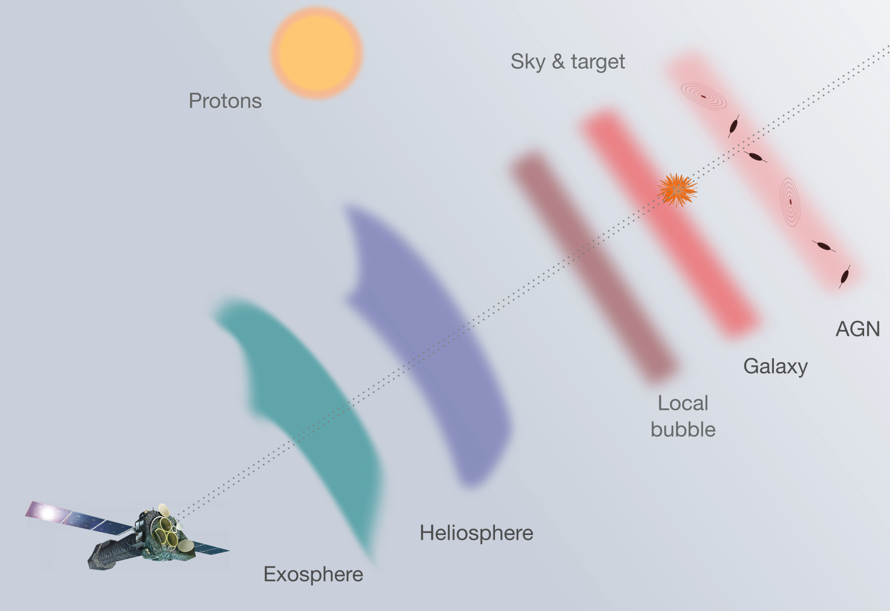
The X-ray sky: XMM-Newton: line of sight
Credit: ESA
Credit: P. Padovani

Slide 15
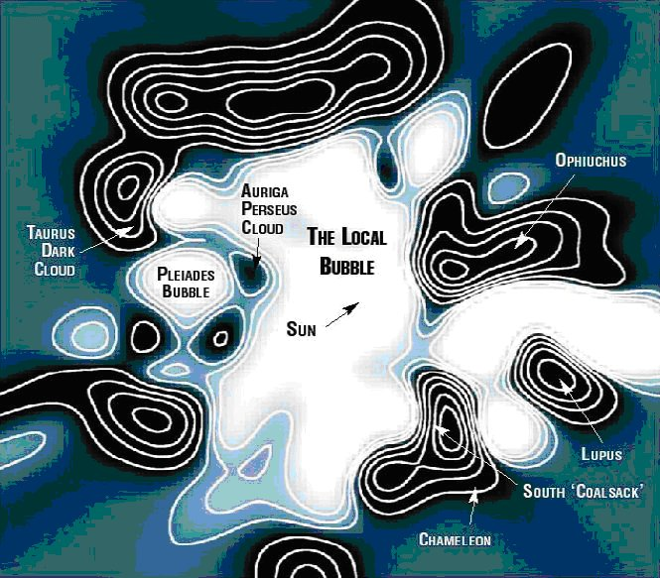
The X-ray sky: XMM-Newton: line of sight
Credit: ESA
Credit: AstonomyCafe.net
Credit: P. Padovani

Slide 16
The X-ray sky: XMM-Newton: line of sight
Credit: ESA
Time variable
Credit: P. Padovani

Slide 17
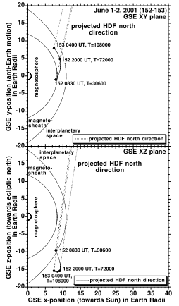
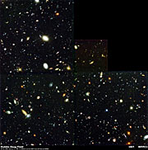
SWCX: detected, XMM: Hubble Deep Field North
Snowden et al. 2004
Credit: ESA
Credit: P. Padovani

Slide 18
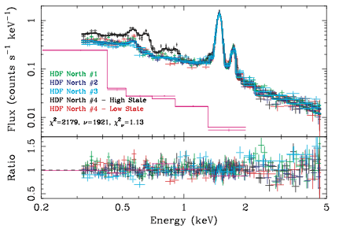
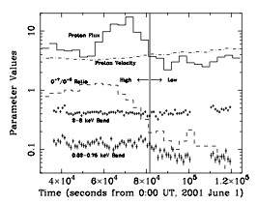
SWCX: detected, XMM: Hubble Deep Field North
Snowden et al. 2004
Credit: ESA
Credit: P. Padovani

Slide 19
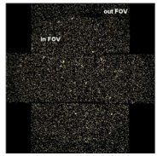
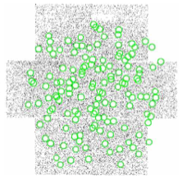
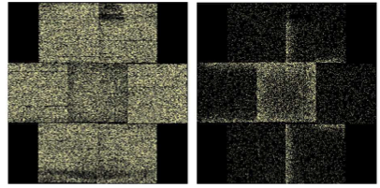
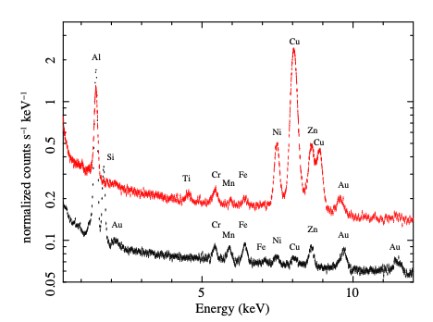
SWCX: detected: XMM-Newton survey & analysis
Cleaning X-ray data, for diffuse emission studies
- point source removal
- soft proton removal
- particle-induced background
Credit: P. Padovani

Slide 20
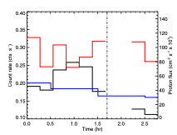
SWCX: detected: XMM-Newton survey
Carter et al. 2011
Archival study: 2000 - 2011
Checked for time variable SWCX
~3.5 % observations show time-variable SWCX
Solar cycle dependence
More SWCX seen at ~sub solar point

Slide 21
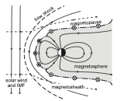
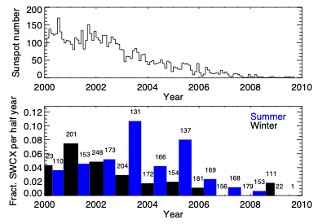
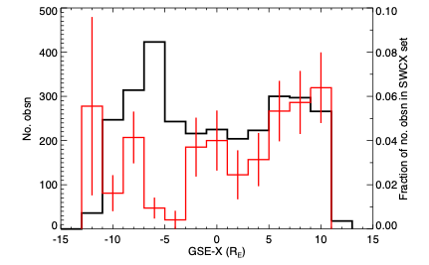
SWCX: detected: XMM-Newton survey results
Archival study: 2000 - 2011
Checked for time variable SWCX
~3.5 % observations show time-variable SWCX
Solar cycle dependence
More SWCX seen at ~sub solar point

Slide 22
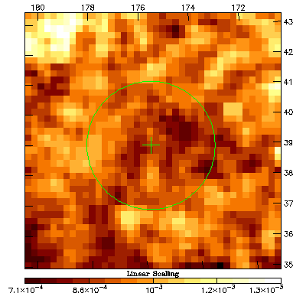
XMM-Newton: detecting a Coronal Mass Ejection
Credit: ESA
Carter et al. 2010
Credit: P. Padovani

Slide 23
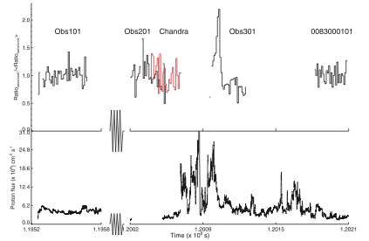
XMM-Newton: detecting a Coronal Mass Ejection
(0.5 to 0.7 keV) / (2.5 - 5.0 keV)
Credit: ESA
ACE SWEPAM proton flux
Carter et al. 2010
Credit: P. Padovani

Slide 24
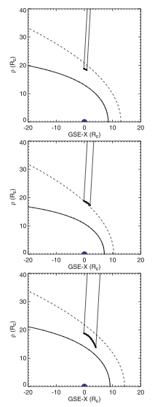
XMM-Newton: detecting a Coronal Mass Ejection
(0.5 to 0.7 keV) / (2.5 - 5.0 keV)
Credit: ESA
ACE SWEPAM proton flux
Carter et al. 2010
Credit: P. Padovani

Slide 25
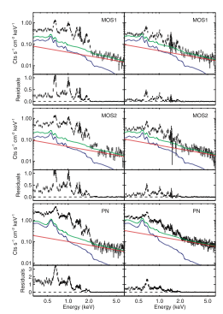
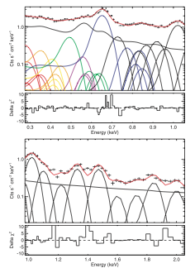
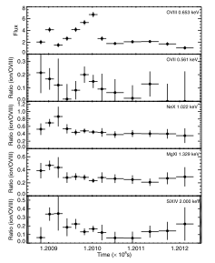
XMM-Newton: Coronal Mass Ejection spectrum
Credit: ESA
Carter et al. 2010
Credit: P. Padovani

Slide 26
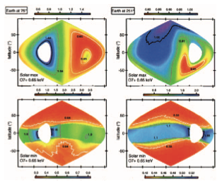
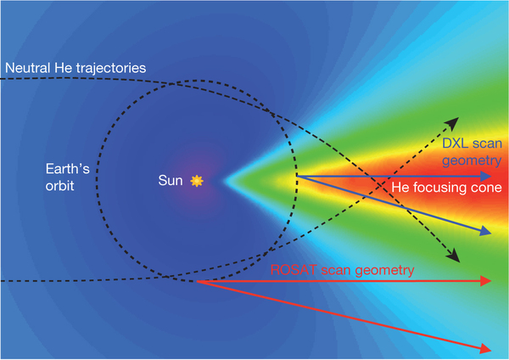
The Heliosphere: also SWCX: simulations
View from downstream
View from upstream
Solar max.
Credit: ESA
Credit: F. Villatoro, 2014
Solar min.
Solar min.: equatorial belt clear
Downwind dominated by CX with He.
Credit: P. Padovani
Koutroumpa et al. 2006: O7+ line

Slide 27
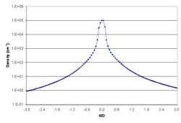
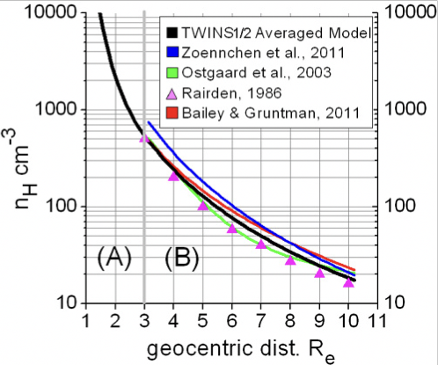
The exosphere: density distribution controversy
PX-ray = ∫ ⍺ * NH * Nsw * Vsw ds
25 cm⁻³ at 10RE
Credit: ESA
Hodges 1994
Hodges: some control by season and F10.7
Know NH, know your X-ray signal
Nightside only, limited distance range
20 cm⁻³ at 10RE
Credit: P. Padovani

Slide 28
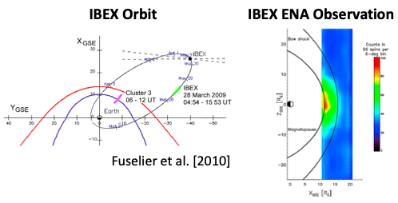
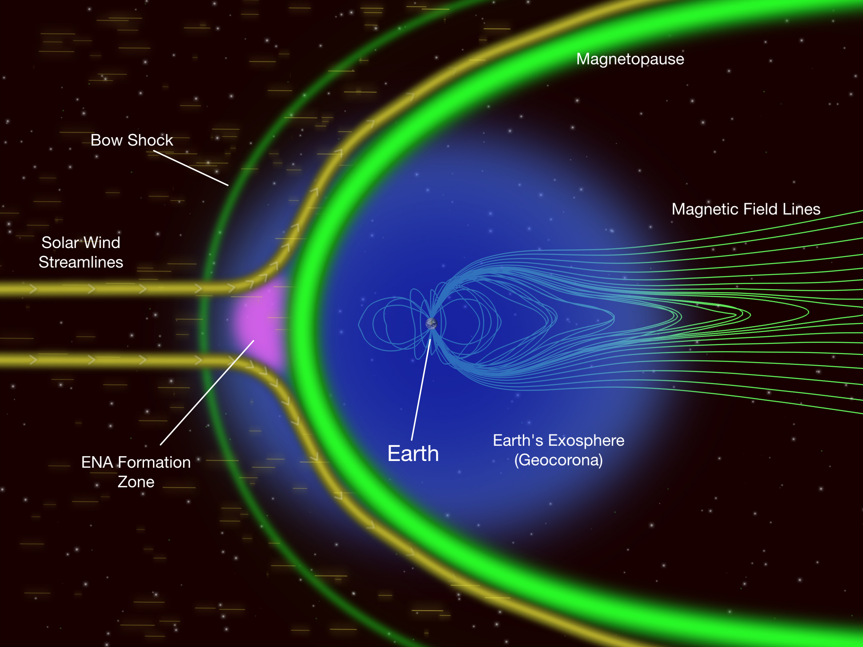
The exosphere: densities, dayside
Dayside ~ 4 - 10 cm⁻³ at R0
Assumes homogeneous magnetosheath
Solar minimum observations

Slide 29
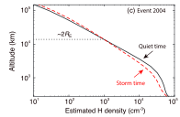
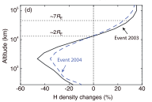
The exosphere: effects of storms
Qin et al. 2017
Credit: ESA
Redistribution of NH during storms
Competition between CX (H and O+, H and H+) to send H into exosphere)
Makes changes to ring current through energetic neutral atom production
Credit: P. Padovani

Slide 30
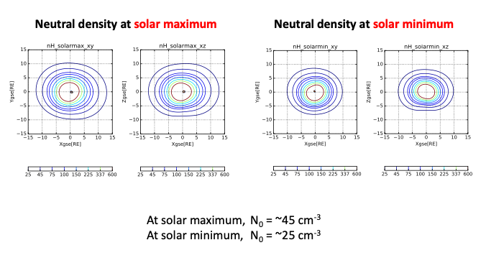
The exosphere: solar cycle dependence

Slide 31

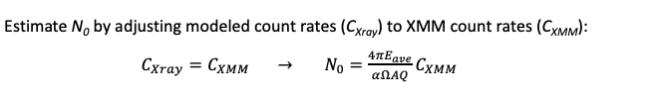
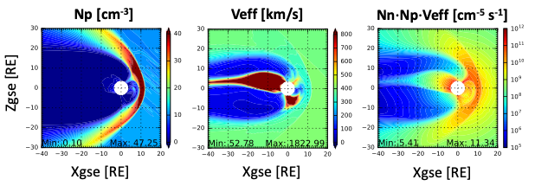
The exosphere: extracted from XMM observations
- (summed background)
= SWCX to get ‘CXMM’
PX-ray = ∫ ⍺ * NH * Nsw * Veff ds
Veff = √ (V²SW + 3kT/m)
MHD simulations, extract plasma parameters; Q
Extract NH at 10 RE (N0)

Slide 32
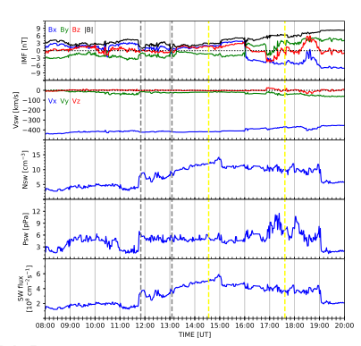
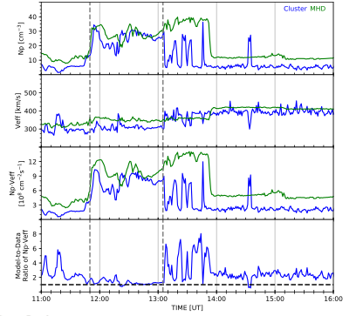
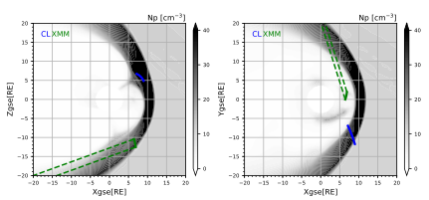
The exosphere: densities higher than thought
XMM-Newton moves ~17,000 km
Density, case 1: ~43 cm⁻³
Density, case 2: ~60 cm⁻³

Slide 33
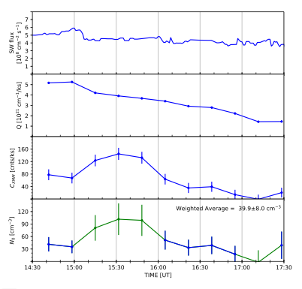
The exosphere: densities higher than thought
XMM-Newton moves ~17,000 km
Density, case 1: ~43 cm⁻³
Density, case 2: ~60 cm⁻³

Slide 34
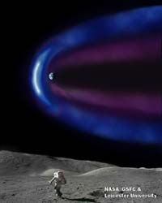

Making the problem an asset
NASA lunar sortie science opportunity
Proposal submitted 2007
Astronaut deployed X-ray imager on surface
Credit: ESA
Credit: P. Padovani

Slide 35

Making the problem an asset
NASA lunar sortie science opportunity
Proposal submitted 2007
Astronaut deployed X-ray imager on surface
Credit: ESA
Credit: P. Padovani

Slide 36


If at first you don’t succeed….
NASA: 2007
Credit: P. Padovani

Slide 37

If at first you don’t succeed….
NASA: 2007
ESA: 2010
Credit: P. Padovani

Slide 38

If at first you don’t succeed….
NASA: 2007
ESA: 2010
NASA: 2010
Credit: P. Padovani

Slide 39
If at first you don’t succeed….
NASA: 2007
ESA: 2010
NASA: 2010
ESA: 2012
Credit: P. Padovani

Slide 40
If at first you don’t succeed….try many times
NASA: 2007
ESA: 2010
NASA: 2010
ESA: 2012
Selected for study June 2015
ESA and Chinese Academy of Sciences
Credit: P. Padovani

Slide 41

Viewing geospace simultaneously
Then, what happens here (ground & fine scale)?
Use radar, optical all-sky imagers, magnetometers, riometers, etc.
Then, what happens here?
Use UV
Firstly, what happens here?
Use X-rays

Slide 42

SMILE
2 imagers, 2 in situ
Joint ESA, Chinese Academy of Sciences mission
Large amounts of UK involvement; including MSSL, University of Leicester, Open University
Ground-based STP community involvement
Science questions:
    - What are the fundamental modes of the dayside solar wind - magnetosphere interaction?
  What defines the substorm cycle?
  How do CME-driven storms arise, and how do they relate to substorm?

Slide 43

Preparing for SMILE: observations
2 imagers
2 in situ
Joint ESA, Chinese Academy of Sciences mission
DMSP/SSUSI:
LBH-long
~electrons
DMSP/SSUSI:
Lyman-⍺
protons
Carter et al.,
under review

Slide 44

Preparing for SMILE: observations
2 imagers
2 in situ
Joint ESA, Chinese Academy of Sciences mission
DMSP/SSUSI:
LBH-long
~electrons
SuperDARN
Flows
Carter et al.,
under review

Slide 45

Linking ground-based observations and SMILE
IMF, solar wind
Observations
MHD simulations
Mp estimation
In situ:
Magnetosphere
X-ray emissivity
cubes
SXI
simulations
Sustained, highly northward IMF case: cusp spot emissions, FACs, ionospheric convection, precipitating particles
Carter, Samsonov, Sembay, Branduardi-Raymont, …in progress

Slide 46



Linking ground-based observations and SMILE
Carter, Samsonov, Sembay, Branduardi-Raymont, …in progress

Slide 47


SMILE-SXI simulations: Mp versus time, cf. MHD
Find Mp many times in SXI simulations
Find from MHD
Compare
MHD

Slide 48

SMILE: SWCX video
T. Sun, NSSC, China

Slide 49







SMILE: multi-scale approach
Ionosphere response: large, medium, & fine scale
Magnetosphere response: in situ, e.g. currents, particles
SMILE: SXI & UVI
UK-led working group: 27 members, 6 countries, diverse projects
Inter-hemispheric response of ionosphere
To fully exploit SMILE data we need support from the ground-based solar-terrestrial community
Global, continental, & local ground-based experiments: radar, all-sky imagers, magnetometers, etc.
Ground-based provides essential multi-scale & multi-cadenced data contemporaneously with SMILE

Slide 50
Conclusions
The discover of solar wind charge exchange X-ray emission has led to:
  X-ray investigations of Solar System bodies
  A better understanding of the sources of the X-ray background for X-ray astronomers
  An opportunity to use this X-ray emission to study geospace
SMILE (#SMILEesacas) will:
  Image the magnetospause whilst simultaneously imaging the ionosphere, plus in situ
  Be launched in November 2023
  Benefits from a better understanding of the neutral exosphere
  Is a fantastic chance for the solar-terrestrial and X-ray communities to work together

Slide 52


XMM-Newton: archival study, extra summaries

Slide 53



SSUSI: building up auroral pictures

Slide 54

Sky background subtraction: 16-Oct-2001
Sky background for 16-Oct-2001 is bright, along Galactic plane
Model background before 06:00 UT, using Xspec
Absorbed polar law + (nh * APEC) + APEC
Sky background plus instrument particle background is 135 counts per ks

