Slide 1
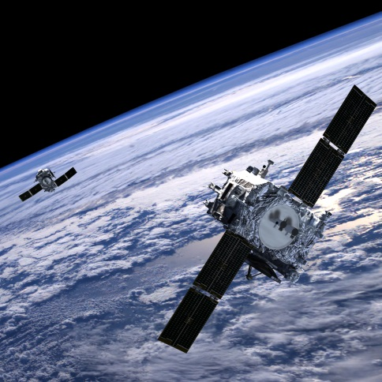
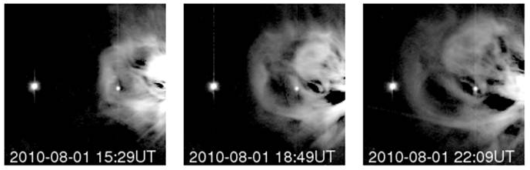
Space Weather and the UK Solar Community
Richard Harrison
Chief Scientist STFC-RAL Space
Notes:
1

Slide 2
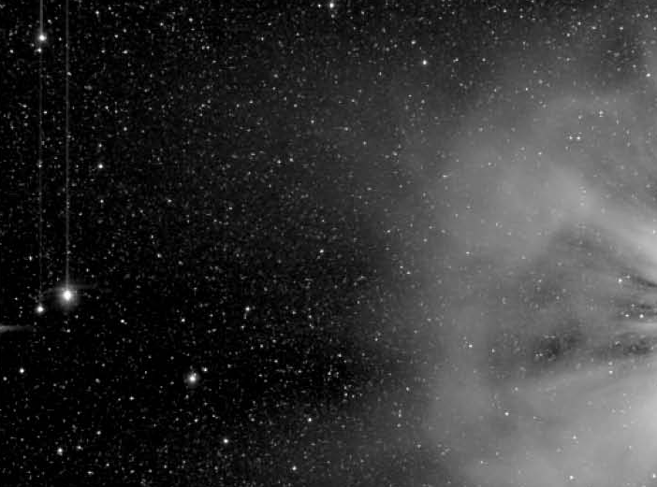
Space Weather and the UK Solar Community
Long, successful heritage in solar/heliospheric science missions, and in key scientific research areas
Well placed to apply skills to emerging space weather projects
    Should view this as two arms – science and application – that is our future
    ‘Safety’ in responding to national requirement to address space weather impacts (Nat’l Risk Register of Civil Emergencies)
So, what is happening?
    National activities – Met Office/BEIS
    ESA SSA Space Weather programme
    UK-US and ESA-US collaborations, Carrington
Notes:
2

Slide 3
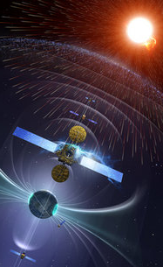
ESA SSA Space Weather programme
Formed out of early working groups in 2009 – entering Period 3
Basic strategy – Lagrangian L1/L5 missions; Hosted payloads; Expert Service Centres (ESC), and more…
Period 2 – Early study phase, including:
  RAL, MSSL, Imperial - L1/L5 Phase 0 Studies with Airbus & OHB (completed Nov 16)
  Coronagraph (SCOPE) Phase A/B1 study (RAL)
  Heliospheric–ESC - at RAL (with M.O.)
  Plasma & magnetic field instrument studies (MAGIC, HOPE at Imperial and MSSL)
Notes:
3

Slide 4
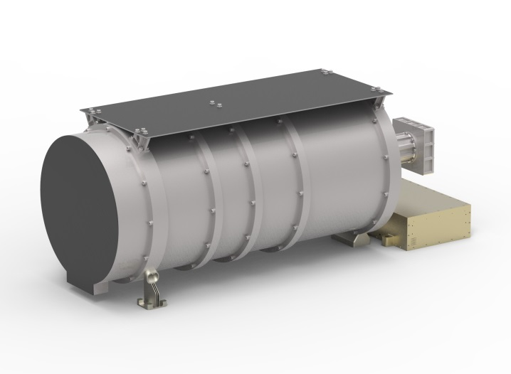
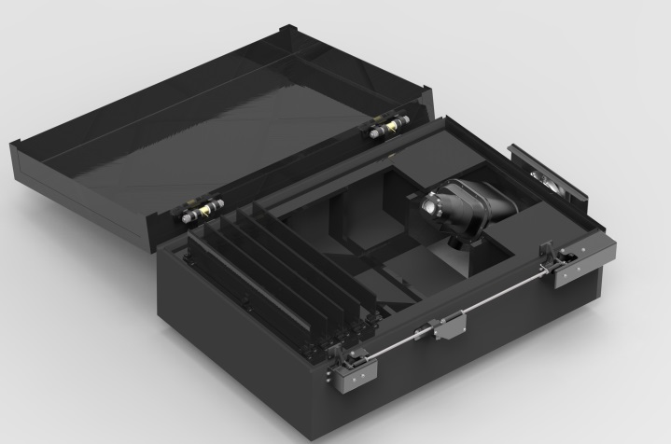
ESA SSA Space Weather programme
ESA Ministerial (Dec 16) – UKSA committed ~ €18M to Period 3 – highest contribution
  ESA draft Plan/Strategy: Lagrange Mission Phase A/B1 (2023 launch(?)); US-ESA negotiations;
Negotiations for UK-identified interests feeding into Programme Board. Includes:
  UK-led coronagraph and HI
  Coordinating role in Remote Sensing payload
  UK-led magnetometer and plasma analyser
  Continuation of ESC activites
  Etc…
UK groups fully engaged – not just to provide a service but recognising the potential scientific return
Notes:
4

