Slide 1
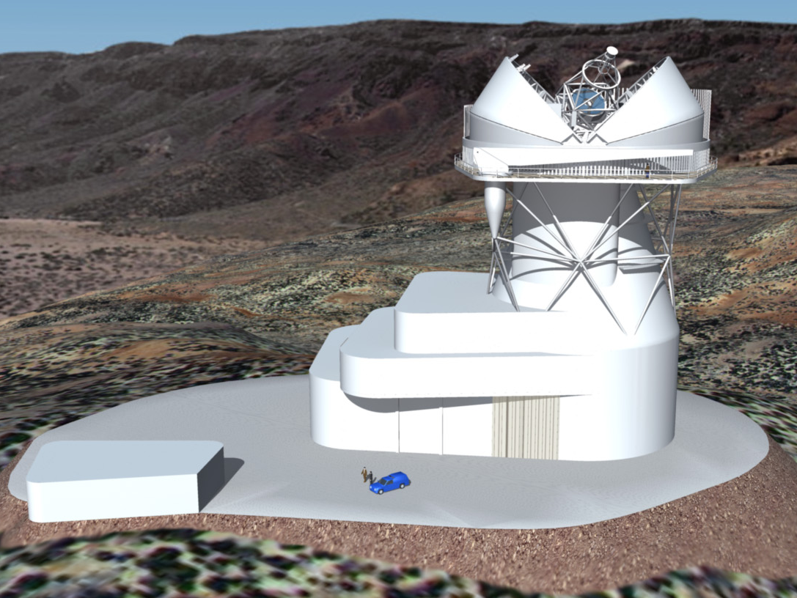
EST: The European Solar Telescope
Sarah Matthews, Mihalis Mathioudakis, Robertus Erdelyi
and the EST team

Slide 2
EST current status
H2020 INFRADEV II proposal has been funded for preparatory phase (1/4/17 -31/3/21) – UK leading legal aspects WP.
SoI has been submitted to STFC. The UK seeks involvement in the following areas:
Turbulence profiling and adaptive optics (Durham)
Telescope transfer optics (UCL)
Real-time data processing (Sheffield)
6.5x6.5k camera development (Andor, QUB, UCL)
First-light instrumentation – spectrograph (etalons/image slicers) (Durham, UCL, QUB)

