Slide 1
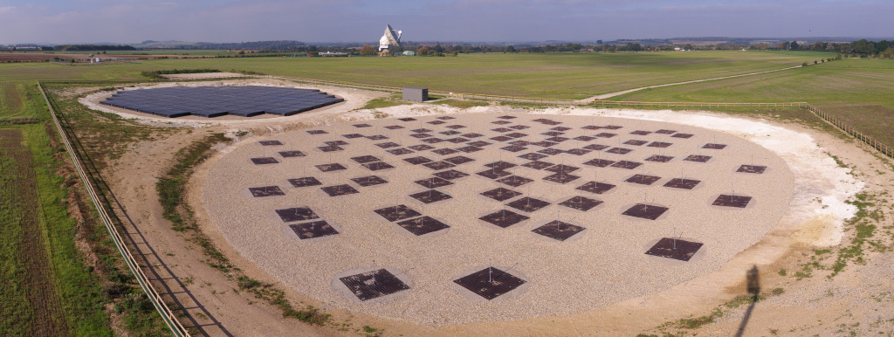
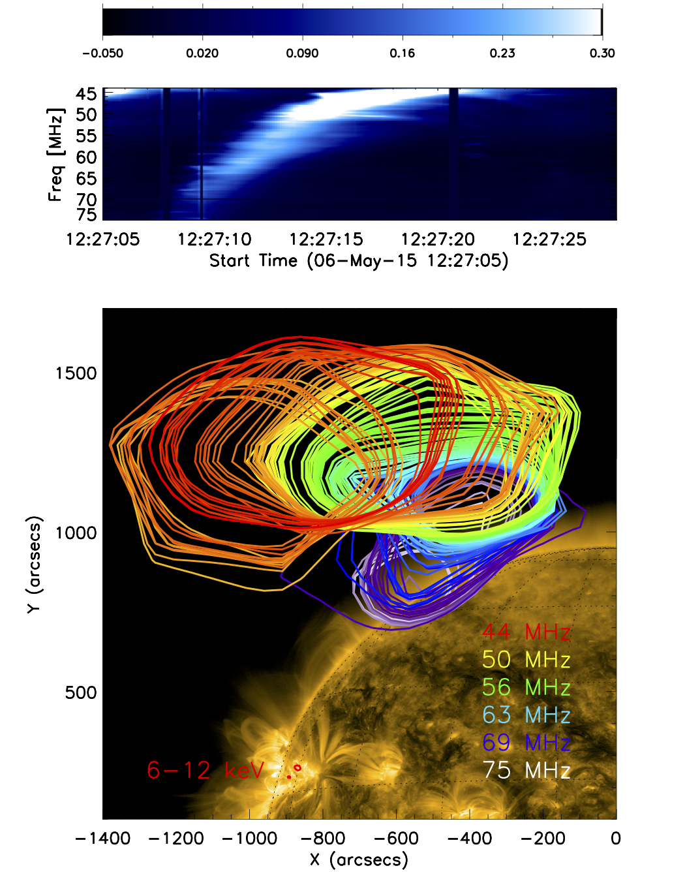
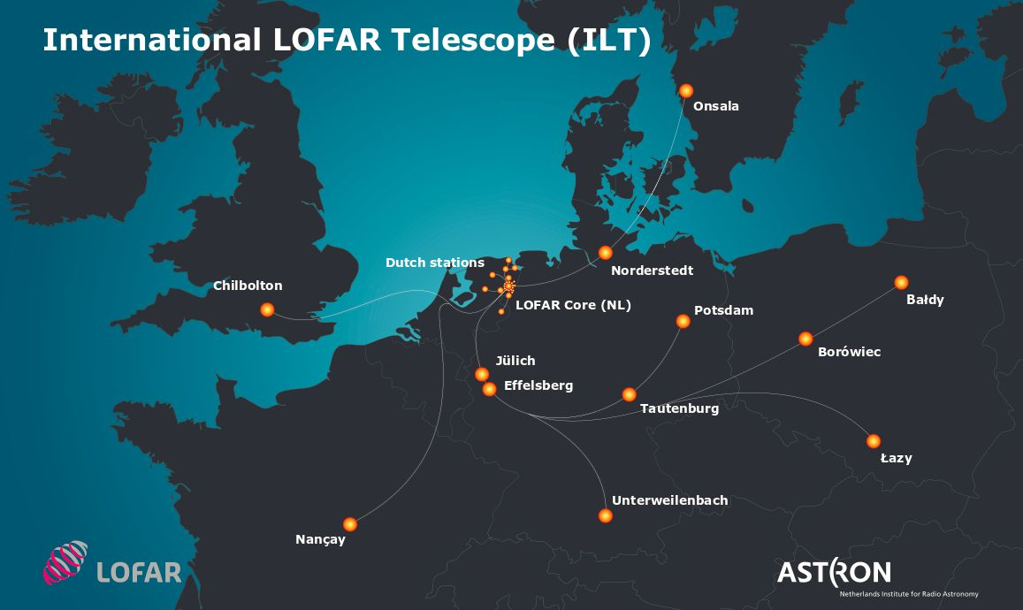
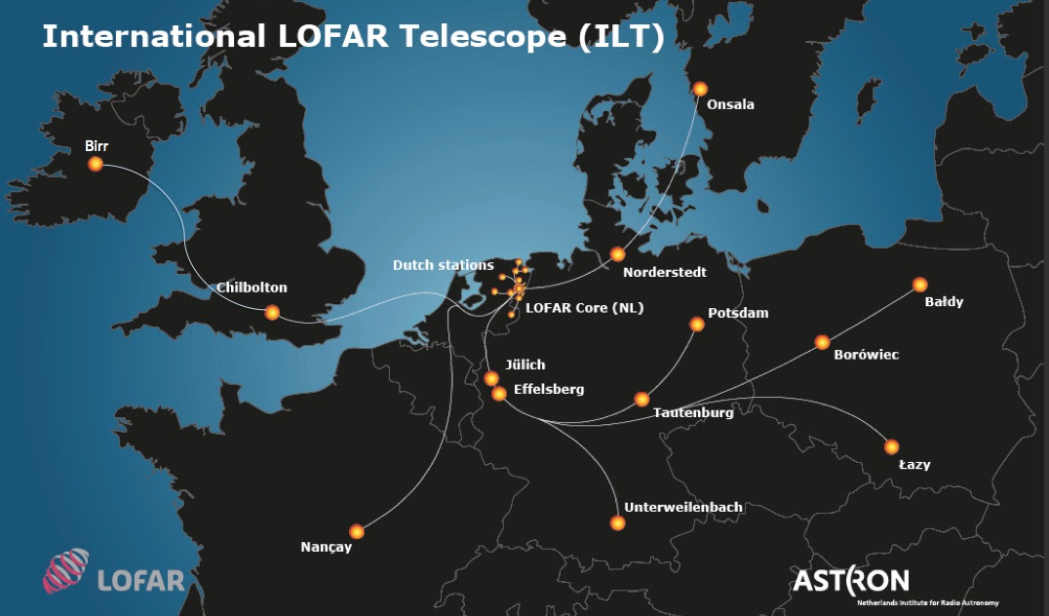
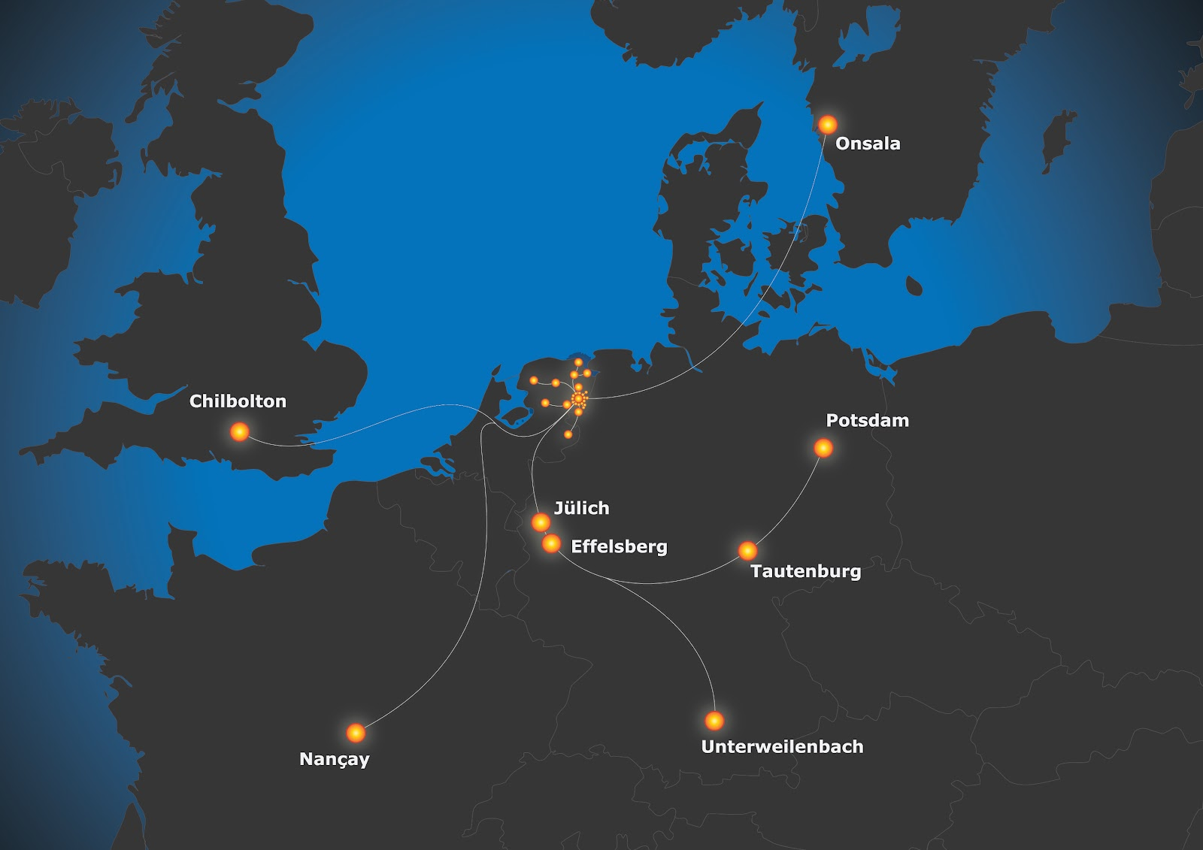
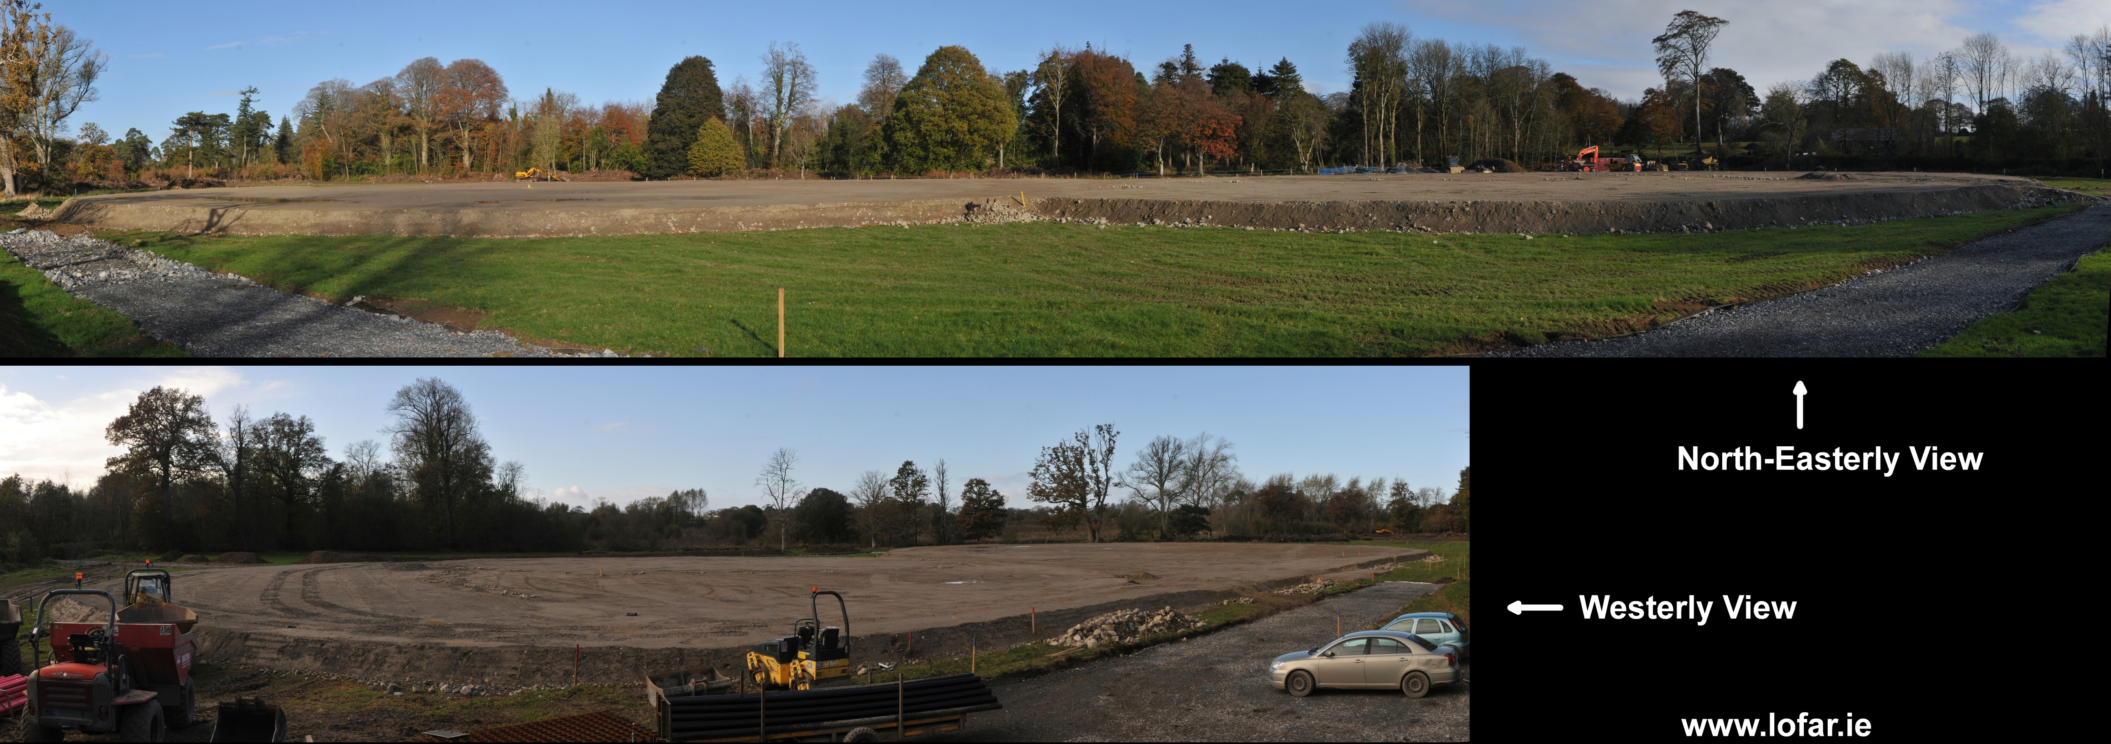
Van Haarlem et al 2014
LOFAR - LOw Frequency ARray
LOFAR is an array of radio antennas distributed across northern Europe, based in the Netherlands.
Solar LOFAR observations allow us to see accelerated electrons as they propagate out from the Sun.
$$∆t=10ms, ∆f=20 kHz$$
I-LOFAR
Station rollout in may – Full operation late Autumn
Can use LOFAR array or local UK Chilbolton Station
6 monthly bid for LOFAR time; next one 8th March 2017
Interested? Contact me (Hamish Reid), Eduard Kontar, Gottfried Mann
LOFAR 2.0 is being proposed
Space Weather has been identified as a major science driver.
Monitor space weather IN PARALLEL with regular operations.
Upgrade will be modular over several years.

