Slide 1
Sheffield University Nova Balloon-lifted Telescope
SunbYte Team
http://sunbyte.group.shef.ac.uk/
https://twitter.com/Project_SunbYte
https://www.facebook.com/projectsunbyte/
Notes:
1

Slide 2
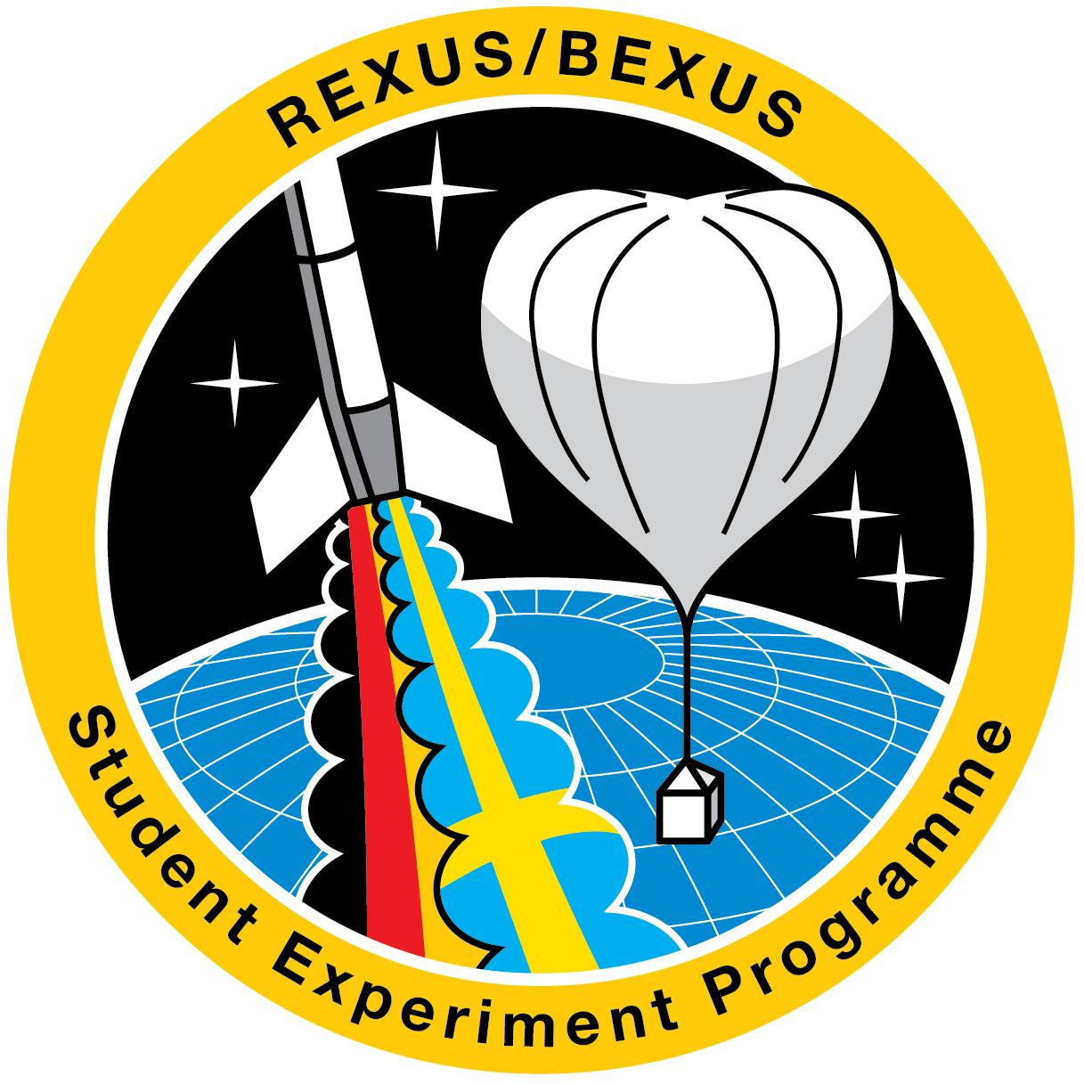
SunbYte is the only UK project (balloon payload competition) to win the REXUS/BEXUS (Rocket and Balloon Experiments for University Students) competition, a European Space Agency programme.
The balloon launch is scheduled for October 2017!
Aim:
Develop low-cost telescope to observe the Sun in H-alpha
Telescope will be lifted 30-40 km above earth’s surface by a helium balloon provided by ESA

Slide 3
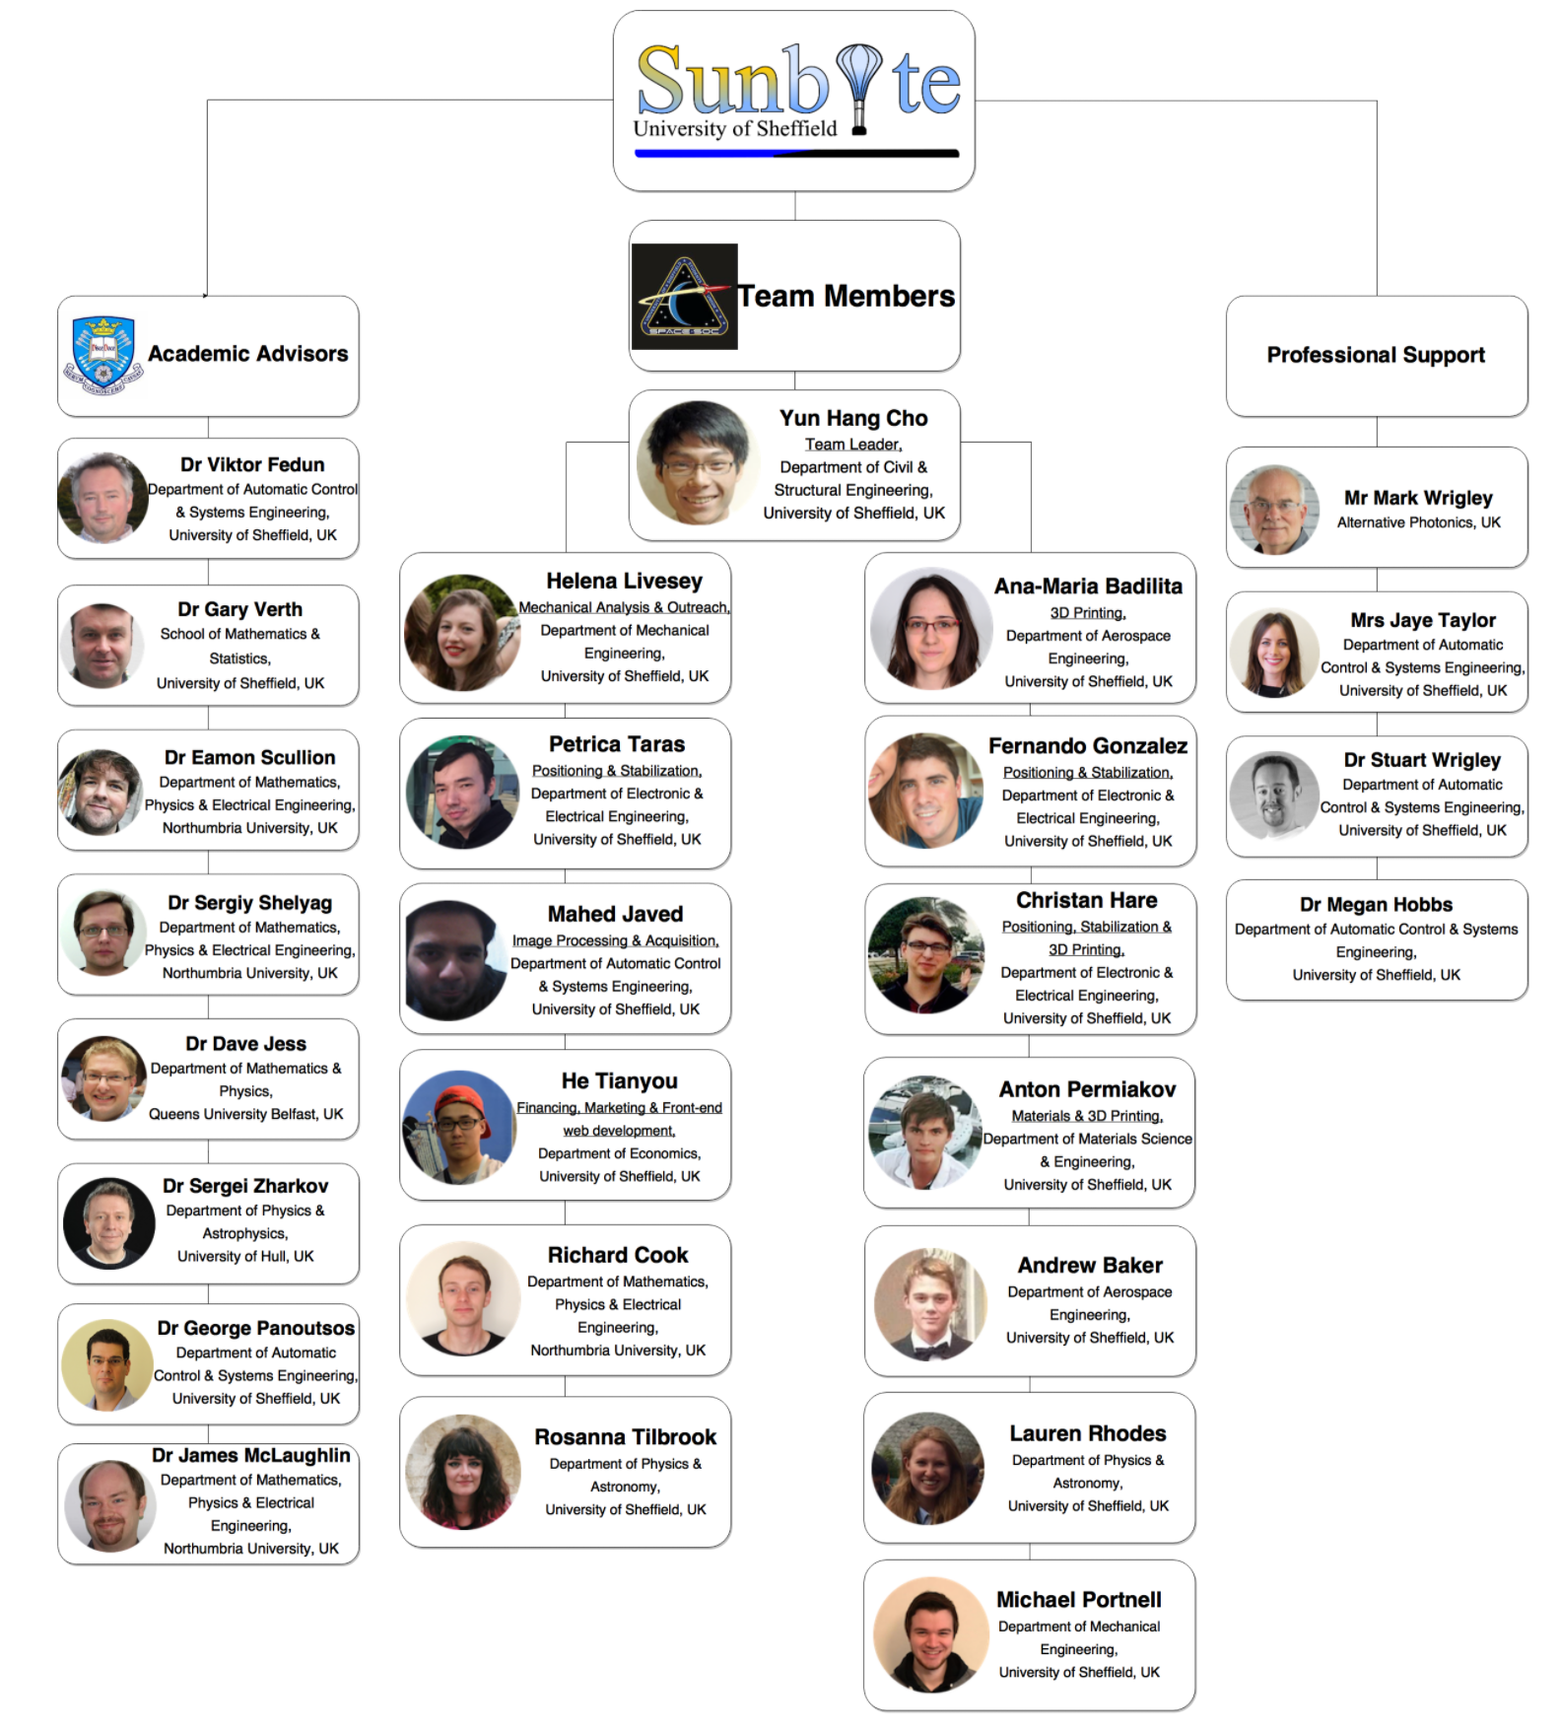

Slide 4
Detect fainter features at the limb such as jets and prominences.
View the lifetime of large jets across the disk - for comparison between active and quiet regions
Share data worldwide with the scientific community (Via VSO)
Notes:
4

Slide 5
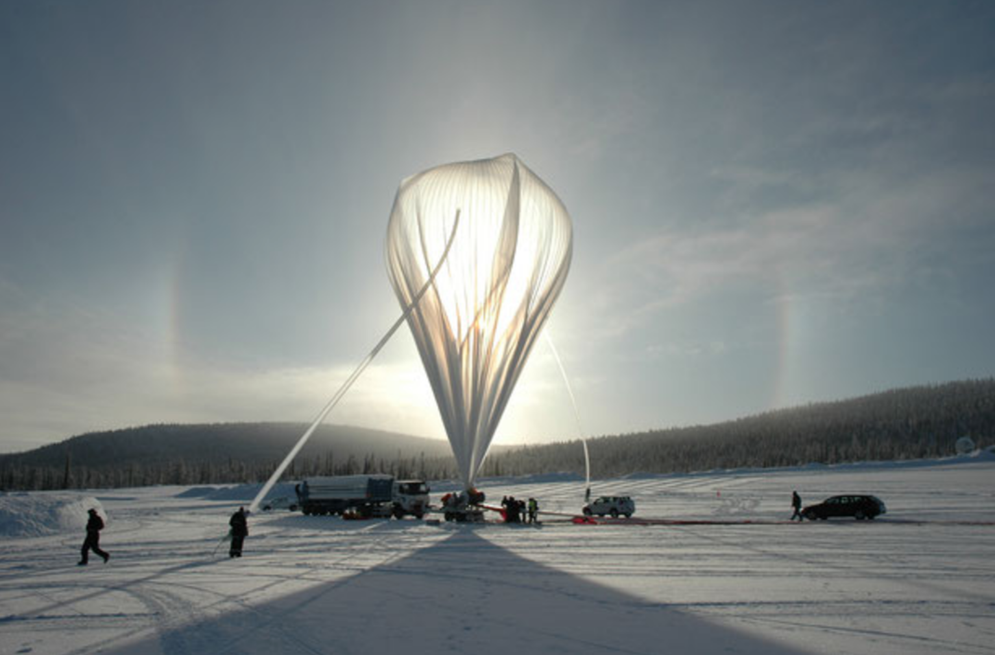
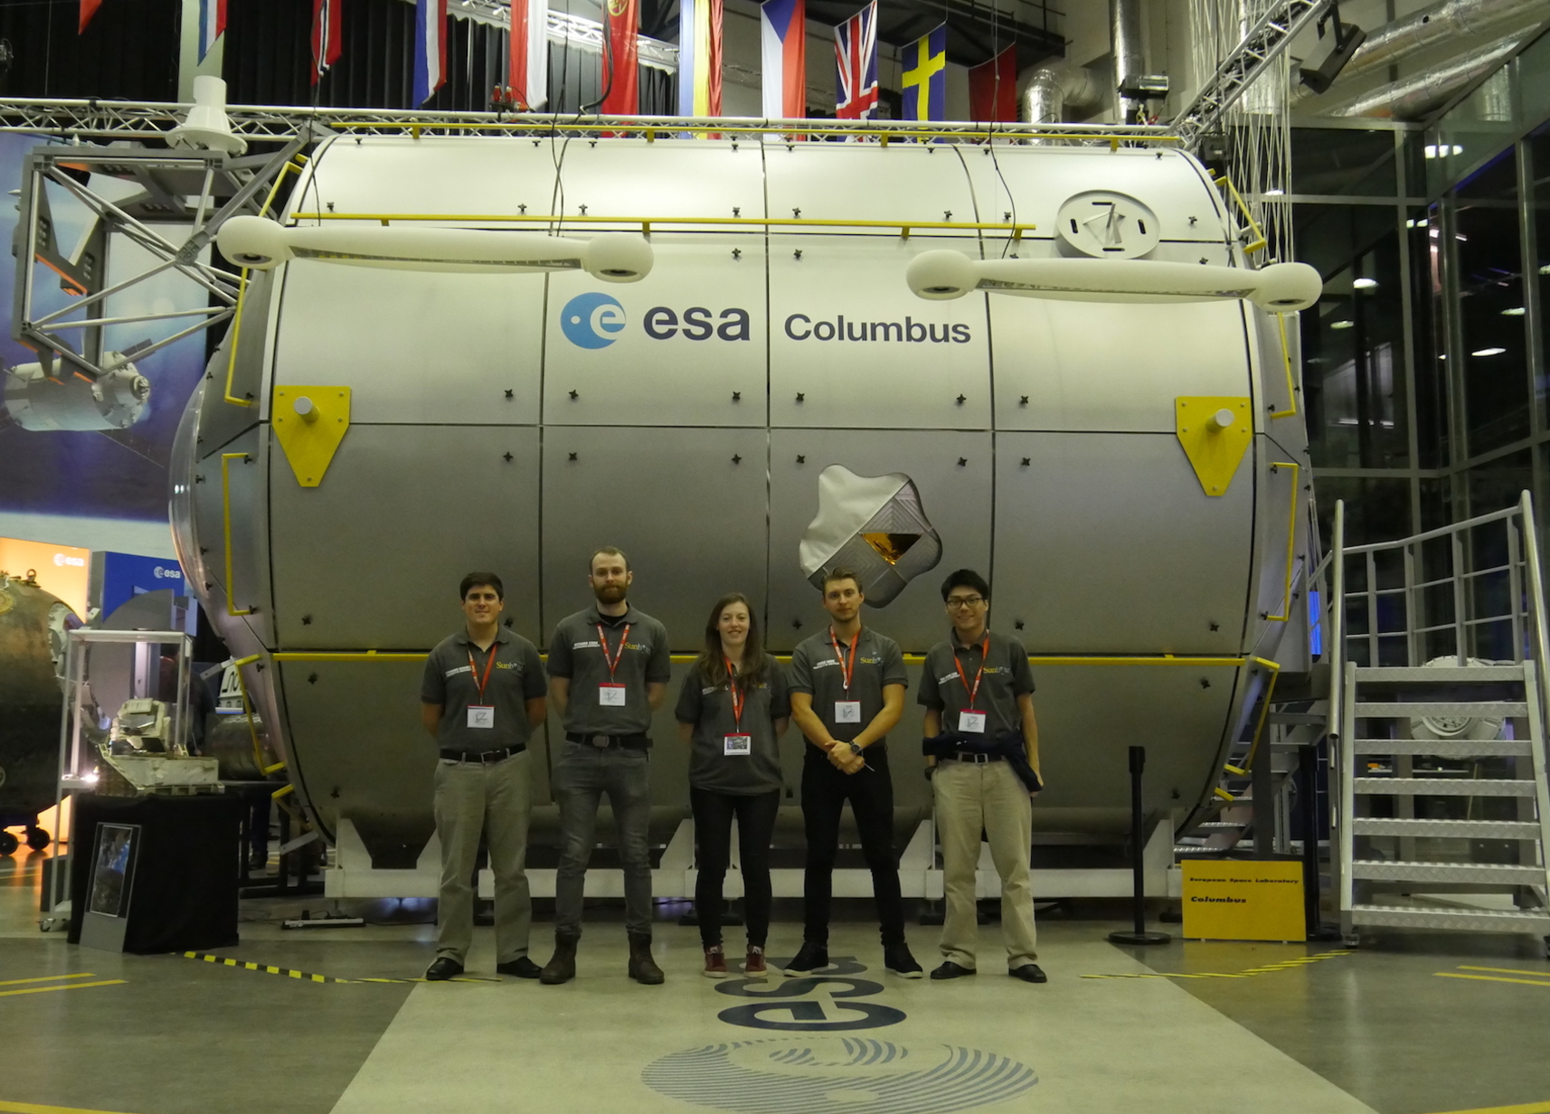
Detect fainter features at the limb such as jets and prominences.
View the lifetime of large jets across the disk - for comparison between active and quiet regions
Share data worldwide with the scientific community (Via VSO)
Frame rate of 40 frames per second;
Observation period of 2 hours, it is expected that 288,000 images will be taken.
Typical lucky imaging techniques will use 1% of the data captured.
It is expected that 28,800 images of scientific value will be generated.
Mirror – 200 mm
Estimated weight < ~11 kg
Resolution 0.6-0.8 arcsec (highly sensitive Zyla camera, manufactured by Andor Technology)
H-alpha line core (6562.8A).
Notes:
5

Slide 6
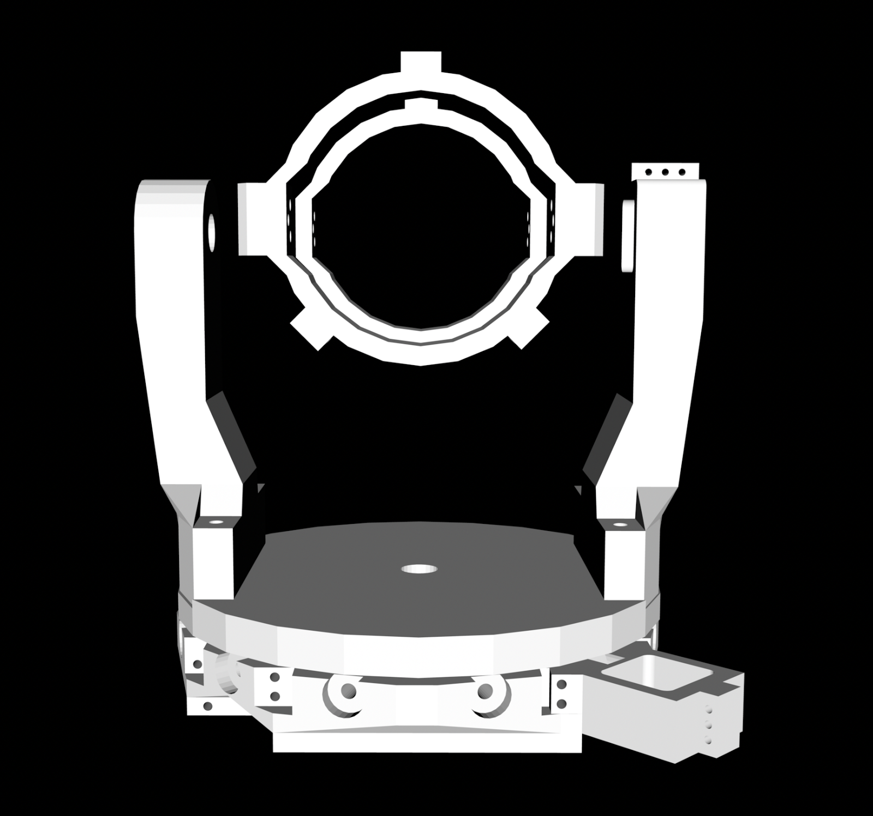
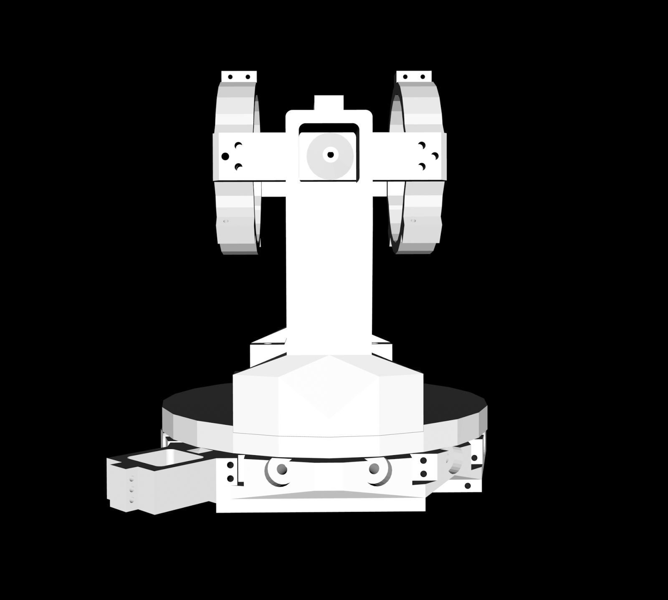
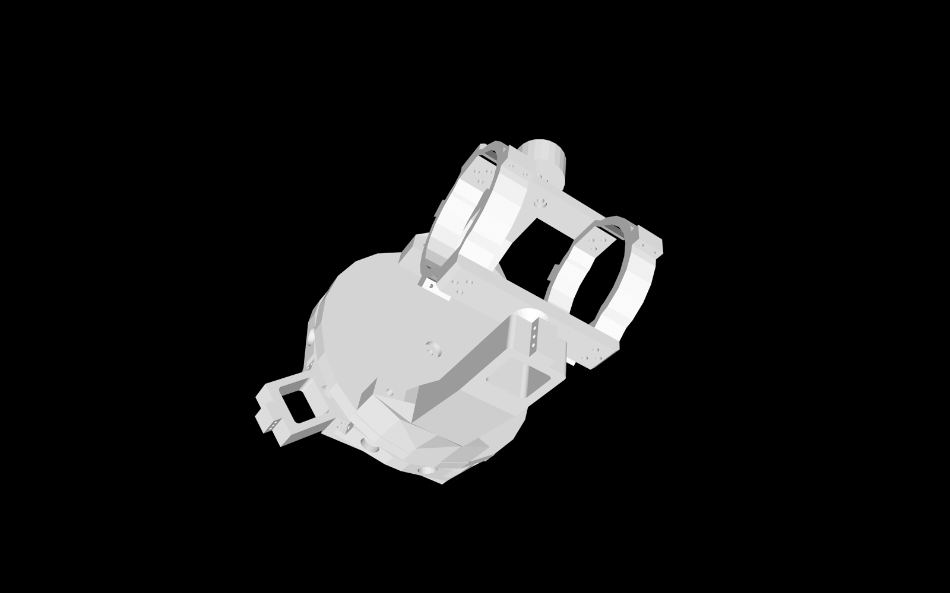
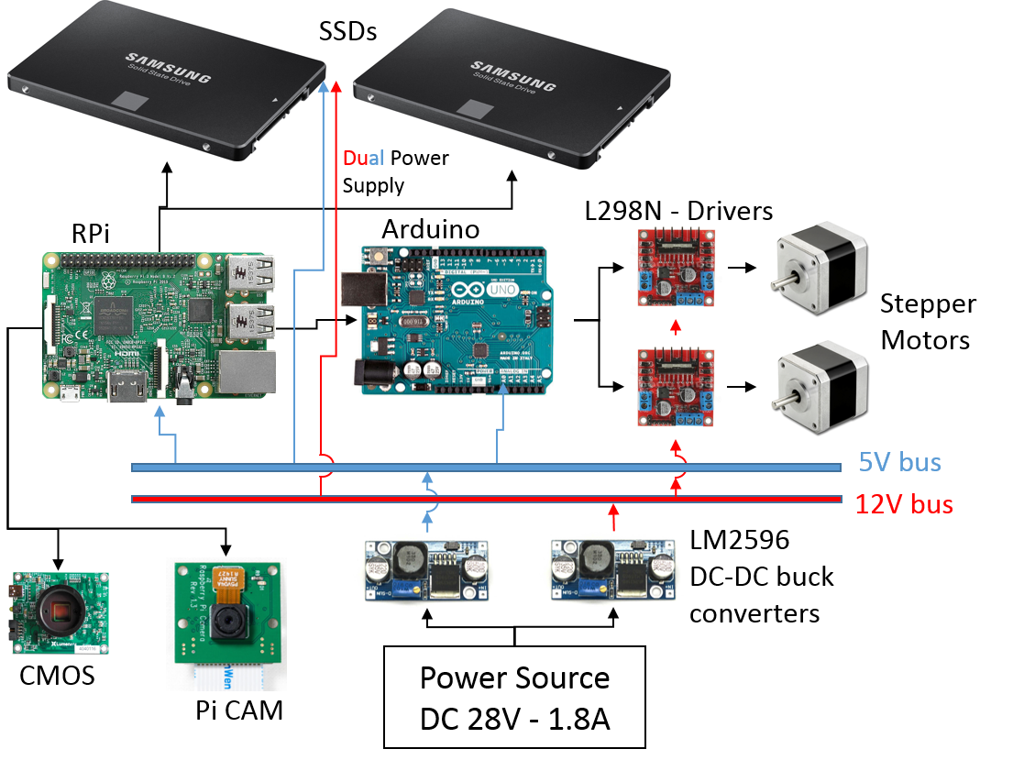
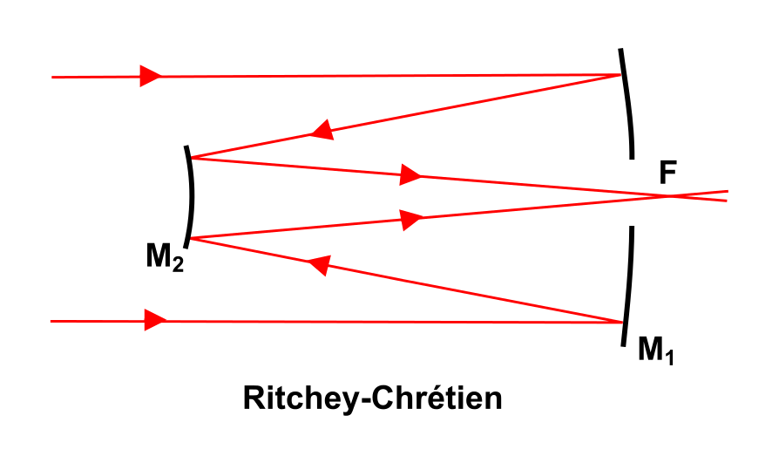
Work Breakdown Structure (WBS)
Mechanical (Design, CAD, FEA, Manufacturing software test model, Mechanical testing);
Electrical and Electronics (Electrical Design, controllers, electrical testing)
Software (Image recognition, Arduino, Raspberry Pi, software testing, post processing)
Initial 3D design of gimbal system
Overall electrical architecture interface.

Slide 7
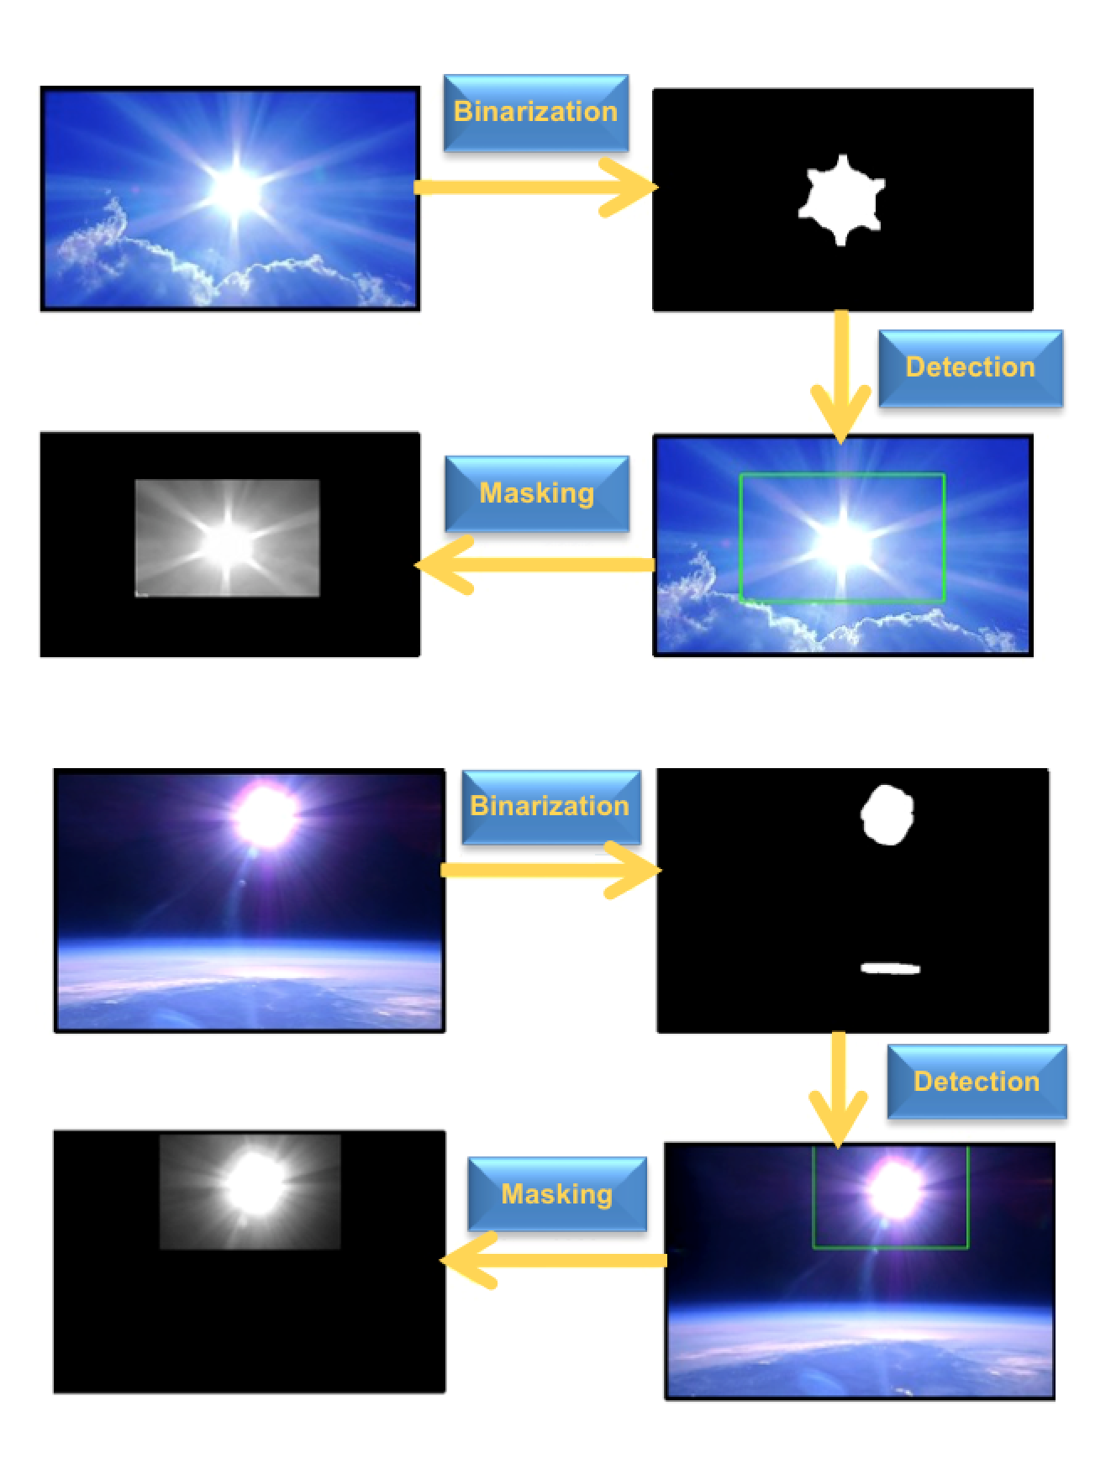
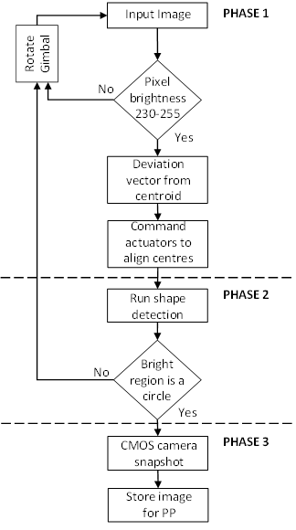
Image Recognition, vision, tracking systems
Algorithm running on daylight.
Algorithm running in upper atmosphere.

Slide 8
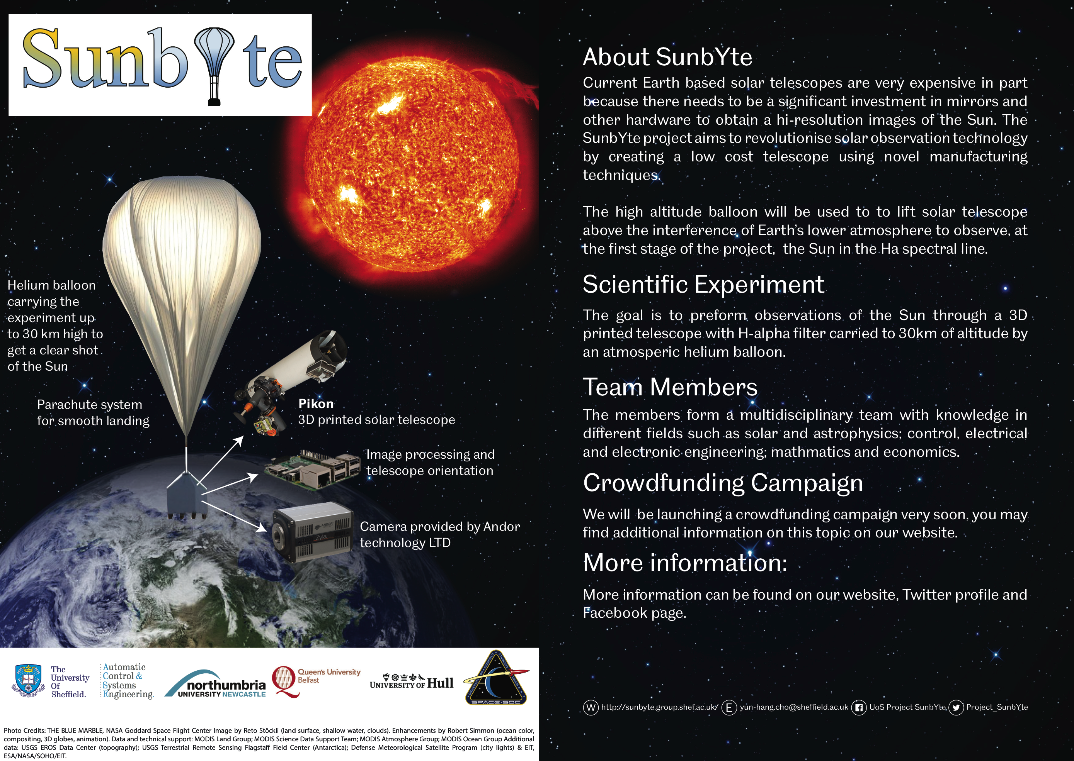
The SunbYte project will provide:
Possibility to adjust telescope on different flights for scientific mission specific needs
Possibility to achieve high impact science for low costs
Continuous high is possible resolution solar observations
Re-coverable/reusable payloads
Rapid response to the new phenomena
Testing platform for solar observations

