Slide 1
Space Weather in situ measurements perspective
Andrew Fazakerley
Mullard Space Science Laboratory (UCL)
UKSP Solar Missions Forum 09 Feb 2017

Slide 2
L5/L1 Space Weather Warning System
Interplanetary Coronal Mass Ejections (ICMEs)
Hazard Potential
sudden magnetospheric compression - GICs
possible prolonged B_{z} -ve, geomagnetic storm
radiation belt enhancements, SEPs (sheath)
Forecasting needs measurements at
L5 RS: active regions (caution)
L5 RS: Earthward ICME (clear risk)
L1 RS : coronagraph (>~ 1 day halo CME alert)
L1 IS : n, V, B (~ 1h geoeffectivity alert)
Sun
L5
L1
Earth

Slide 3
L5/L1 Space Weather Warning System
Stream Interaction Regions (SIR) and High Speed Streams (HSS)
Hazard Potential
Radiation belt enhancement from fast streams
sudden compression of magnetosphere - GICs
Forecasting needs measurements at
L5 RS: near-equatorial coronal holes (caution)
L5 IS: measure fast streams, waves (caution)
L1 IS : n, V, B (~ 1h geoeffectivity alert)
Sun
L5
L1
Earth

Slide 4
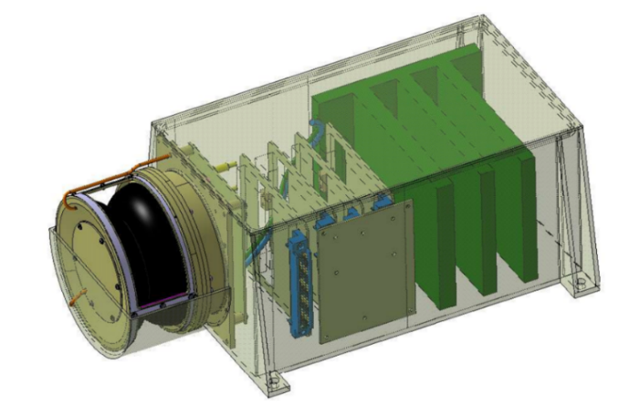
L5/L1 missions: In situ measurements (UK focus)
Magnetometer (Imperial College)
Solar Wind Analyser (MSSL/UCL)
Preliminary study sets out requirements and shows importance of minimising spacecraft magnetic field, and using a long boom
Emphasis on reliability and longevity
Double Star FGM: Carr et al 2005
Preliminary study sets out requirements and shows how a development of SWA-EAS can deliver the requirements.
Emphasis on reliability and longevity
Solar Wind Analyser concept, developed from Solar Orbiter SWA-EAS

Slide 5
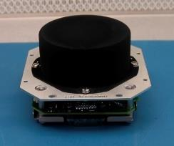
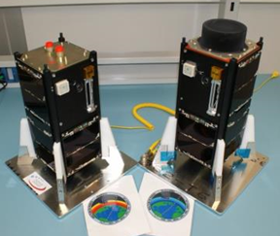
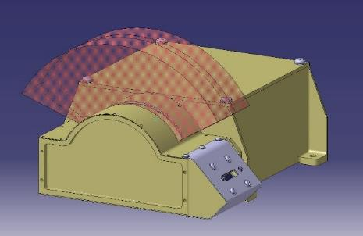
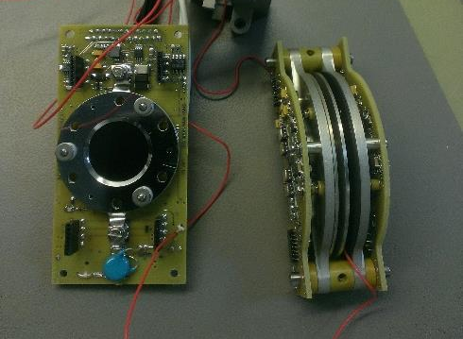
Earth-orbiting missions: In situ measurements (UK focus)
QB50 (MSSL/UCL)
HOPE-M (MSSL/UCL)
Fleet of cubesats to launch in 2017 to study lower thermosphere.
Several types of small sensor, (INMS, FIPEX, LP)
INMS x 14 from MSSL, novel mini-analyser design
ESA funded breadboard
Small sensor for GEO satellites
Measure plasmas causing spacecraft charging that causes anomalies
“SWAN” design variant, optimised for solar wind, was planned for Sunjammer mission
HOPE-M, breadboard
novel mini- analyser design

Slide 6
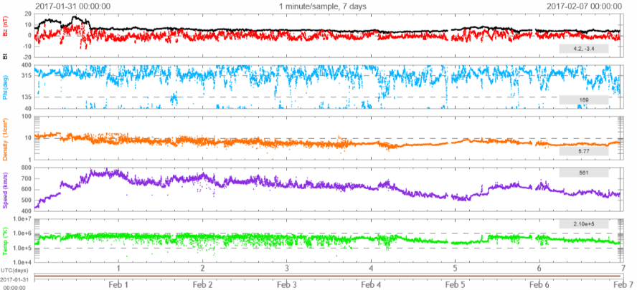
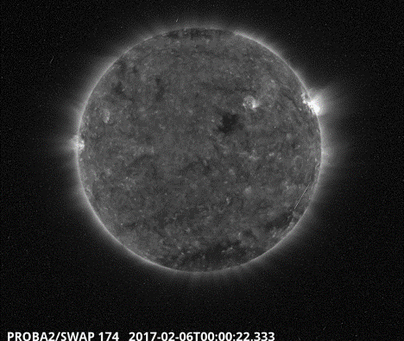
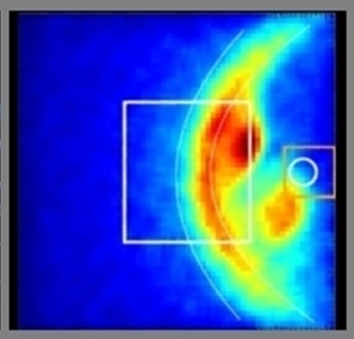
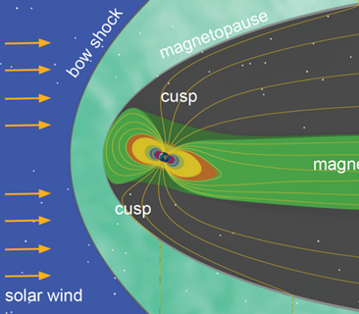
Also…
Current
DSCOVR now operating at L1,
measuring solar wind
Proba-2: 2 year extension recently approved (includes SWAP solar disk imager)
Future
SMILE – ESA-CSA small mission, SpW theme, will be first to image boundaries of magnetosphere, in soft X-ray, also image aurora
(THOR late 2020s if selected)

